Slide 1

Prevent
OFFICIAL
David Layton-Scott
Regional Contest Coordinator
East of England

Slide 2
Prevent……. a reminder
CONTEST IS THE UNITED KINGDOM'S COUNTER-TERRORISM STRATEGY. IT WAS FIRST DEVELOPED BY THE HOME OFFICE IN EARLY 2003, AND A REVISED VERSION WAS MADE PUBLIC IN 2006. FURTHER REVISIONS WERE PUBLISHED ON 24 MARCH 2009, 11 JULY 2011 AND JUNE 2018.
PURSUE, PROTECT, PREPARE
PREVENT IS ABOUT SAFEGUARDING AND SUPPORTING THOSE VULNERABLE TO RADICALISATION.
IT AIMS TO STOP PEOPLE BECOMING TERRORISTS OR SUPPORTING TERRORISM
A community safeguarding programme

Slide 3
Three elements
Responds to the ideological challenge of terrorism and aspects of extremism, and the threat from those who promote theses views
Provides practical help to prevent people from being drawn into terrorism and ensure they are given the appropriate advice and support
Enable people who have already engaged in Terrorism to disengage and be rehabilitated

Slide 4
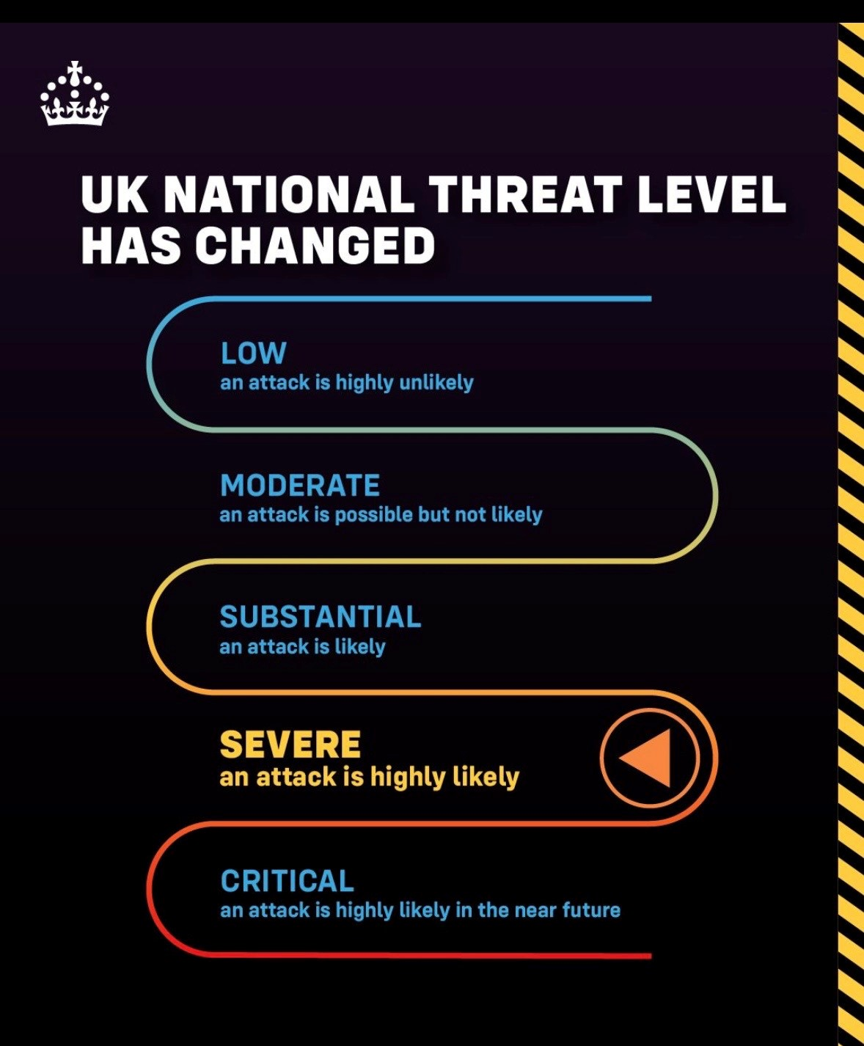

Slide 5
Regional Threats
Islamist Inspired Terrorism
Extreme Right-Wing Terrorism
Self-Initiated Terrorism (S-IT)
Islamist Extremism/Terrorism continues to pose the main threat to the region. Whilst there has not been an Islamist terrorist attack in the UK directed from a group based overseas since the London 7/7 bombings in 2005, the threat persists in the form of Self-initiated Terrorism (S-IT).
It is assessed that it is highly likely the threat from Extreme Right Wing Terrorism (ERWT) will continue to increase through social media and online platforms. We should be concerned as to the radicalization of young people and look to take steps to put interventions in place to stop them taking this path.
S-IT are the UK’s most likely threat due to the difficulty to predict and detect potential attacks and the use of low sophistication easily accessible weapons such as vehicles and bladed weapons. Often influenced by online material and extreme content, we have seen many young people aged 20 years and under involved.
Notes:
The following couple of slides outline the national risk profile – this is important information for staff to know and understand. You DSL will use this information to inform your risk assessment and drive CPD to ensure staff are more able to spot the signs of radicalisation and have meaningful conversations with leaners including where needed counter narrative
Online - Popular extremist social media platforms:
Gab, Vkontakte (VK), Discord, Chan, DLive, Steam, Twitch, Odysee, Telegram, Parler
Extremist groups are becoming more adept at utilising online platforms including use of encrypted platforms to share information (Telegram), gaming as a hook and recruitment tactic (ie world of war) and AI Bots with associated algorithms to make extremist/terrorist information easily accessible.
This is possibly our single biggest risk as the accessibility of information online and simply the scale of it presents real challenges – making online safety in the curriculum and filtering hugely important.
Case studies
Swindon teenager (16yrs time of arrest, 18yrs time of sentence) found guilty of 6 offences relating to possessions and dissemination of terrorist material. The investigation was centred on online chat groups with liked minded individuals sharing and posting extreme right-wing views, content and instructional material. He regularly posted racist and antisemitic material and propaganda and distributed information about how to create weapons and explosives. He was sentenced to 7 years custodial.
Gateshead teenager (17yrs) pleaded guilty to 7 offences (5 under the Terrorism Act). He was using online channels to upload and share bomb making manuals inc how to build a pipe bomb in addition to indecent images of children. He was sentenced to 28months inprisonment.
S-IT - On 30 October, 66-year-old Andrew Leak attacked the migrant centre at Dover port by throwing three petrol bombs from his vehicle before taking his own life at a nearby petrol station.
Leak, a pensioner from Buckinghamshire, had previously served in the armed forces. He is reported to have recently had his benefits cut and appeared to be suffering from both physical and mental health difficulties. Leak appeared to be supportive of a significant number of conspiracy theories relating to anti-immigration, grooming gangs, Covid vaccines and the New World Order.
Finsbury Park mosque attacker – Darren Osbourne we believe was radicalised to commit his attack very quickly using online platforms (suggested 3 weeks). He went on to hire a van and commit the attack (low sophistication weapon)

Slide 6



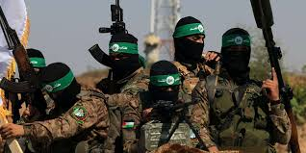

Slide 7
Prevent scheme missed chances with Amess and Southport killers, report says
Anderson report recommends potential large expansion of Prevent to include individuals with no fixed ideology
Anderson says Prevent reforms undertaken and planned should make such failings harder to recur and adds: “But more needs to be done. It has to be clear that people with a fascination with extreme violence can be suitable subjects for Prevent, even when they have no discernible ideology.
“Prevent needs to up its game in the online world, where most radicalization, now takes place. It needs to get better at information-sharing and be more open with the public to gain the trust on which it depends. In the longer term, I believe that Prevent could work better as part of a comprehensive violence prevention and safeguarding strategy.”

Slide 8
While ideology is an important consideration, a clear identifiable ideology is not mandatory to make or adopt a Prevent referral. As the Independent Prevent Commissioner noted, ‘adherence to an extreme ideology is in law neither a necessary nor a sufficient condition for entry into Prevent or Channel. As an early intervention programme, Prevent must consider susceptibility to terrorist ideology or involvement, rather than limiting Prevent to cases where a terrorist ideology has already taken hold. For some people, it might take spending time and building trust with a professional before an ideology becomes clear. It is important to consider that emerging movements could evolve to meet the definition of terrorism, and to remain alert to new potential threats.
A fascination with extreme violence, mass casualty attacks or massacre could be an indicator of susceptibility to terrorism, either before an ideology has been adopted or as a co-occurring interest.

Slide 9
What are COM Networks
Community “COM” networks are online groups involved in child sexual abuse, cybercrime and offline violence.
These networks are dynamic and often overlap across the threats although not every case will involve all three. The majority of those involved (victims and perpetrators) are predominantly but not always children under the age of 18.
Members of the COM Network engage with deviant beliefs, behaviours and offending. Offenders engage in all forms of extreme behaviours,and seek kudos by performing the most severe acts of degrading and sexualised and physical violence and engendering the greatest fear in their victims.
Com networks are active on all social media and online gaming platforms but primarily operate on discord and Telegram which are popular communication platforms

Slide 10
Sub group 2
A group acting online who hold extremist mindset and who promote violent nihilistic worldview, encourages damage to property, harm to individuals and potentially acts of terrorism

Slide 11
Mental Health and Online Cultures
Expressions of anxiety and suicidal ideations have been common themes in recent Prevent referrals,as well as expressions of violent intent in which poor mental health was identified as an existing factor. Individuals with poor mental health and/or neurodiversity can be targeted and exploited by individuals who operate within online subcultures.764 are an online community which has been referenced in reports who glorify violence and coerce victims into making disturbing content, including extreme levels of self harm. There are several groups similar in nature to 764 who are considered community groups within the Com network.

Slide 12
Why education ? A younger audience
It is thought highly likely individuals under the age 18 will be at higher risk of exposure to terrorist ideological propaganda within the online space. A significant proportion of referrals in which online propaganda material was referenced , related to individuals under the age of 18.
Propaganda material was primarily accessed and stored digitally. Apps such as TikTok have been used for sharing extremist material commonly accessed by a younger audience.

Slide 13
In the year ending 31 March 2025, individuals aged 11 to 15 accounted for the largest proportion of the 8,759 referrals to Prevent (3,192; 36%) where age was known (Figure 6). However, this was down from 40% the previous year, bucking the trend since year ending March 2021 where this age group has accounted for an increased proportion of referrals each year. Those aged between 16 to 17 account for the second largest proportion (1,178; 13%) of all referrals.
around one-third of Prevent referrals (2,955 of 8,778) had at least one mental health or neurodiversity (MHND) condition recorded; Autistic Spectrum Disorder (ASD) was the most common condition recorded (14% of all referrals; 1,226 of 8,778); two-thirds of referrals (5,823) had no MHND information recorded, either because no concern was identified or relevant information was not captured

Slide 14


Tools
Guidance
Understanding and identifying radicalisation risk in your education setting
Managing risk of radicalisation in your education setting
Prevent duty guidance 2023
Risk assessment
Risk and threat information from Counter-Terrorism Police
Risk assessment templates from the DfE
Updates and resources
Regional Prevent Education Coordinator newsletters
www.educateagainsthate.com
Educate Against Hate newsletter
Notes:
It is important that as a DSL you understand what is expected of your setting in the Prevent Duty Guidance. To help you do this, the DFE have published guidance to help. You can see the titles of some of these resources on the slides.
As a DSL you need to understand the national risk and threat picture as well as the local risk and threat picture. This will help you undertake actions that are proportionate to your setting. In most areas you will be able to receive the official level Counter terrorism Local Profile (CTLP). CTLPs are documents produced annually by Counter Terrorism (CT) policing annually across all regions & provide a strategic overview of the risk & threat from terrorism-related activity within a specific geographic area. They are important because rapidly evolving terror threats, mean that information around local counter terrorism issues needs to be shared to a wider spectrum of stakeholders - including education-to help mitigate these risks.
Each regional Prevent coordinator sends out a newsletter. This includes information on the most recent resources available to support the education sector. Put link in chat at this point.
The DFE has also produced risk assessment guidance and templates. (More information later in presentation.)
Educate against Hate is a website for educators containing government advice and trusted resources to help safeguard students from radicalisation.

