Slide 1


Child Sexual Abuse
Threat Overview and Emerging Challenges
Martin Grace
Threat Lead – CSA National Crime Agency

Slide 2

** Warning -this presentation contains material which some may find upsetting**

Slide 3
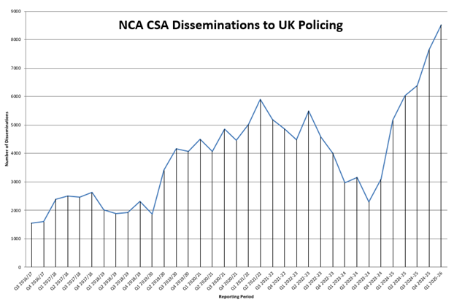
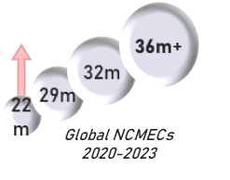
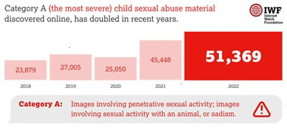


The SCALE of CSA is increasing
1.3-1.6% of the UK-based adult population (~710-840,000) pose a sexual risk to children. 15% girls and 5% boys experience CSA before the age of 16, but only 1 in 6 will report it.
The SEVERITY of CSA is increasing
Most serious online imagery and that involving under 10s both doubled in 5 years. younger children. Offenders commission livestreamed abuse on demand (contact abuse by proxy) for £20 -£50.
Emergence of Com Networks sharing and inciting increasingly depraved material
The COMPLEXITY of CSA is increasing
Offenders use privacy tools inc the darkweb and end-to-end encryption to collaborate, share images and contact children online. Generative AI has already increased the amount of online CSA.
Com Networks operating across varying threat areas, including Cyber, CSA and Terrorism
Notes:
The SCALE of CSA is increasing
1.3-1.6% of the UK-based adult population (~710 - 840,000) pose a sexual risk to children.
15% girls and 5% boys have experienced CSA before the age of 16.
Only 1 in 6 will report it, abuse has life long impact on victims.
(source:-Above Stats from NSA)
Volume of global industry referrals increasing: NCA triages & prioritises industry reports, sending 20,000 actionable intelligence leads per year to UK police forces.
Source: CSERB data
70% of CSA offences related to contact offences committed against children, 30% relate to IIOC offences.
52% of police recorded crime (E&W) involved children (aged 10-17) offending against other children
(Source : VKPP Totality analysis)
NCA provide volume intelligence to UK policing to support on average 900 arrests per month and safeguard 1,300 children per month
NCA & Policing arrests and safeguards have doubled since 2017
The SEVERITY of CSA is increasing
Rapid increases in the severity of imagery identified.
Emerging evidence of the link between images and contact offences.
Offenders commission livestreamed abuse on demand (contact abuse by proxy) for £20 to £50 on average.
(Source NSA and Livestreaming NAC report)
Group-based CSE accounts for 5% of all identified and reported CSA
(Source: VKPP totality analysis/COCAD data)
The emergence of Com networks sharing and promoting increasingly sadistic and depraved material.
Definition -
Transnational Virtual Networks (TVN) of criminal actors which engage in a variety of illegal acts or coerce others to do so in furtherance of their own personal gain, development of their infamy, or in furtherance of their ideologies.
The network can be broadly broken down into 3 identifiable sub groups:
A Group operating online primarily involved in extorting minors to commit digital and real world sex crimes, criminal act against the person, property and animals; and the promotion of self harm and suicide (SEXTORTION COM)
A group acting online who hold extremist mind-set who promote a violent Nihilistic world view encourages the damage to property, harm to individuals and potentially acts of terrorism (OFFLINE COM)
A group who have a common purpose to conduct criminal activities that maliciously use digital technologies that target UK commerce/infrastructure by means of Network Intrusions/Ransomeware etc (CYBER COM)
These networks are highly dynamic and often overlap across the threats, although not every case will involve all three.
The majority of victims and offenders are children under the age of 18, but do include adults, who engage with deviant beliefs, behaviours, and offending.
There appears to be no limit to offenders’ depravity; embracing all forms of extreme behaviour, from acts of extreme violence through to obscene sexual acts.
Com Networks are active on virtually all social media and online gaming platforms, but mainly operate on Discord and Telegram.
The NCA recorded 108 UK referrals from the NCMEC related to ‘Com’ linked extortion activity in 2024. This has increased from 40 in 2023 and 18 in 2022. This largely consists of referrals received via NCMEC, and would exclude offending that does not meet a platform’s NCMEC referral threshold.
NCMEC’s CyberTipline19 recorded 226 reports relating to the extortion focused ‘Com’ groups ‘CVLT’ and ‘764’ globally in Q1 2024. This compares with 261 reports for the whole of 2023 and 78 reports in 2022.
The COMPLEXITY of CSA is increasing
UK CSA Offenders use the darkweb and end-to-end encryption to collaborate, share images and contact children online
End-to-end encryption is increasing harm to children by reducing the visibility of offending
Generative AI is already increasing the amount of CSA material available online.
(Source:NSA)
THREAT PICTURE
¾ million adults that pose varying risks to children
½ million CSA victims
CSERB/DRB
Our ability to protect children and manage offenders is hampered by limited resourcing
In 2024, NCA received 70,000 actionable CSA referrals via NCMEC alone and has received 58,000 in the first 8 months of 2025. The volume of referrals has doubled since 2019 and both the complexity of cases and severity of harm are increasing within that. With both offenders and platforms’ adoption of AI, plus the impact of Ofcom, we predict the workload could double again the next 5 years.
This impacts both NCA and forces:
NCA- We have increased CSERB the staff to 115 which makes it our largest single intelligence team, but these officers are still very much hampered by our legacy technology, but as Graeme set out to Ministers, the open caseload will remain unacceptably high. Obviously there is significant risk to the effectiveness of the NCA response to CSA if the Agency does not receive adequate funding through the SR settlement. Failure to invest in automation of CSERB processes and deploy AI, coupled with a reduction in NCA headcount will mean the Agency will be unable to keep pace with increases in online CSA offending, increasing the number of open cases held within CSERB and putting more children at risk of abuse.
Forces- We are working with NPCC on a review of the end to end online CSA effort from intelligence to outcomes. HO TCSA team are involved. While NCA and forces have pivoted resources from other crime types to CSA, the pressures on: POLIT teams, Digital Forensics and offender management are particularly acute. The Review will likely highlight the need for improvements in process, another look at risk v resource, the need for partners outside policing (eg PREVENTION, Education, Health) to invest commensurately in reducing the threat to children and for the need to far more closely harness Home Office investment in technology across law enforcement to actually deliver improvements in relation to CSA:
Digital Forensics, where CSA is the largest crime type, but delays continue to grow wasting police effort, as well as delaying safeguarding opportunities.
CAID: AI already allows us to save huge officer time (and would reduce exposure to CSAM). We must invest now in a project to move away from avoidable human grading of images.
Data exploitation to identify the highest risk offenders far quicker, building on existing success with VISOR, but building APIs to wider police databases, plus DBS, HMRC, GCHQ, etc.
Integration of case management and MI across the system
Under the Online Safety Act, the NCA will take reporting direct from platforms that do not report to NCMEC. We cannot guarantee that we will be in a position to commence on 3rd November, so HO officials have proposed to amend the SI commencement date. We are aiming to take voluntary reporting as early as possible: as soon as the technology is finished and tested, likely by the end of the calendar year. Hard to predict how many additional reports we will get, but without the agreed ongoing Home Office funding, we will not be in a position to commence.
We need urgent and sustained investment in law enforcement technology to manage volume and increasing demand to better protect children

Slide 4

Press play to watch

Slide 5




“This holds true to only girls with BPD and NPD. This is the trick I mostly use. The trick I use to get girls to cut my name on their body. My one go to trick with which I have over 200+ female slaves in my cult.
Be a bully.
Find a void in the girls life. It can be anything ranging from daddy issues to body image issues. Once you do, bully her using it and exploit that void. For example if she has daddy issues, just bully her about how she got molested as a child by her dad. Break her down, break her self esteem and ego down to dust. She should be nothing but a mere soulless body once you are done with it. She will have given up.
That’s when you be the “nice guy” and offer her a shoulder to cry on. She will then develop intense Stockholm syndrome and be attached to you. This is because she knows what brutality you are capable of yet still choose to be calming and nice towards her.
This will make (her) open up and hence you can use her to do your dirty work for you. This only would work if you are a true Machiavellian, and not shackled by morals and ethics because obviously it would require you to be cunning and heartless to manipulate a girl like this.
This has worked for me all the time, the screenshots in Tragedy of Wormy, she was hesitant to send me nudes and cut for me because she had a boyfriend. 30 minutes of constant torture and she was my pet, barking on my order. “

Slide 6
“Our analysts estimate that thousands of users – offenders and victims –have exchanged millions of messages online relating to sexual and physical abuse….it is a threat here in the UK with reports increasing six-fold from 2022-2024.”
James Babbage– Director General – Threats - National Crime Agency.
Speaking at the launch of the National Strategic Assessment 2025 regarding Com Groups
Notes:
Scale taken from NAC assessment
The National Assessments Centre's (NAC) mission is to articulate the single picture of the threat.
The NAC are the NCA's centre for assessed intelligence reporting and are commissioned from across the community – NCA, LE, UKIC, HMG – all taskings must relate to SOC.
The NAC consult widely with stakeholders throughout the authoring process, but remain independent within assessments, supported by effective governance through PHIA Standards
The assessment of scale is currently reliant on rudimentary, piecemeal data and intelligence, providing limited insight into volumes of offending; however, it is almost certain that ‘Com’ linked offending has been increasing globally between 2020 and 2024.
It is almost certain that ‘Com’ linked offending is under-identified and under-reported. Victims are unlikely to report offending, and where offences are identified, links to ‘Com’ will not always be apparent to frontline law enforcement.
There is currently no single reporting mechanism that would capture identified ‘Com’ related criminality, impacting the collation and assessment of offending
Further issues that contribute to understanding scale include:
• groups rapidly evolve, splinter, and rebrand, which makes it difficult to maintain an up to date picture;
• individuals often participate across multiple ‘Com’ groups, making it difficult to discern the overall numbers of individuals involved;
• nomenclature – some groups are well known such as 764, however, not all have ‘obvious’ names that would make them easily identifiable;
• the inability to perform index/keyword searches on the content of key platforms; and
• the international, cross-threat nature of offending means that the law enforcement identification, response and recording is fragmented across different offence categories and law enforcement organisations domestically and internationally
The NCA recorded 108 UK referrals from the NCMEC related to ‘Com’ linked extortion activity in 2024. This has increased from 40 in 2023 and 18 in 2022. This largely consists of referrals received via NCMEC, and would exclude offending that does not meet a platform’s NCMEC referral threshold.
NCMEC’s CyberTipline19 recorded 226 reports relating to the extortion focused ‘Com’ groups ‘CVLT’ and ‘764’ globally in Q1 2024. This compares with 261 reports for the whole of 2023 and 78 reports in 2022.
Open source intelligence platforms have attempted to map ‘Com’ networks active on Telegram, estimating that there are 1,967 unique accounts across 78 Telegram groups. Beyond these, 303 additional groups were identified in the wider network. Across 50 of these groups, there were approximately 17,420 members, with an average of 348 members per chat.
Discord reported that, in 2023, it had blocked 130 groups and 34,00020 accounts linked to harm focused ‘Com’ networks. There are no other estimates currently available for Discord, however, there is work ongoing within private industry to understand and map scale.
Open source news reporting obtained and analysed more than 3 million messages from more than 50 chat groups on Discord and Telegram. Multiple ‘Com’ subgroups and thousands of users in nearly a dozen countries on three continents were identified.

Slide 7
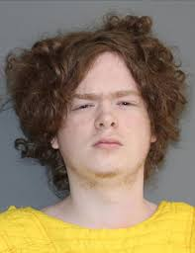

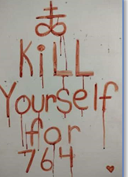
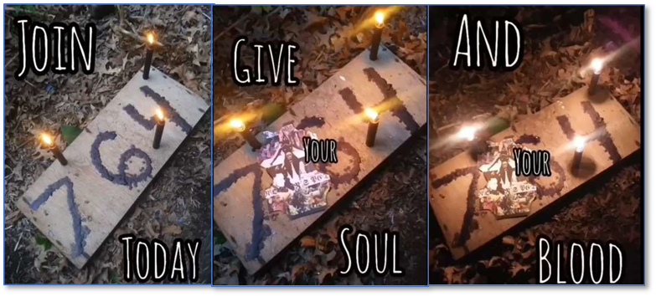
764
The original 764 group was initially founded by Bradley Cadenhead,
Cadenhead started 764, incorporating a Discord-based group known as CVLT,
He was arrested in July 2021 on charges relating to indecent images of children.
He was sentenced to 80 years in prison
Notes:
The original 764 group was initially founded by Bradley Cadenhead, a young individual from the United States, who, despite his age, became the central figure in the formation of this decentralised criminal network.
Cadenhead, used the first three digits of his hometown’s ZIP code (Stephenville, Texas ZIP code 76401) to name the group.
With the aid of an unidentified associate met on Minecraft, Cadenhead started 764, incorporating a Discord-based group known as CVLT, a community notorious for forcing children to perform sexual acts on camera, subsequently using the recordings for sexual extortion.
He was arrested in July 2021 on child pornography charges.
He was sentenced to 80 years in prison for possession with intent to promote child pornography.

Slide 8
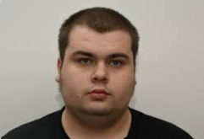
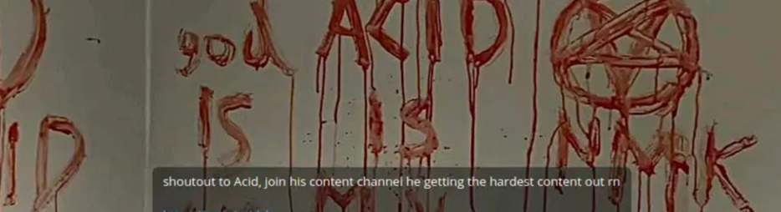
Cameron FINNEGAN
aka ACID
Was arrested on the 26th March 2024,
Devices confirmed that he was affiliated with the ‘com’ network and was a member of the group No Lives Matter and 764.
He was a member of a group titled 764 Terror Week, where members were going to commit acts of terror on behalf of the group.
FINNIGAN claimed he was going to murder a homeless man and shared pictures of a tent that his victim was staying in.
In January 2025, he pled guilty terrorist, CSA and criminal damage offences and was sentenced to 6 years
Notes:
Was arrested on the 26th March 2024, for making comments online that he was going to kill a
homeless person.
Devices confirmed that he was affiliated with the ‘com’ network and was a member of the group No Lives Matter and 764.
No Lives Matter encourage members to commit ‘real world’ crimes such as vandalism, arson, assaults and murders.
He engaged with vulnerable females online and encouraged one of his victims, who was based in Italy, to commit suicide.
Evidence was recovered of him having spray painted his username and group name (ACID and 764) onto buildings and had damaged cars by stabbing their tyres.
He was a member of a group titled 764 Terror Week, where members were going to commit acts of terror on behalf of the group. FINNIGAN claimed he was going to murder a homeless man and shared pictures of a tent that his victim was staying in.
In January 2025, he pled guilty and was sentenced to 6 years for:
1 x count of Sec. 58 (NLM Kill Guide); 1 x possession indecent images of a child; 2 x counts of criminal damage; 1 x encouraging / assisting a suicide

Slide 9
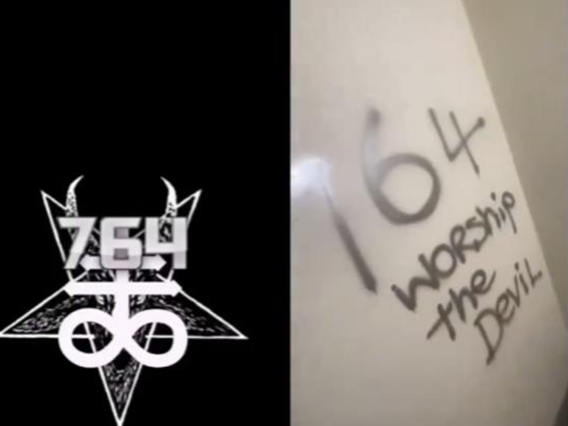
Behaviours and indicators of concern
The below are potential behaviours or indicators that a young person maybe involved in an exploitive and /or an abusive relationship with a Com Group and may apply to both victims and offenders.
In isolation these behaviours / indicators may be insignificant or unrelated to Com Group offending, grooming or victimisation.
  Self-harm (of note, cutting numbers/letters /symbols, or to the breasts/genitalia) known as cut signs or fan signs)
  Numbers, letters symbols written in blood on walls knowns as ‘blood signs’
  Interest, possession or promotion of extreme themes
  Disengaging from education
  Obsession with new online friends
  Unexplained injuries or death of pets
  Unexplained injuries to siblings
  ‘Doxing’ (the malicious sharing of private or identifiable information) and/or
  ‘Swatting’ (abuse of the 999 system to trigger an armed police response to a location)
  Unexplained money or gifts
  The use of encrypted or fringe communications platforms (Discord and Telegram)

Slide 10
This is what we ask of you…
Develop your understanding of the threat by familiarising yourself with the information in the notice shared with the papers
Share this notice with safeguarding practitioners in your area, for awareness purposes
Not to share with children and young people, to avoid increasing their exploration of, or engagement in, Com Groups
Look out for indicators of a young person’s involvement, interest or victimisation, taking a safeguarding-first approach to ensure an effective response
Follow your local safeguarding policies and procedures to manage concerns about a child, young person, or another person who may be at risk of harm
Report concerns to the police, calling 999 if a child or young person is in immediate danger

Slide 11
Press play to watch

