Slide 1


Child Death Review in Complex Circumstances: Understanding the process when no body is recovered
National Child Mortality Database
Vicky Sleap Deputy Director, NCMD
Eleanor Weller, CDOP Manager, Cambridge & Peterborough CDOP
www.ncmd.info

Slide 2
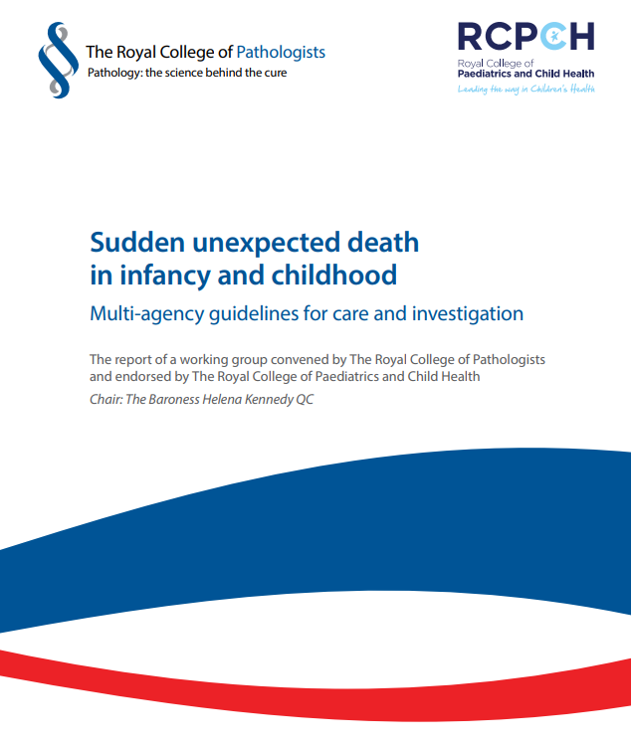
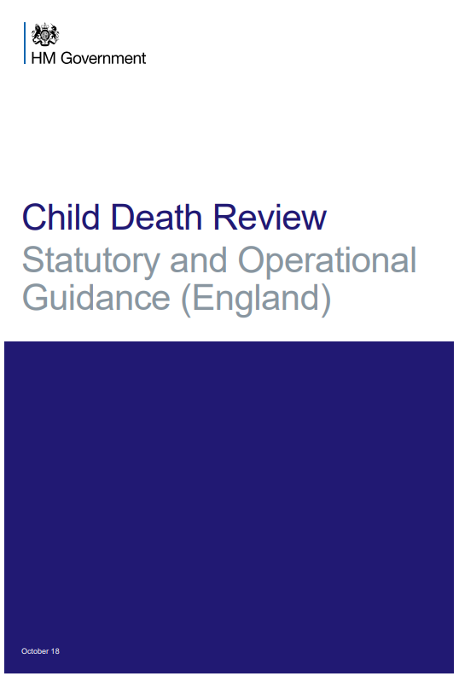
The child death review process in England
National Child Mortality Database
Statutory process since 2008 (legislation enshrined within The Children Act 2004)
The process includes babies born at pre-viable gestations (i.e. <24 weeks gestation) who show signs of life
It also includes unattended stillbirths in the community, but not terminations of pregnancy
Revised guidance was issued in 2018 following recommendations from the Wood Review (2016)
www.ncmd.info

Slide 3
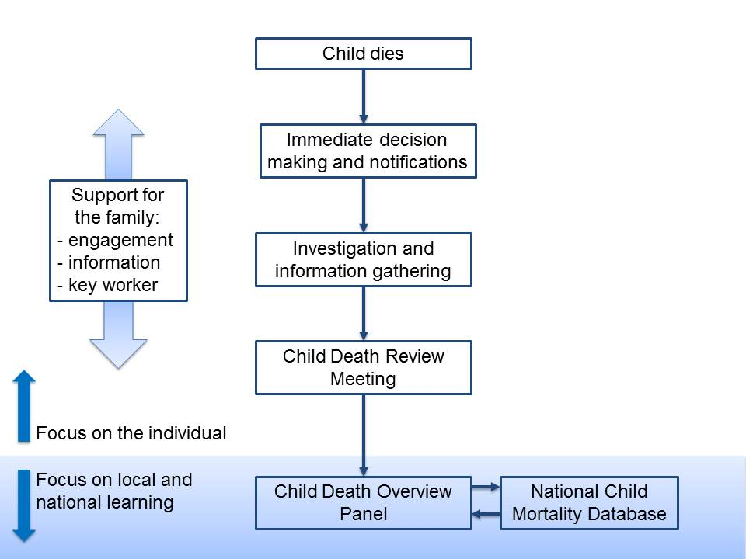
CDR meeting: final multi-professional meeting involving practitioners who were directly involved in the case, for local learning and reflection
CDOP: Independent, anonymised, multi-professional scrutiny by senior agency representatives (excluding though the child’s named medical or other professionals)

Slide 4

What is the National Child Mortality Database (NCMD)?
A programme of work that collects and analyses data from the Child Death Review Process on the deaths of all live born children in England who die of any cause, before their 18th birthday.
Commissioned by the Healthcare Quality Improvement Partnership on behalf of NHS England.
Led by University of Bristol, in collaboration with UCL Partners, Anna Freud Centre and QES
Charity partners are the Lullaby Trust, Sands and Child Bereavement UK

Slide 5
Where does NCMD data come from?
National Child Mortality Database
www.ncmd.info
@NCMD_England

Slide 6

What is the purpose of child death review?
National Child Mortality Database
To understand how and why children die.
To identify learning to inform policy and practice at a local, regional and national level.
To reduce the number of children who die.
www.ncmd.info
@NCMD_England

Slide 7

Deaths with additional complexity
Most child deaths can progress through the CDR process quite smoothly with no additional complexity
Where more than one statutory process applies it can often be difficult for professionals to know what they are required to do and at what point in the process
This is particularly true if there are other statutory safeguarding processes triggered

Slide 8

Anna’s story

Slide 9


Anna’s story
It's just like there's an empty part in our lives which is not there…at the moment the bigger part of me is trying to say that she's alive and must be alive because there's no body and there's no murder weapon, there's no proof to actually prove she's dead…I won't stop until I know the actual answer. I will still keep searching because she's out there somewhere. She doesn't deserve to just be lying in some ditch or something
- Anna’s brother at the time of her disappearance

Slide 10
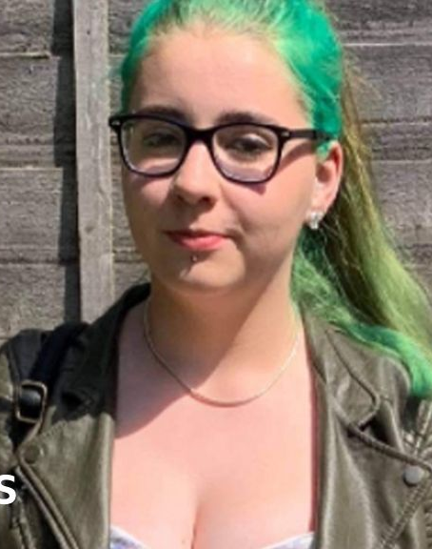
17 years old
Lived with her biological mother, step-father and 6 full/half siblings.
Loved, and was a very talented, photographer
Recognised as a young carer for some of her siblings
Of Gypsy Traveller heritage

Slide 11
Early-mid July 2020
Anna messages an online friend telling them that she needs to tell her mother something, but she feels ‘sweaty and nervous’ even thinking about telling her.
Two weeks later she messages her friend again, sharing that her step-father has been sexually abusing her. Her friend encourages her to tell her mother.
Anna sends a text message to her mother saying that she needs to talk about something important, but she cannot tell her step-father. Her mother’s response was to ask if she was pregnant, or if her step-father was using a dating app again.

Slide 12
17th July 2020
Anna tells her mother that her step-father has been sexually abusing her.
The following morning her mother tells her that she does not believe her and that she was lying.
Anna’s mother suggested that she spends the night with her paternal grandparents whilst matters ‘calmed down a little’

Slide 13
18th July 2020
Anna’s step-father collects her from her grandparents.
When her grandparents said goodbye to her that morning, this is the last time that they, or anyone apart from her step-father, is known to have seen her alive and well.

Slide 14
21st July 2020
Anna’s mother reports her missing, claiming that she had done this before and would undoubtedly return. Police establish that she has never been reported as missing before.
Her step-father tells Police that he had collected Anna, stopped to roll a cigarette on the way home, they argued and then Anna left the vehicle and walked away. He couldn’t pinpoint where and appeared unfamiliar with the actual location he showed officers.

Slide 15
Multi-agency response
Multi-agency response
22/07/2020
The day after Anna was reported missing by the Perpetrators in this case, a multiagency strategy discussion was held.
24/07/2020
This was followed by a review of the strategy meeting two days later. The outcome of this second strategy meeting was that the case would not be opened to CSC, but that the Police would continue to look for Anna and refer to CSC, if appropriate, once Anna had been found.
**Sept 2020
There was a further follow up strategy meeting seven weeks later, following the arrest of Anna’s step-father for murder. This meeting records that, prior to Anna going missing, the family had been known to CSC in other areas for some time, and that Anna’s siblings were previously on CP plans in other areas for physical abuse and neglect.

Slide 16
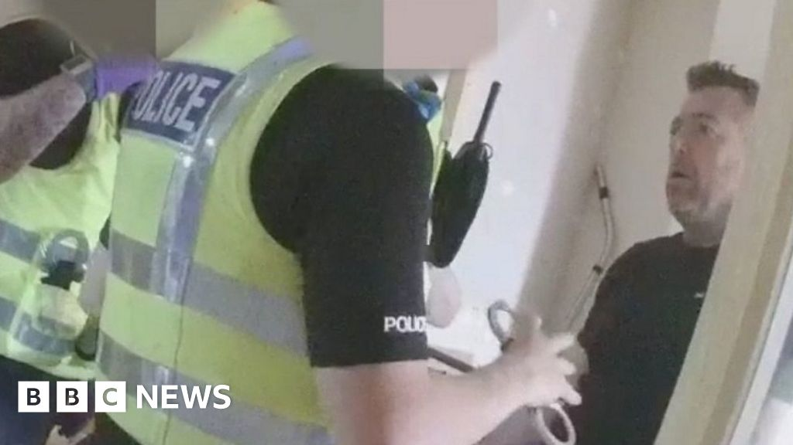
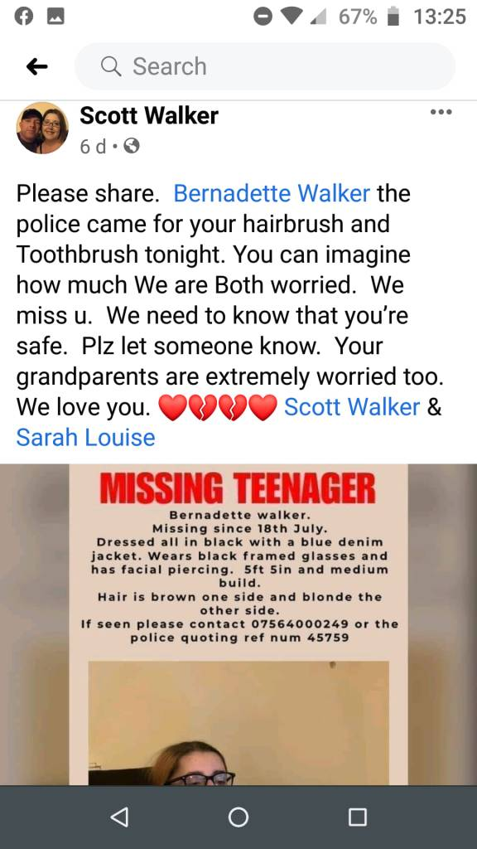
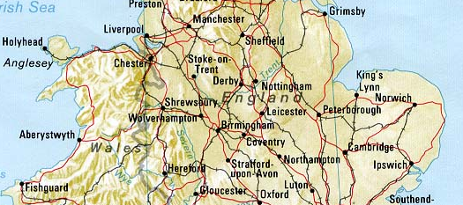

Police investigation
Police investigation
Step-father
Anna
Step-father
Mother

Slide 17
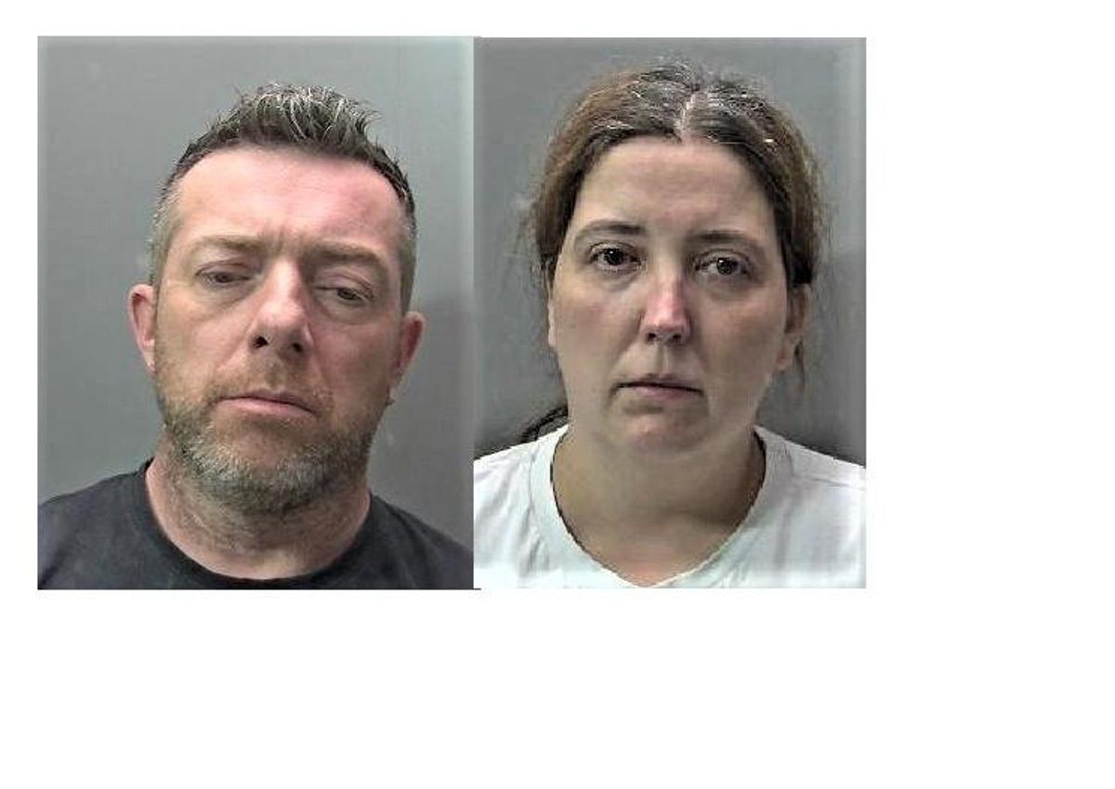
Convictions
Life imprisonment
Six years in prison

Slide 18


Anna’s notebook was found in her rucksack. Somewhat poignantly, this is what Anna had written
Told my mum about my dad and the abuse. She called me a liar and scribbled threatened to kill me if I told the Police. She said that the other kids matter more. I love (scribbled feeling unwanted. I feel nothing right now cause I always thought mum would deal with it and it would all go away. But, no, he’s still here, telling me I made it up. (scribbled out word) what kind of parent wouldn’t believe their daughter? But it's fine, I’m going to pretend its/I’m okay till I leave home and then I will block them out of my life. I’d rather say I’m an orphan, then say I have abusive parents who couldn’t give a shit about what happens to me. If I was brave enough, I probably would have already left or just killed myself…
July 2020

Slide 19
Rapid Review/ CSPR
A rapid learning review was undertaken, and this identified learning that stemmed from the time that Anna went missing. As the learning was immediately responded to and addressed without delay by policing colleagues and CSC, a Local Child Safeguarding Practice Review was not commissioned, and the National Child Safeguarding Practice Review panel was informed.

Slide 20
Domestic Homicide Review
In September 2021, at the conclusion of the trial which had resulted in the convictions and sentences of the perpetrators, a referral was made to the Safer Peterborough Partnership for consideration of the case as a domestic homicide review (DHR).
This report was published in July 2025.

Slide 21
Child Death Overview Panel (CDOP)
In September 2023, it was identified that the case had not been referred to the local Child Death Overview Panel. This appears to be the result of an oversight due to there having been no confirmed death at the time of the perpetrators’ arrests and this decision not being reviewed administratively when her step-father was convicted of Anna’s murder.
Anna’s death was reported to the local CDOP on the 15th September 2023, three years and 25 days after she was first reported missing.
** statutory legislation states ‘two working days’ to report a child death to CDOP.

Slide 22
Missed opportunities and difficulties
Late notification of death
No joint agency response triggered/immediate information sharing
Resistance from agencies to share information
DHR focus vs CDOP focus
Poor reporting into the National Child Mortality Database (NCMD)
Wider family/siblings not appointed a key worker for CDR process
Notes:
Anna’s death was reviewed by the Cambridgeshire and Peterborough CDOP in September 2025, around five years after she was first reported missing, and once all other investigations and reviews had concluded.

Slide 23
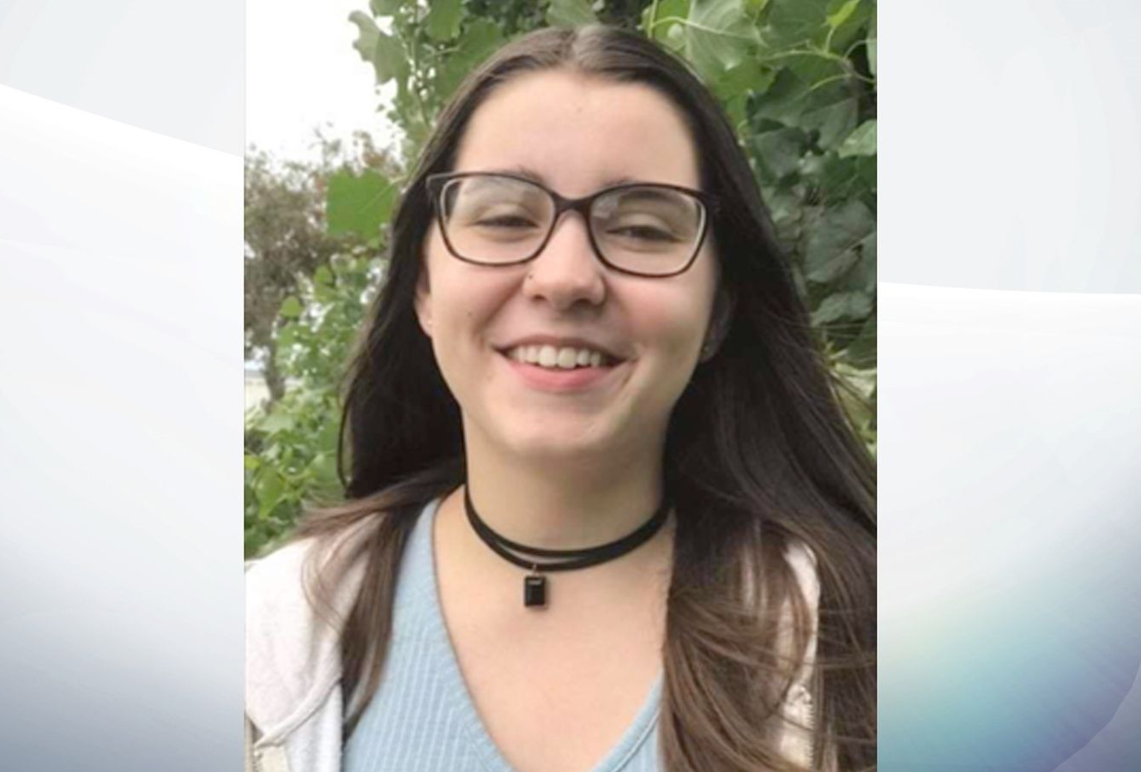

Slide 24
Statutory reviews
National Child Mortality Database
There is some overlap in the purpose of these three statutory review processes
Process | Purpose | Criteria
Child death review | To understand how and why children die. To prevent future deaths, improve support for bereaved families, and identify necessary changes in professional practice or policy | All live-born children in England who die before their 18th birthday (excluding stillbirths and legal terminations of pregnancy)
Child Safeguarding Practice Review | To identify improvements, share learning, and prevent future incidents, rather than assigning blame. | A child dies (including suicide) or is seriously harmed, and abuse or neglect is known or suspected.
Domestic Homicide Review | To identify lessons to improve multi-agency responses, prevent future deaths, and enhance support for victims | The death of an individual aged 16+ resulting from violence, abuse, or neglect by a partner, ex-partner, or household member
www.ncmd.info
@NCMD_England

Slide 25
CDR process
National Child Mortality Database
Scope and criteria is different from DHR and CSPR
Focus is on identifying "modifiable factors" to improve general public health and child safety.
Considers the whole life of the child and factors which may have contributed to vulnerability, ill-health or death
Includes information from every agency who had contact with the child throughout their life and was involved in the process after death
There is a legal obligation on professionals to contribute and they can be compelled to do so.
www.ncmd.info
@NCMD_England

Slide 26
How CDR learning is driving real improvement
National Child Mortality Database
CDR statutory guidance due to be updated
NCMD was commissioned to analyse CDR data and make national recommendations for change
Update to the Homelessness Code of Conduct to ensure families can follow safe-sleeping advice
Change in BNF advice to pharmacists for dispensing of medication that may cause drowsiness
Change in the type of asthma inhalers provided to include dose counters
www.ncmd.info
@NCMD_England

Slide 27
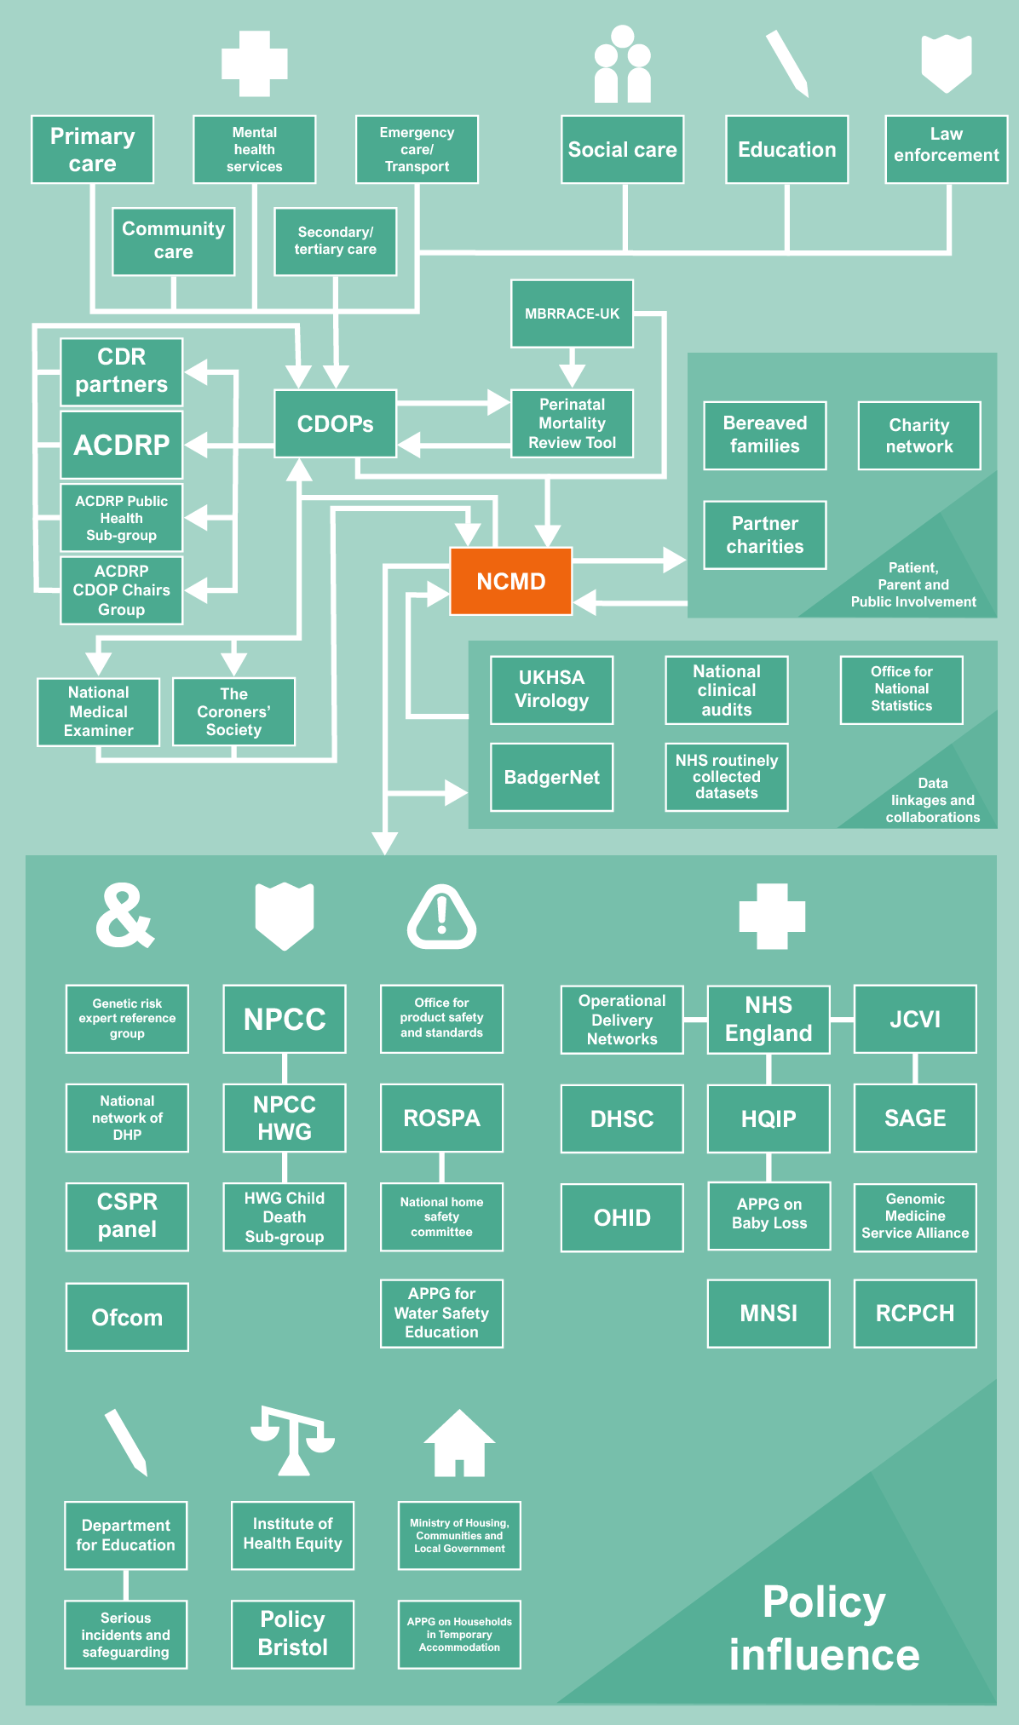

Slide 28

Keep in touch
National Child Mortality Database
Follow
us on X @NCMD_England
Visit
our website at www.ncmd.info
Sign up
to our mailing list here to be notified of future events and publications
Join us
On our LinkedIn group here
Follow
Us on Blue Sky @ncmd.bsky.social

