Slide 1
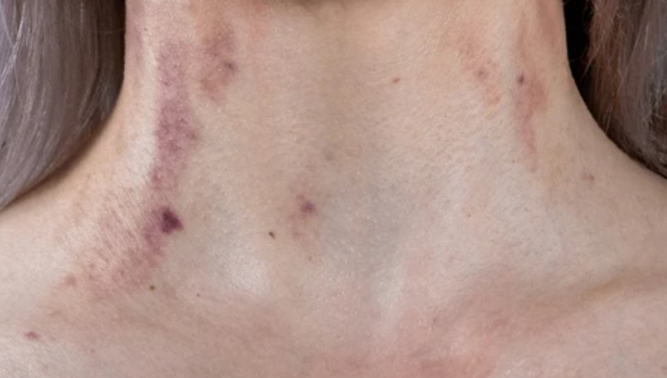
Cases of neck bruising identified in the Humber Forensic Prototype
Examples from the Humber Forensic Prototype
Dr Elisabeth Alton

Slide 2

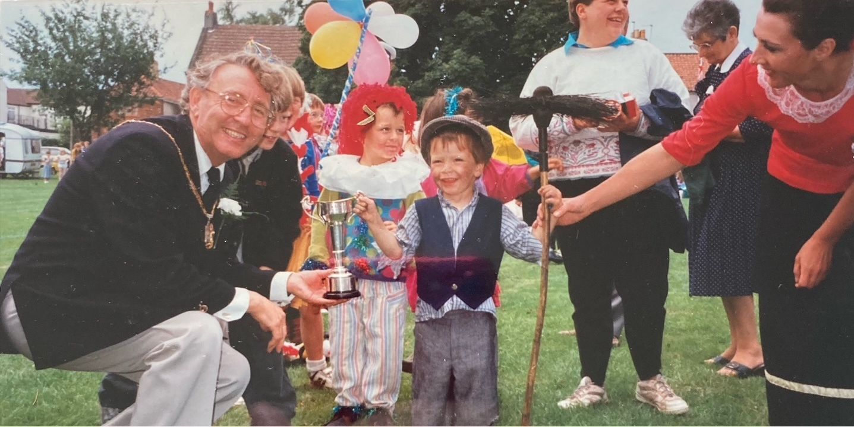
History of the Humber Forensic prototype
Developed from a SAR-
Adult A
Aimed to end the inequality between children’s and adult’s safeguarding
Aims to provide a documentation and interpretation service for adults at risk of harm who may have suffered a potential non-accidental injury as a result of physical abuse or neglect
Need to establish ‘proof of concept

Slide 3
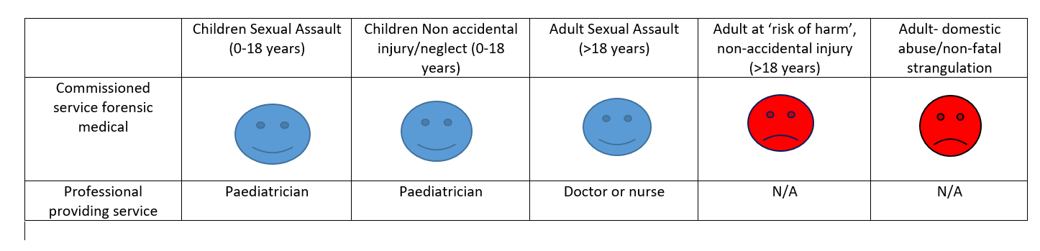
Provision of clinical forensic service
England

Slide 4
How does the service work?
Alert arrives at SAT
Injury? Physical abuse
Communicate with FME
On the day discussion with SW
Visit with social worker
Agree ? visit
Microsoft Word - Multiagency Forensic Examiner Policy (HR updated).rtf
Notes:
Focus groups

Slide 5
Six women and one man with neck bruises
Four thought to be non-accidental injuries
One due to a fall (unusual circumstances)
One probably due to an overtight surgical gown acting as a ligature
One due to a manual handling incident (not recorded in care home records)
Notes:
Fractured sternum

Slide 6
Case 1
103-year-old lady
Living in her own home
Adult son had moved back in
Care calls twice a day
Mobile with limitations
Lacked the capacity to consent to a safeguarding referral
Vascular dementia

Slide 7
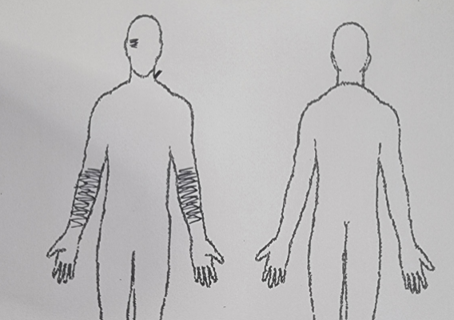
Initial safeguarding

Slide 8
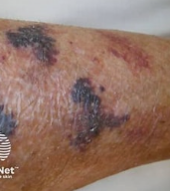
Documentation of injuries
Senile purpura from wrist to elbow bilaterally
BUT very marked demarcation at wrist
Laceration at left wrist
Black right eye

Slide 9
Neck Injury
Laceration and bruising to left side of neck
Bruising angle of jaw

Slide 10


She caught it on a rose bush
How did the neck injury happen?

Slide 11
Mobility
Walked with a non-wheeled zimmer
Could manage on the flat
Step down to the garden
Could not manage this without assistance
Had not been out alone since the carers started over a year ago

Slide 12
What else did we know
What did we find out
Injuries not present the previous evening (Saturday)
Son had been out drinking
Previous altercations
‘carer stress’

Slide 13
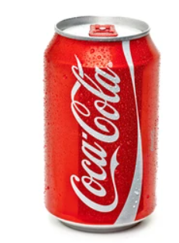

How much pressure do you need to strangle someone?
Jugular vein 4psi,
Carotid artery 11psi,
Trachea 34 psi.
Opening a can of coke 20psi
Adult male hand shake 80-100psi

Slide 14
What was the outcome?
Lady was moved to respite
Settled really well

Slide 15
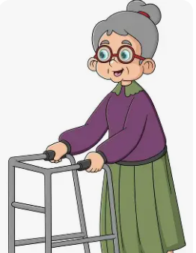
Learning Point
Consider mobility
Could this lady have been in the garden given her mobility?

Slide 16
Case 2
Case 2
Elderly lady
Care home resident
End of life care
Non-mobile

Slide 17
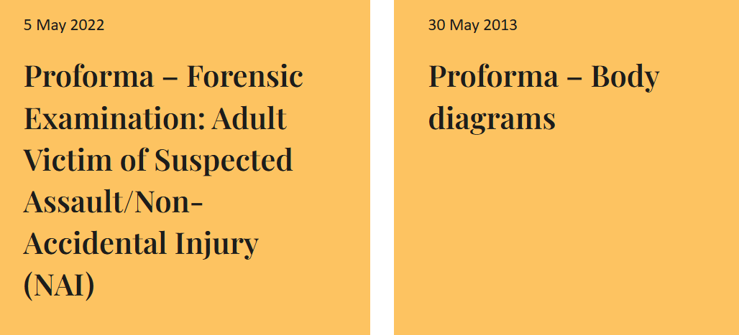

Documentation

Slide 18
The Visit
Accompanied by SW
Capacity assessment
Best Interests- SW, care home manager, care home nurse
Did not involve family due to potential abuser being a family member
Gathered medical information including medication

Slide 19
The examination
Victim supported by care home nurse and HCA
In depth discussion with care home nurse around-
Care and support needs
Feeding/fluids
Behaviours that challenge
Observed manual handling technique

Slide 20
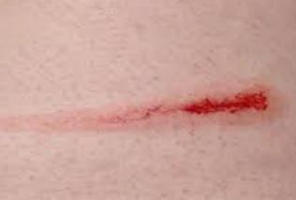
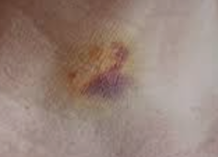
Injuries
Bruising to neck
Left side of neck- 2 -1.5cm circular bruises over side of neck
Small abrasion just beneath this
Abrasion- result of blunt trauma,
Cause a superficial disruption of the epidermis
Bruise- blunt force trauma,
Visible leakage of blood into the soft tissues as a result of damage to blood vessels

Slide 21
Bruising- what does the literature tell us?
Controls in brackets
Victims 57.4% had bruises (16.8%)
Head neck and torso 42.7% (3.8%)
Extremities 57.3% (96.2%)
Dimension 5.4. +/-3.1cm (3.4+/-2.3cm) i.e bruises bigger in victims
86.6% family members were the perpetrator
Bruising as a Marker of Physical Elder Abuse Aileen Wiglesworth et al JAGS 57:1191–1196, 2009

Slide 22
What does the literature tell us- neck injuries
Anatomically- unusual on the neck as a protected area and underlying bony structures are not in close proximity to the skin
(Stark, M., Clinical Forensic Medicine p163)
Less than ½ of victims will have a visible neck injury (46.6%)
(White, C., et al, ‘I thought he was going to kill me’: Analysis of 204 case files of adults reporting non-fatal strangulation as part of a sexual assault over a 3 year period, 2021, Journal of Forensic and Legal Medicine)

Slide 23

Who was the likely perpetrator?
An adult male relative had visited the day before
Unusual to visit alone
At one point prevented the nurse entering the room
Stayed for a few hours

Slide 24

What was done
Police checked for previous convictions
Checked whether he worked with children or vulnerable adults
Adult male and female he lived with ‘spoken to’ by police
Not allowed to visit alone
Visiting with door open and frequent staff checks
Insufficient grounds to proceed with a case

Slide 25
Case 3
Elderly gentleman
Care home resident
Dementia
Attentive daughter

Slide 26
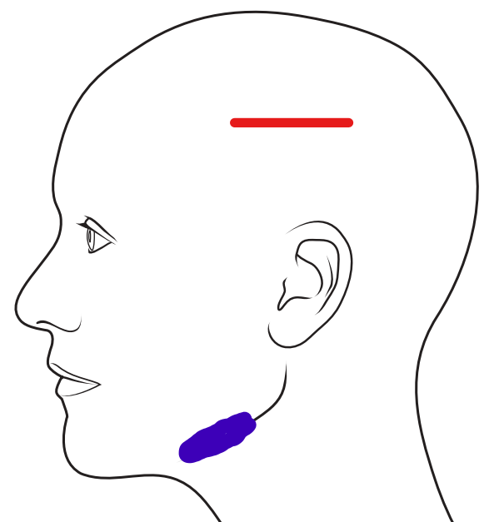
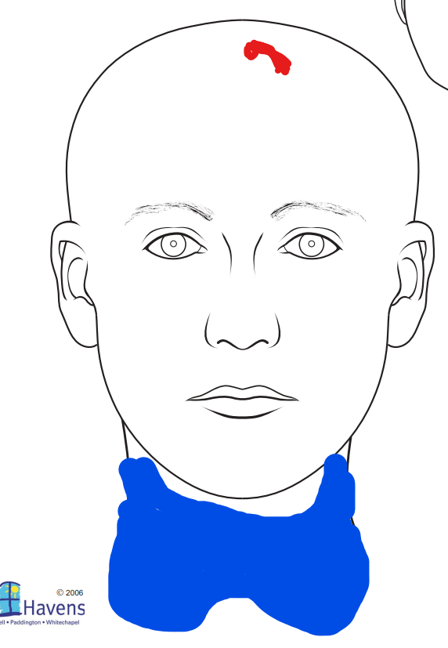
Injuries

Slide 27
History
‘Unwitnessed fall’ or ‘unexplained injury’
Asked the care home what might have happened
‘He could have fallen against his bathroom sink’

Slide 28
Unexplained injury protocol
Under development
Put it to use
Fantastic social worker
Put the questions to both the home and the daughter

Slide 29
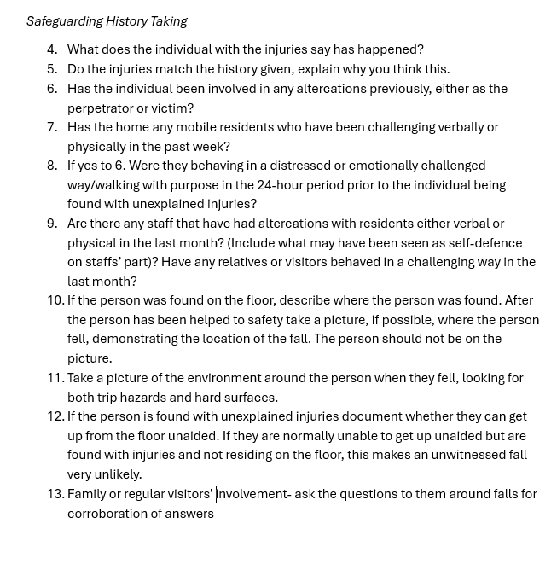

Slide 30
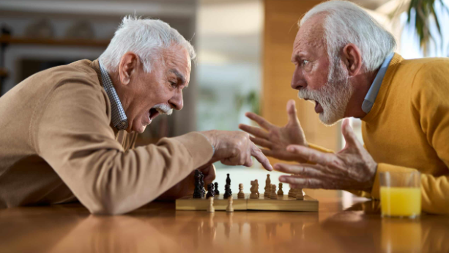
Care Home Whistleblower described an undocumented altercation

Slide 31

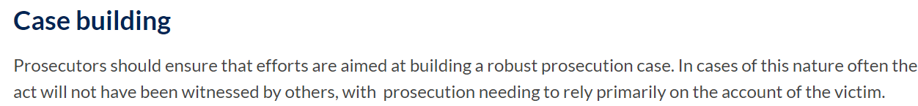

Slide 32

NFS in the elderly
Problematic in all cases
Unable to give an account for themselves
Cognitively impaired

Slide 33
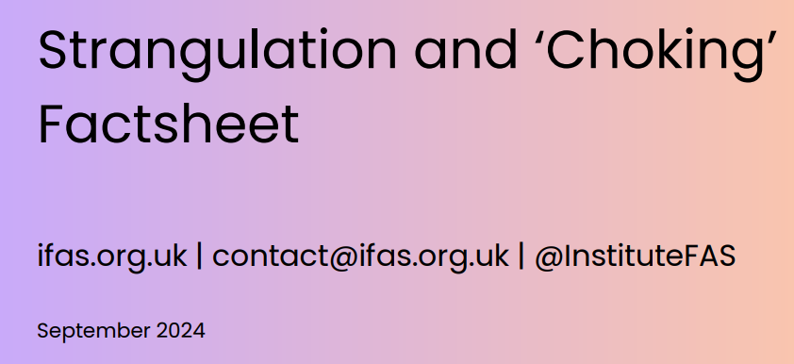
Capacity Assessments- NFS
Imperative we get this right
Complex area
High risk behaviour
Rarely a ‘one off’
Strangulation/Choking Factsheet

Slide 34

Any Questions
Elisabeth.alton@nhs.net

