Slide 2



Training Thursday Housekeeping
Please do keep yourself on mute.
There will be an opportunity to ask questions at the end of the presentation.
This session is being recorded.
The recording, together with the slides, will be freely available on the East Region Safeguarding Learning and Development Platform: https://eastsafeguardinglearningplatform.co.uk/
Notes:
Standard title slide

Slide 3


Safeguarding at Christmas
Presented by: Chelle Farnan – Safeguarding Clinical Lead NHS England – East Region
Notes:
Standard title slide

Slide 4
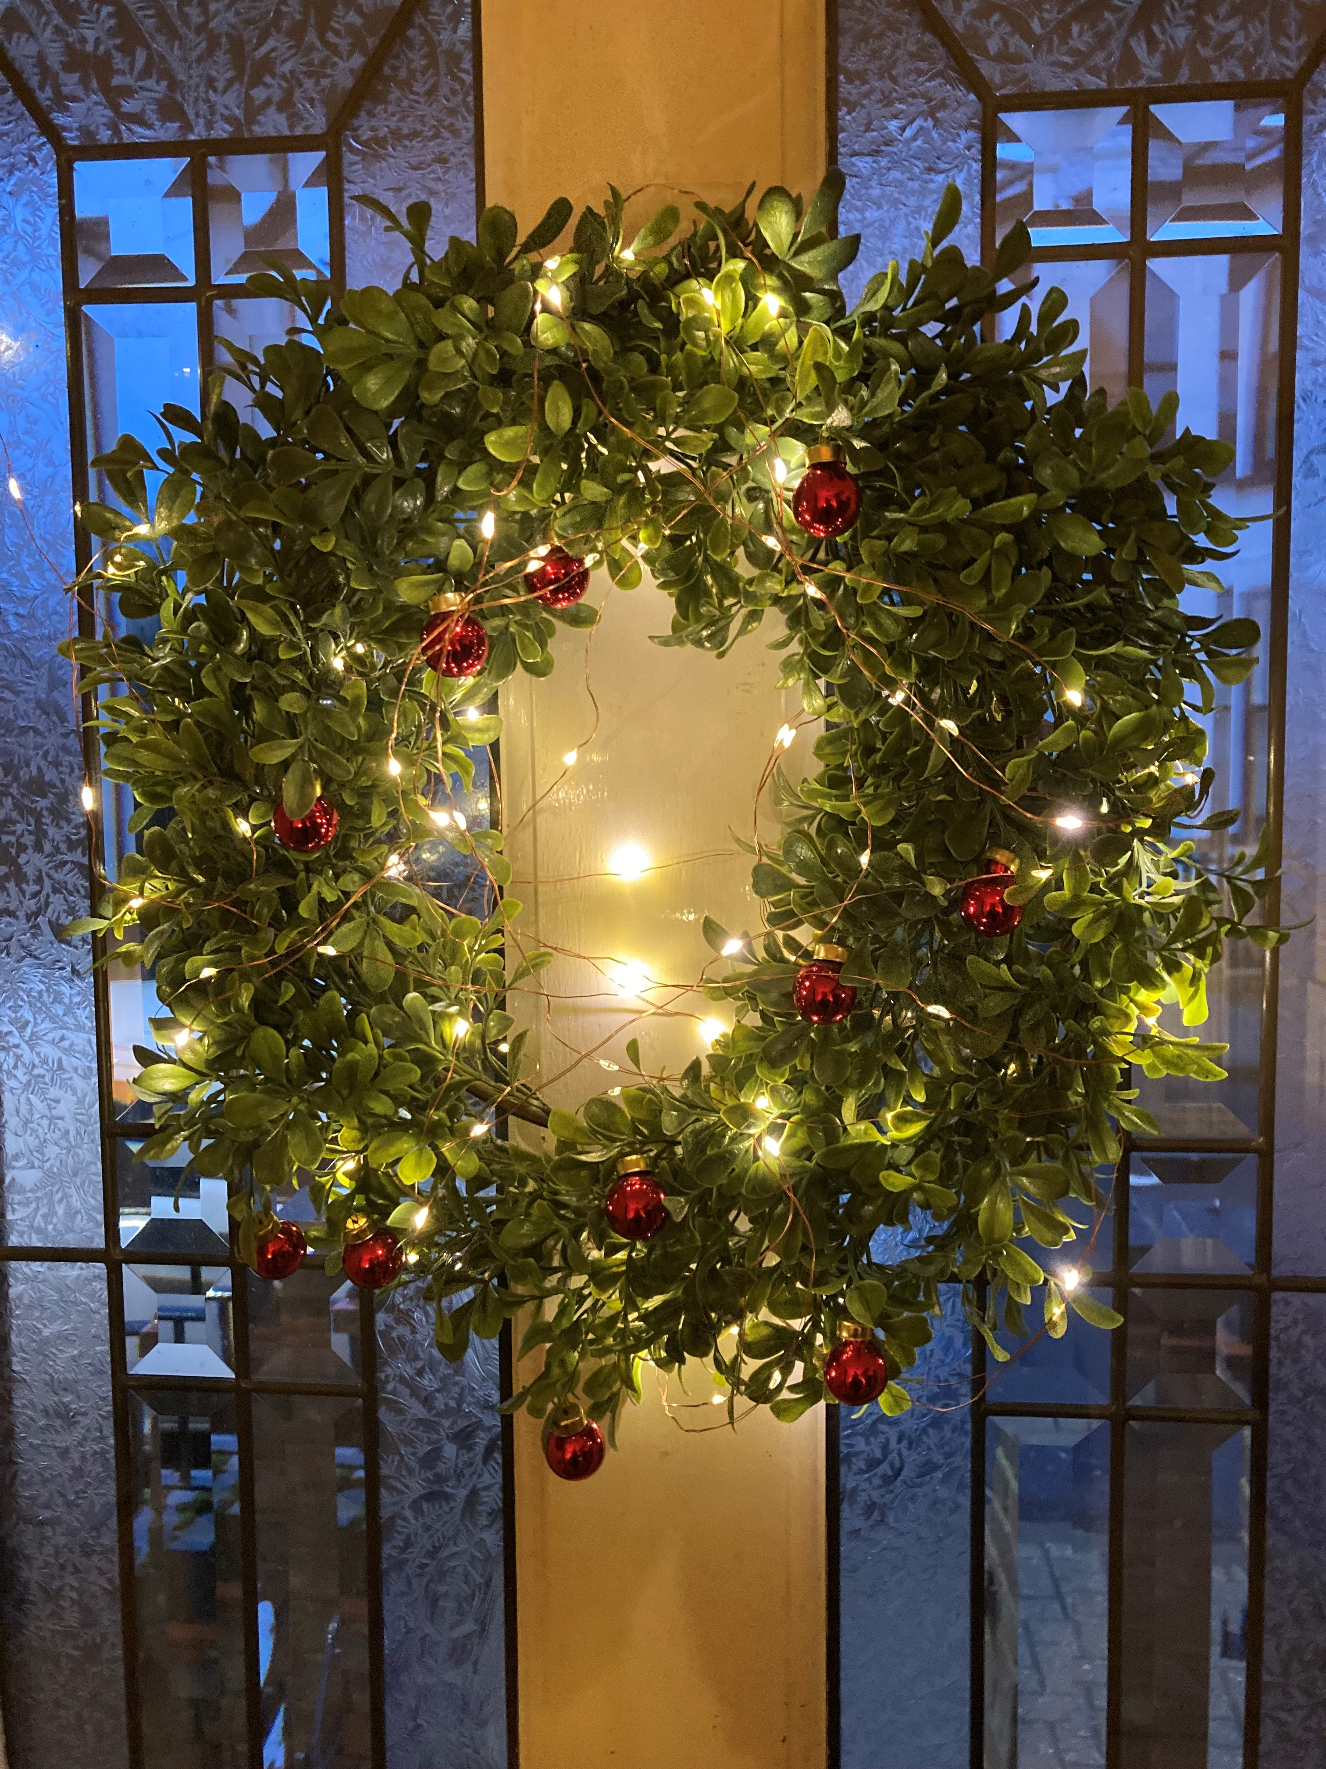
December can be a particularly challenging time of year for lots of people for a whole range of reasons …
Notes:
”Quote” slide with placeholder for image on right hand half

Slide 5
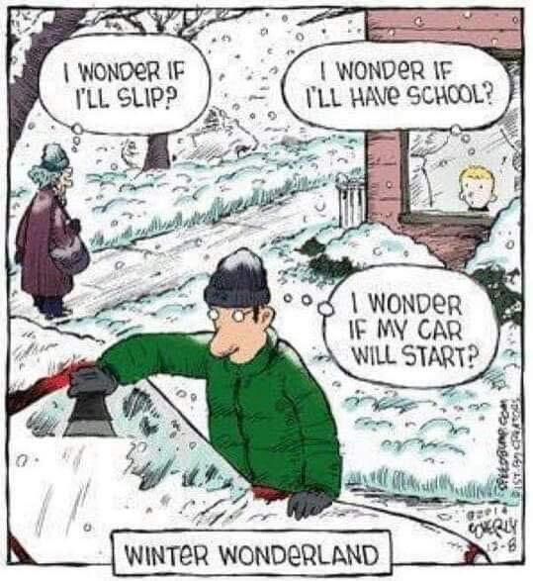
For a start there’s the good old British weather!

Slide 6
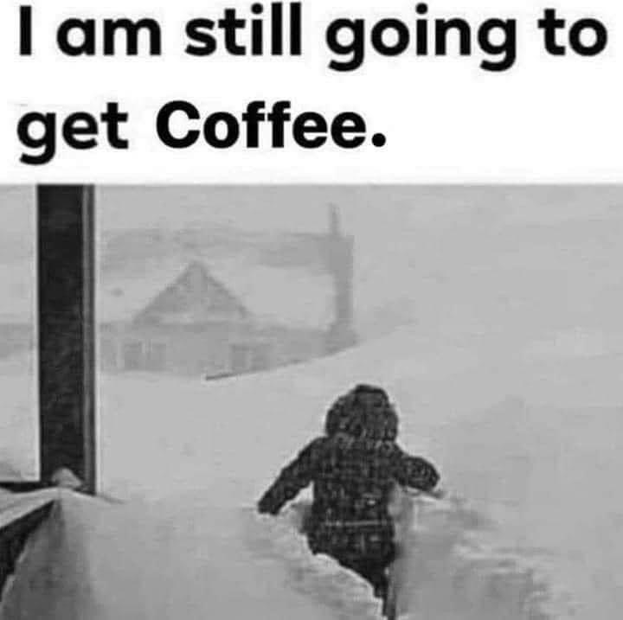
We tend to carry on regardless in the UK!

Slide 7
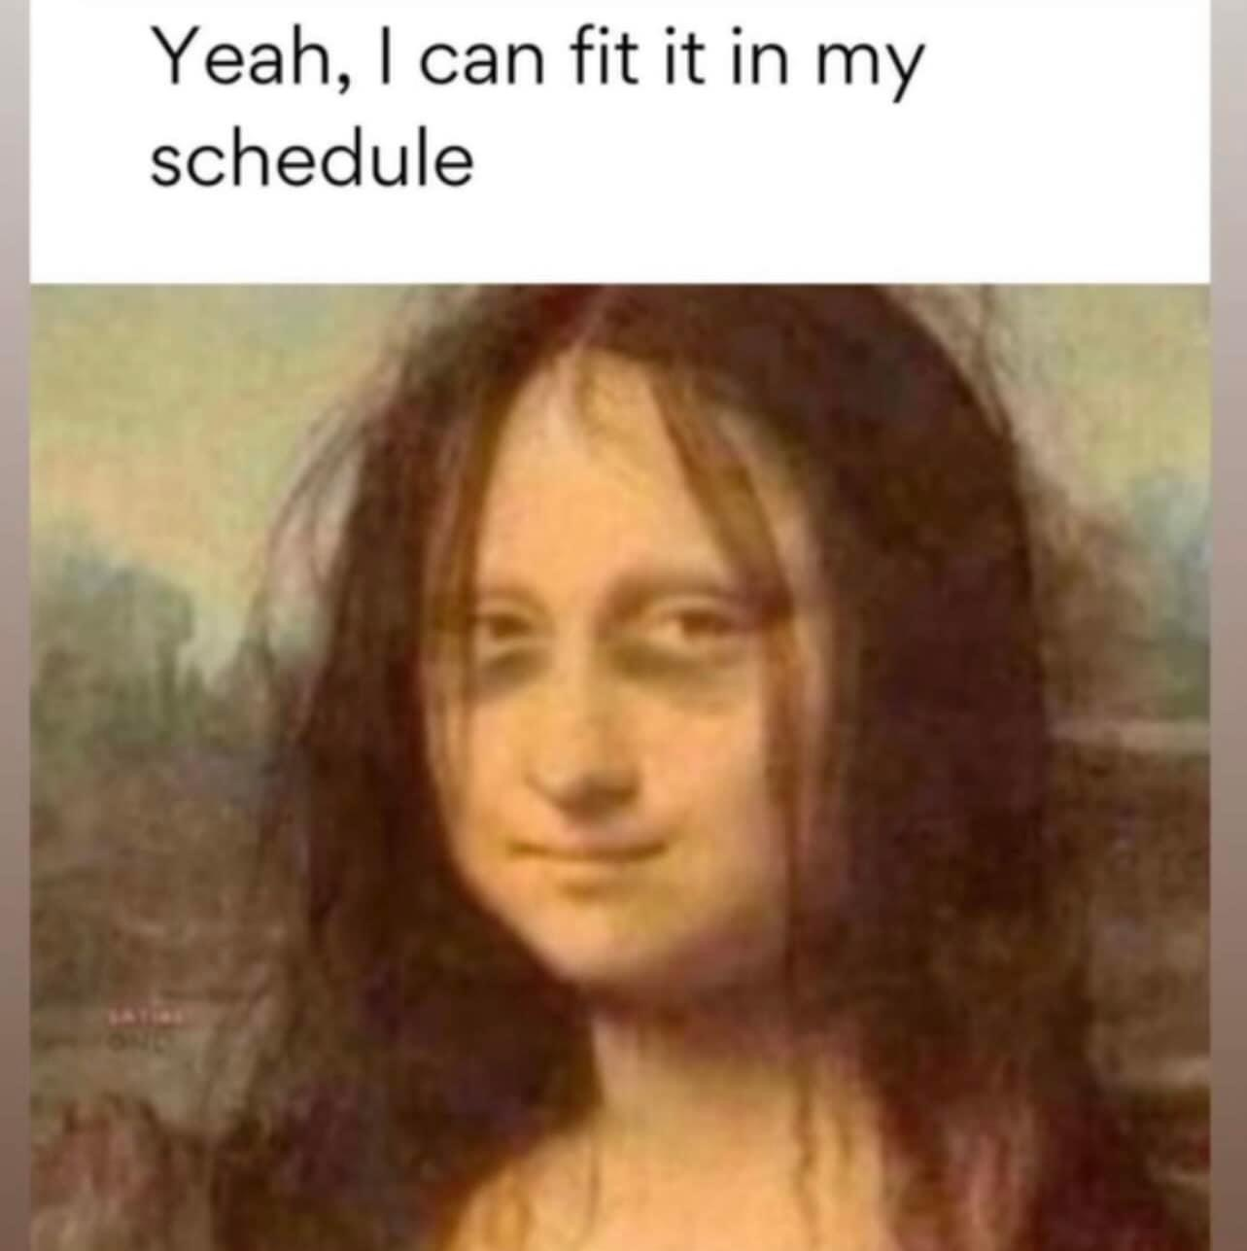
There is the total busyness of the whole time…

Slide 8
Found in a carers chat room
I’m facing a real struggle this Christmas, I’ve got everyone coming to me for dinner and I also need to visit my mum in her care home
Can’t you have her over to you as well for dinner, then you don’t have split yourself in two?
She’s got dementia and a broken hip; I don’t think I could cope caring for her as well as cook and entertain everyone else
What about your daughter, can’t she help?
No, she 8 months pregnant. I won’t bring Mum home; I recon she’ll have a better time with her friends. Thinking I’ll visit her on Boxing Day instead; it’ll be too much in the one day
Yes, I remember running around the last few Christmases trying to make everyone happy. You end up exhausted. Try if you can, to carve out a bit of time for yourself. Easier said than done I know

Slide 9
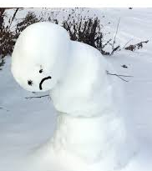

It can be overwhelming

Slide 10
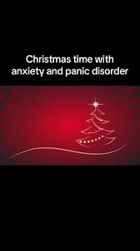
People with preexisting mental health conditions can find the holiday season even harder to cope with.

Slide 11
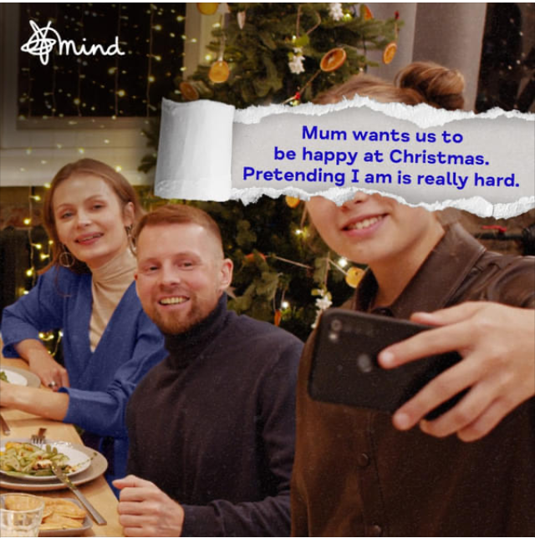
Everyone is ‘expected’ to be happy!
There’s the
Enforced
proximity

Slide 12
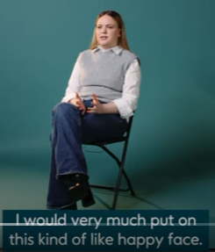
Isn’t
everyone’s
idea
of
fun
https://youtu.be/lrkrT5NXnNM

Slide 13


For Christmas 2025, the mental health charity Mind is primarily focusing its media efforts on raising awareness about managing mental health during the festive period and encouraging community-based fundraising initiatives.
Their key message highlights that social media and advertising can create "unrealistic expectations" of a perfect Christmas, which can exacerbate feelings of loneliness and inadequacy. Things can build up, like a snowball…

Slide 14



Slide 15
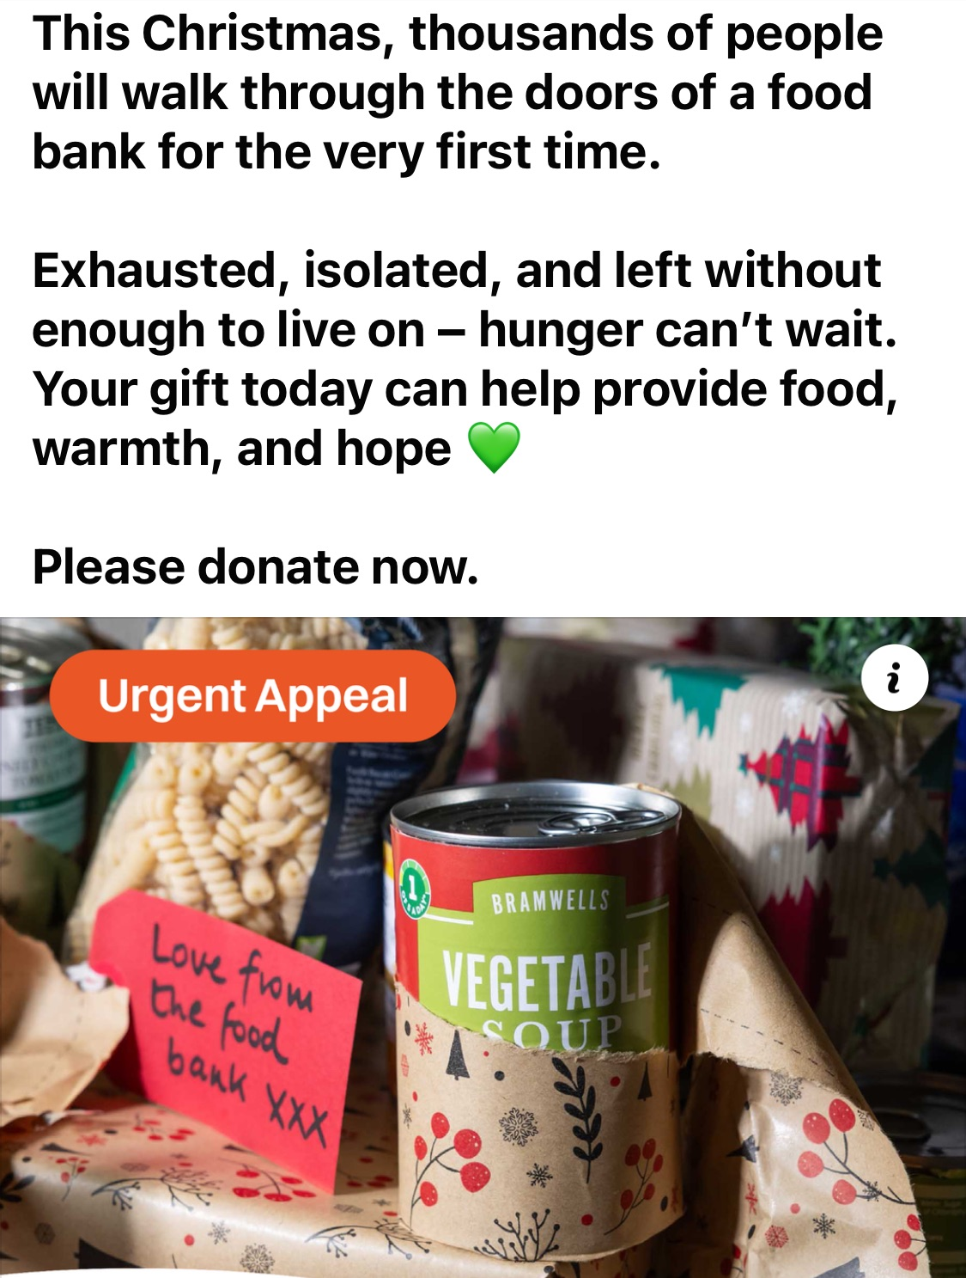
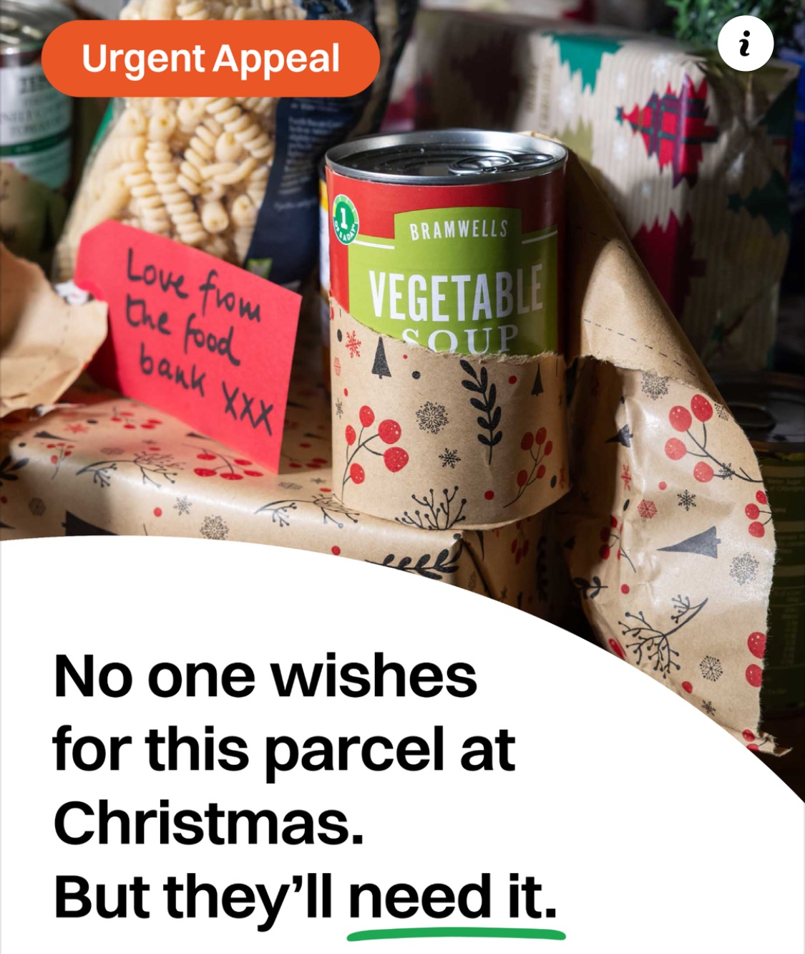
Also, the financial hit of the extra food, drink and of course gifts.
With the biggest time gap between December and January paydays.

Slide 16
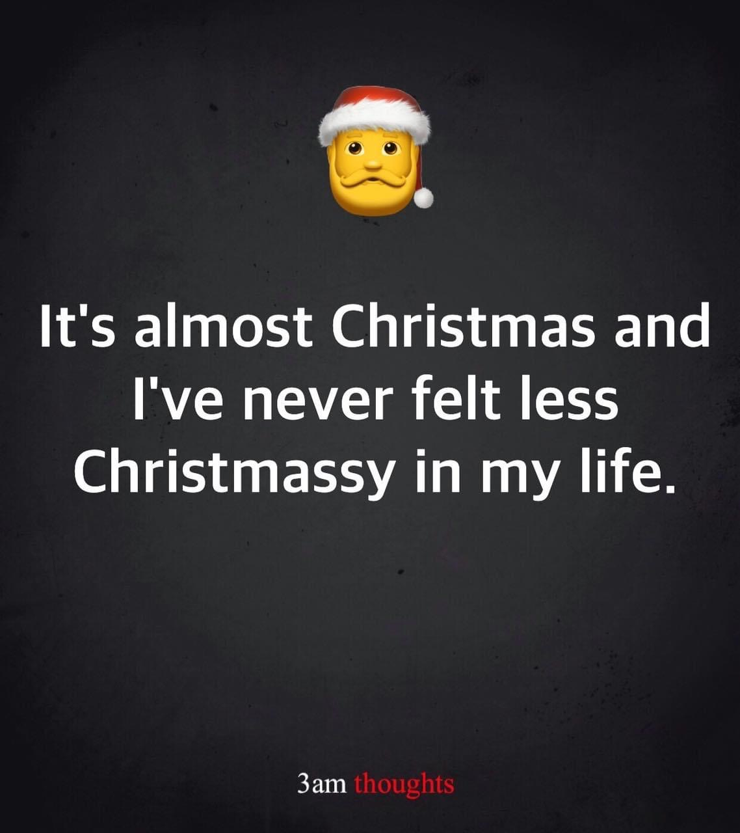
Sometimes you are just not feeling it…

Slide 17
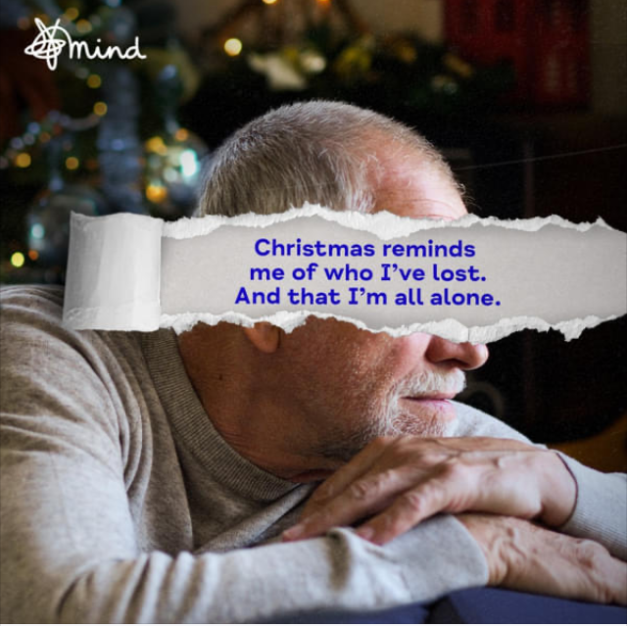
Sometimes Christmas can trigger painful memories
Text
Notes:
Plain slide with subhead and bullets

Slide 18
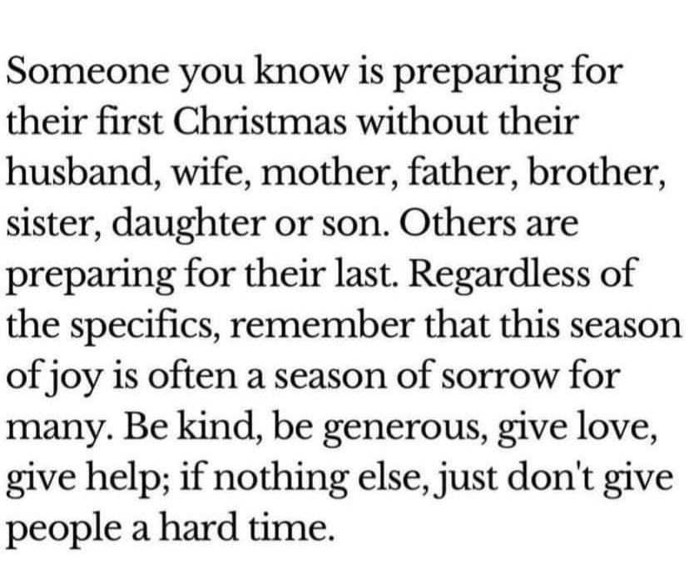


Slide 19
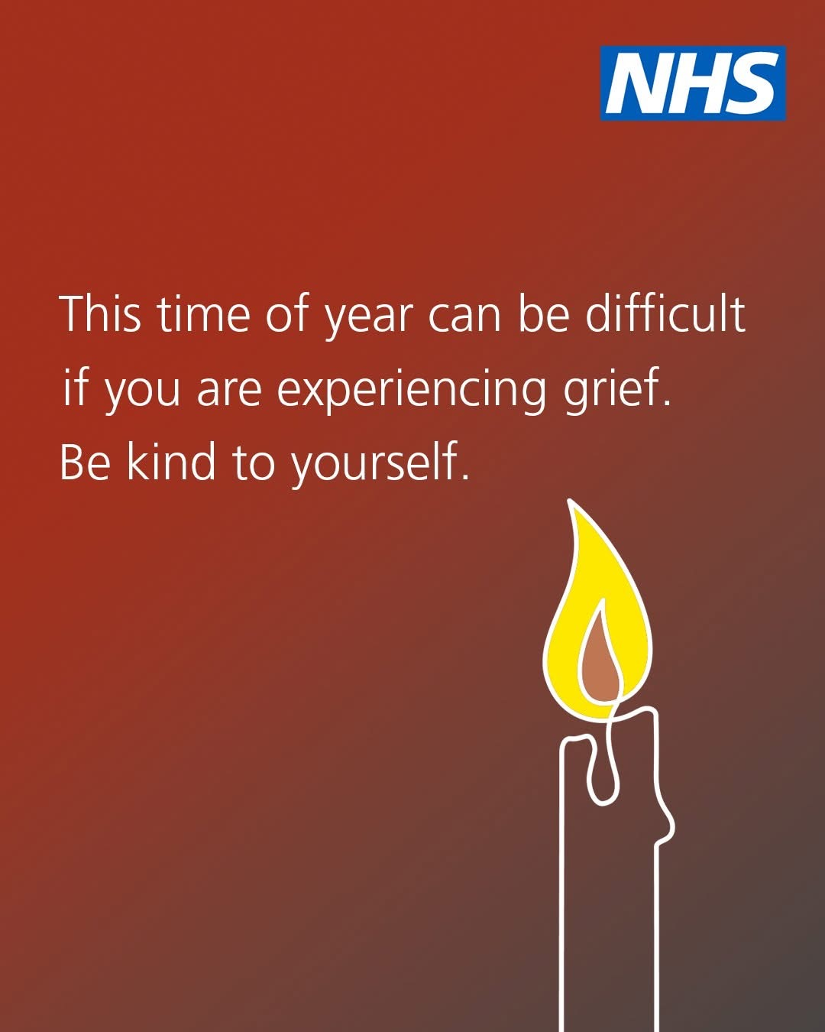
The NHS offers guidance on coping with bereavement and grief
https://www.nhs.uk/mental-health/feelings-symptoms-behaviours/feelings-and-symptoms/grief-bereavement-loss/
https://www.nhs.uk/mental-health/advice-for-life-situations-and-events/bereavement/

Slide 20
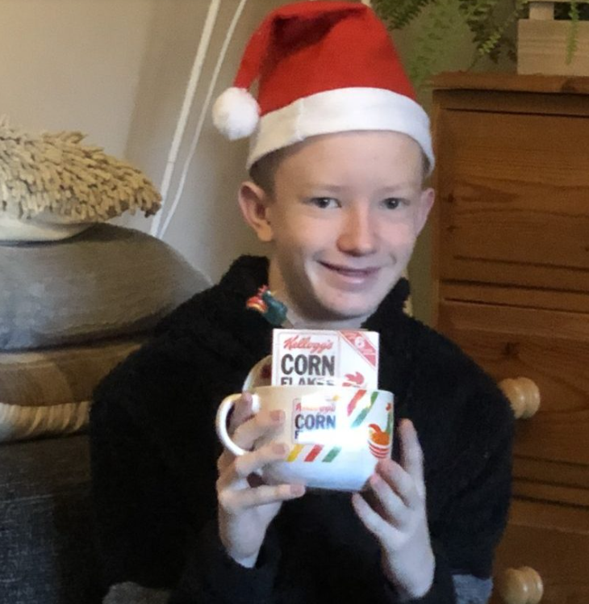
Liam Walsh: Supporting Bereaved Parents Through Christmas
Christmas, birthdays and other significant anniversaries can be an especially challenging time for bereaved families. The National Child Mortality Database wanted to invite those affected by child death to share with them how they can best support them during these difficult periods.
Liam Walsh has shared a blog, based on his own lived experience on how to do just that.
This can be access at the below link.
Supporting bereaved parents through Christmas

Slide 21
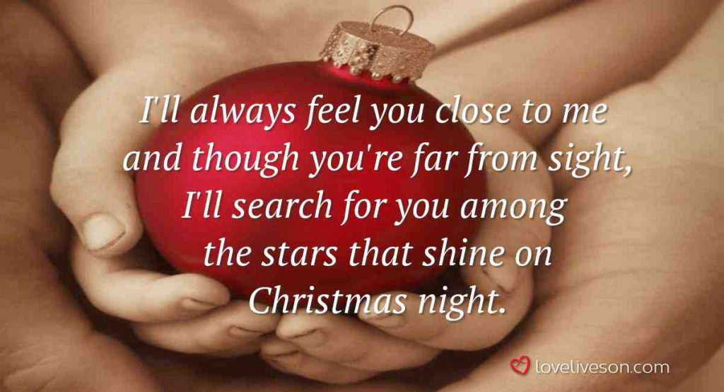

Slide 22

December …
With the end of
another year
looming and so
a potential
sense of failure
for some folks – it
can be profound.

Slide 23
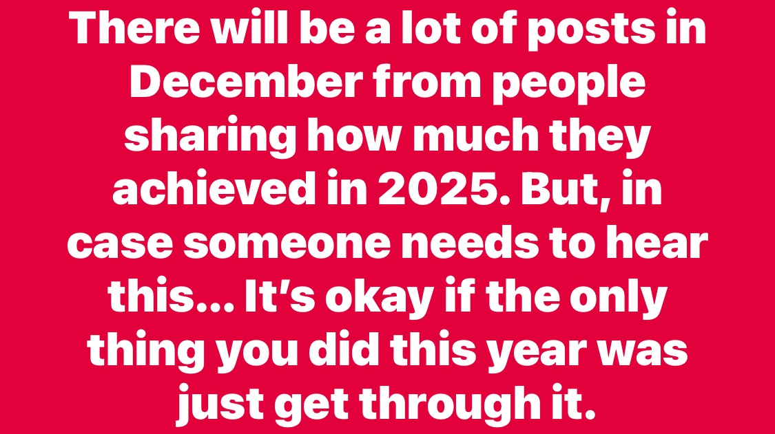

Slide 24
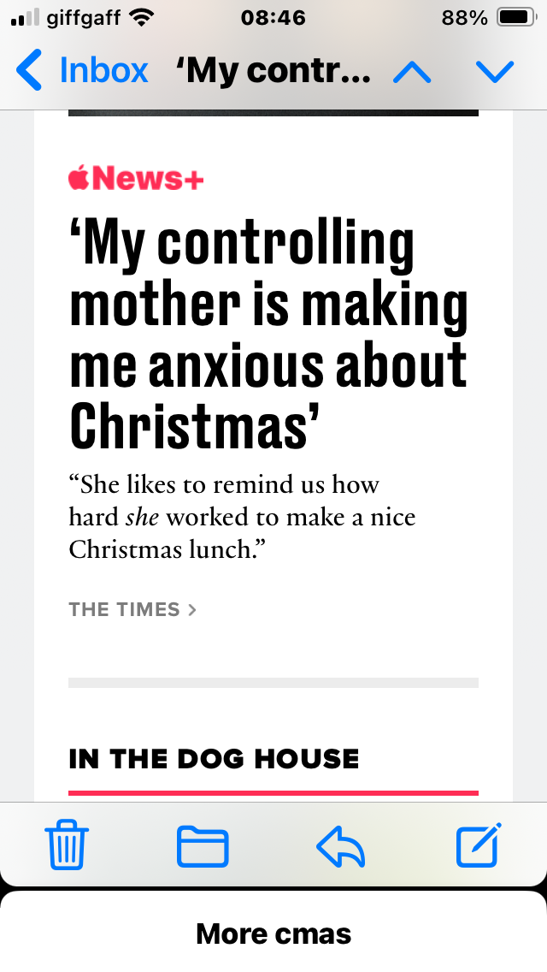
The media just love to hype up how ‘awful’ Christmas time can be, and with smart phone’s there seems to be no escape from the toxic messaging

Slide 25
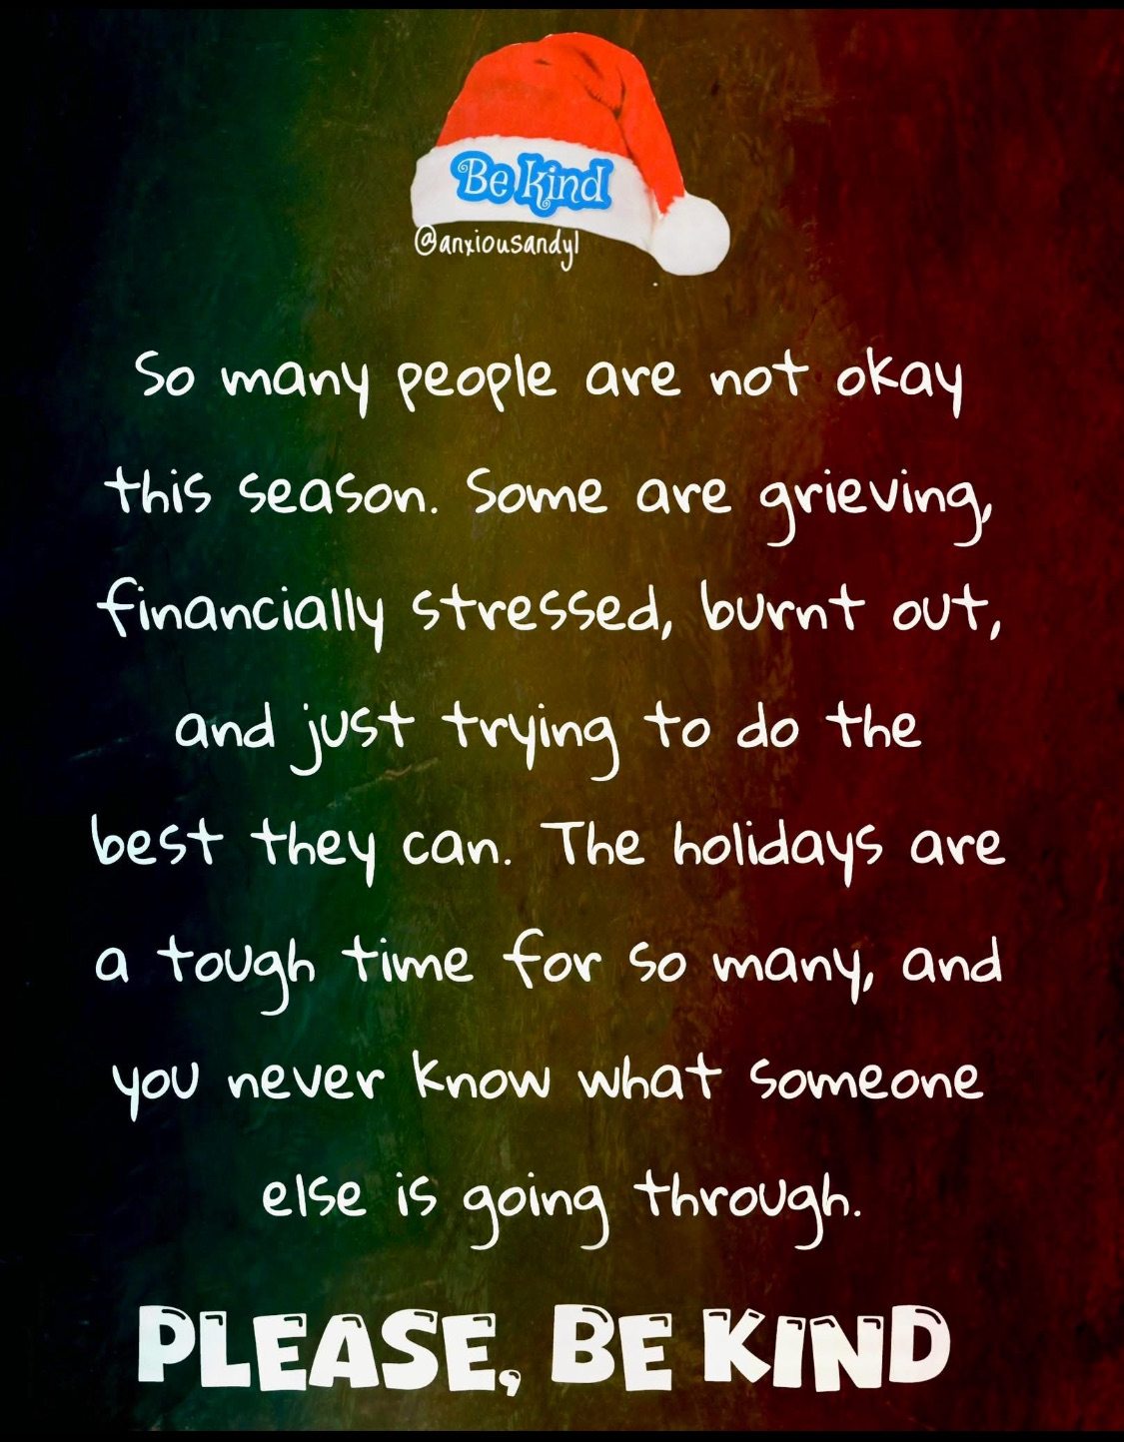
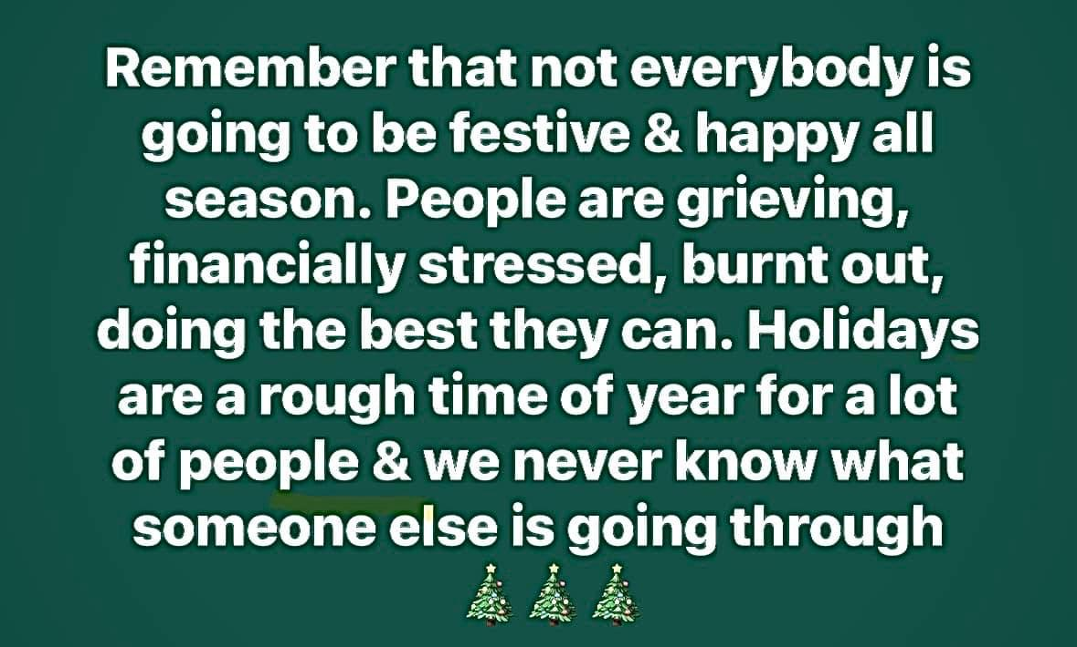

Slide 26
Which crimes spike over Christmas and why? | Metro News
Domestic abuse
visit Refuge’s website for support and information
Drink driving
There is a link between Christmas celebrations and a big increase in drink driving.
Rape/sexual assault
People tend to let their hair down at festive parties – perfect time for preditors to strike.
Burglary
Christmas tree lights illuminate the gifts underneath, making them enticing to a burglar.
Notes:
Christmas is a time for joy and celebration – but serious crime can be even more devastating if it happens in the holiday season.
And, rightly or wrongly, some types of crime are associated with the festive period.
But is there any truth to the stereotype that certain crimes see an increase at Christmas?
Domestic abuse
There are many factors that could spark physical or emotional abuse within the home at Christmas.
The stress of the holiday period, family tensions and being in close proximity with family for long periods can all contribute to an attack.
And an increased consumption of alcohol and drugs, at a party or while celebrating the holiday, can trigger abuse.
Sandra Horley CBE, chief executive of domestic abuse charity Refuge, said the charity actually receives fewer reports at this time of year.
But she believes that could be because the abuser is physically close-by more often than usual.
She said: ‘At Refuge, we actually receive fewer visits to our website, and fewer calls to the National Domestic Violence Helpline (run in partnership with Women’s Aid) around Christmas than we do at other times of the year.
‘It can often be very difficult for a woman experiencing domestic violence to access support during the festive period – a period when her abusive partner may be spending more time at home and monitoring her behaviour more closely than ever.’
If you think you may be experiencing domestic abuse, visit Refuge’s website for support and information
Drink driving
There is plenty of evidence to suggest a link between Christmas celebrations and a big increase in drink driving.
Many police forces around the country run annual drink driving campaigns, in a bid to catch motorists who go out for a few then get behind the wheel.
Whether it’s driving home after the Christmas party or taking a friend home after a boozy evening, people seem more relaxed about breaking this law in December.
It doesn’t matter how cold it is. It’s not worth it.
Rape/sexual assault
Many police forces are aware of the increased likelihood of rapes and sexual assaults in winter.
People tend to let down their hair at Christmas dos – and the joyful atmosphere can be the perfect time for an attacker to strike. Officers believe that many use alcohol as an excuse for committing sexual assaults.
Burglary
An invasive, upsetting crime, burglary is possibly even more tragic at Christmas.
While there is a risk of being burgled throughout the year, it can be greater at Christmas.
New items may be on display, and the Christmas tree may illuminate the gifts underneath, making them enticing to a burglar.
Burglars often target items they can easily carry – such as laptops, jewellery, and money.

Slide 27
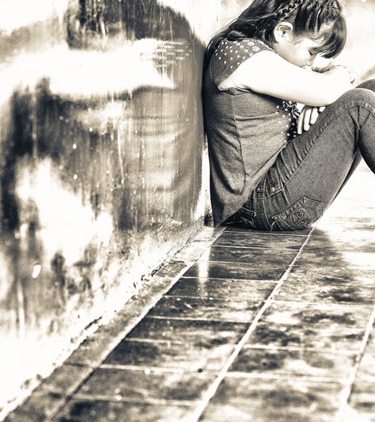
Domestic Violence during the festive season
The Christmas period typically sees a rise in police responses to domestic abuse incidents.
Research has indicated an estimated 15,000 children will be exposed to domestic abuse during the two-week festive period in 2025/26.
Factors which can contribute to domestic violence include:
Financial stress
Alcohol consumption
The pursuit of a 'perfect' Christmas, and
Prolonged close quarters

Slide 28
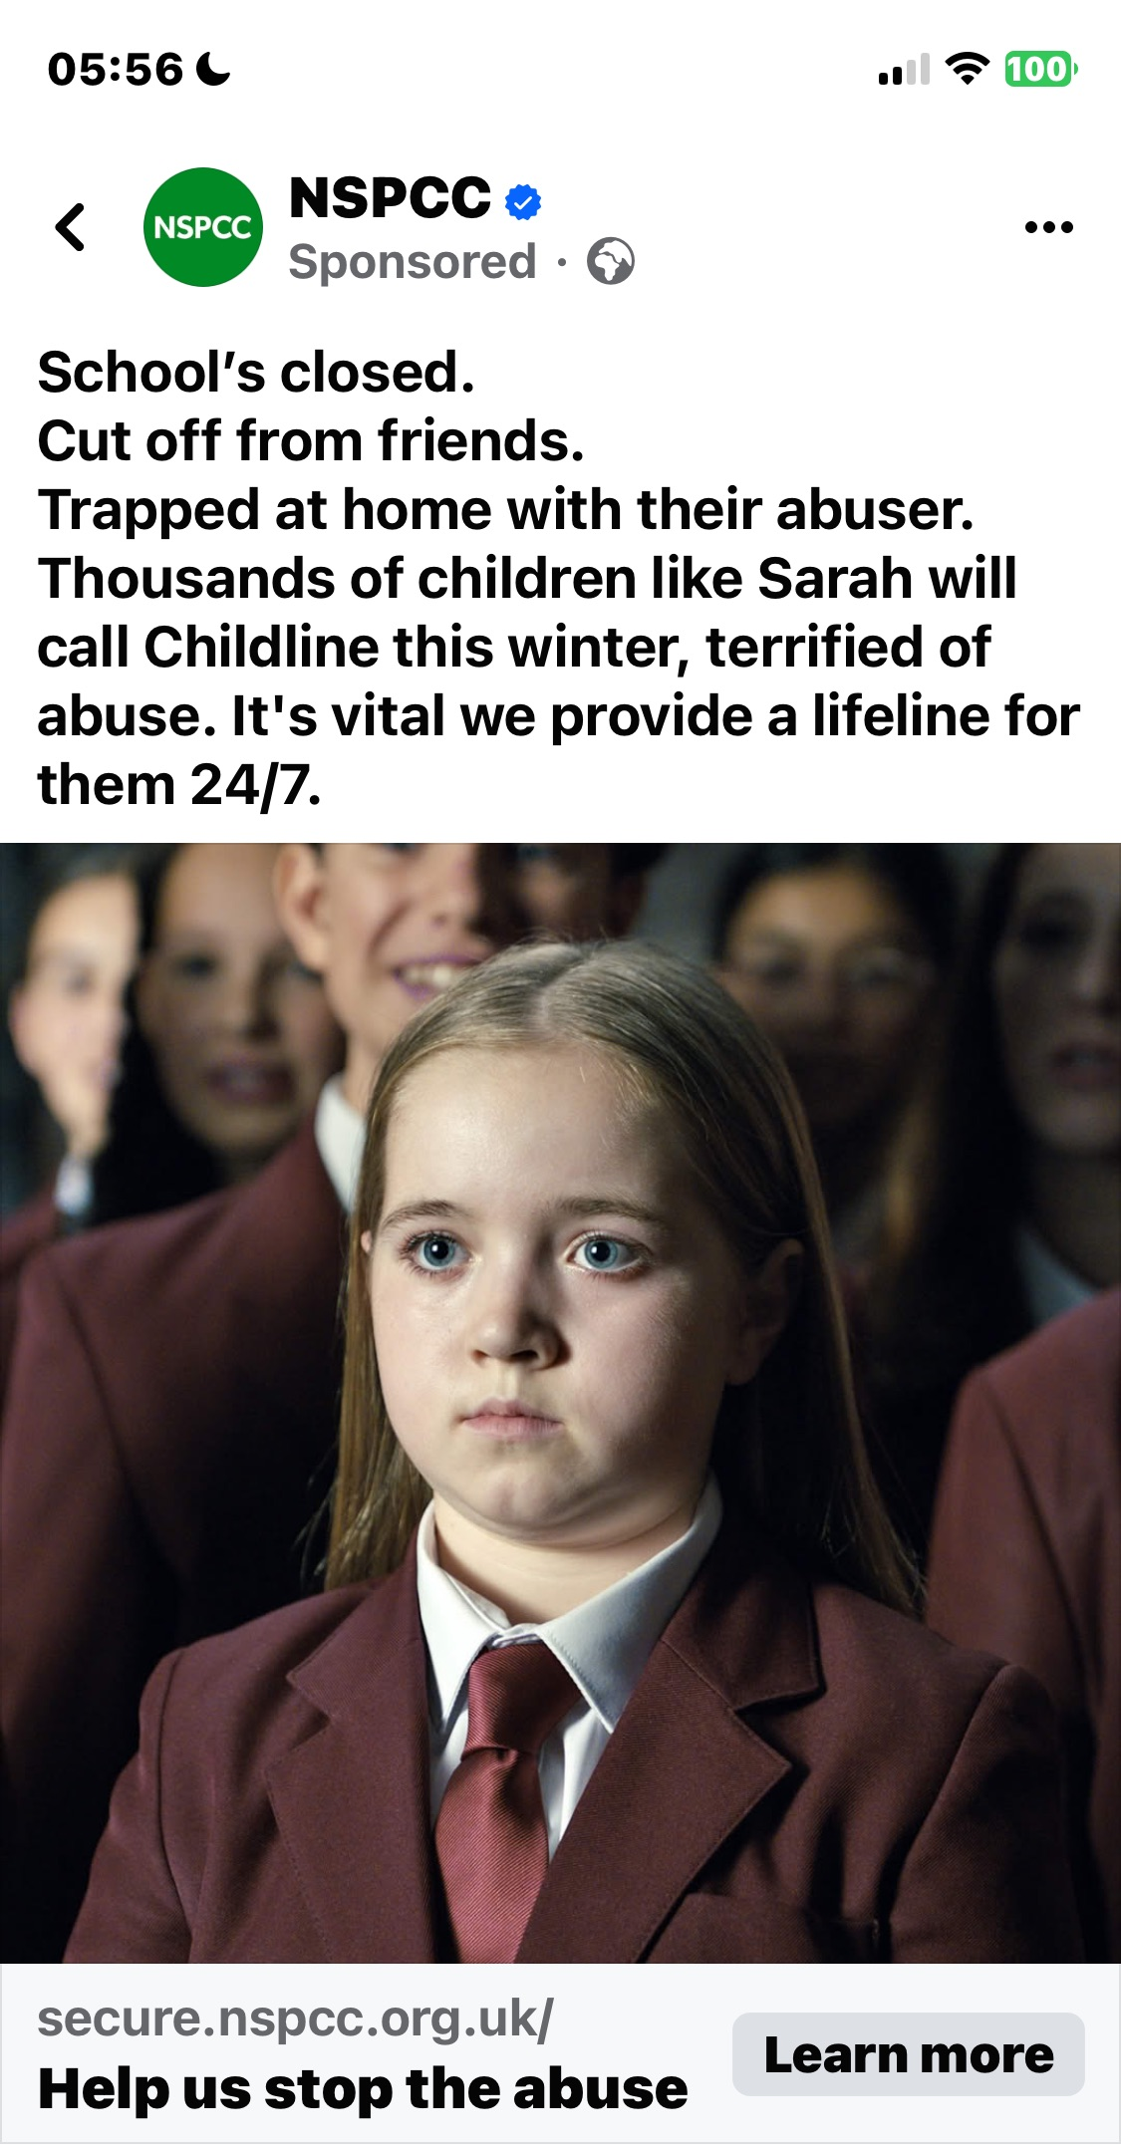
The avenues for support or to report are reduced.
https://www.youtube.com/watch?v=ePFKarsV1oQ

Slide 29
What Drives the Increase in Incidents?
It is crucial to acknowledge that incidents tend to rise during Christmas, & after events such as sporting football games /tournaments.
These occurrences do not cause abuse but provide perpetrators with excuses to exert more power and control over their intimate partners.
Perpetrators of abuse make a deliberate choice to act abusively and should always be held accountable for their actions.
Many abusers exploit the Christmas period and other factors such as alcohol, financial stress, or mental health issues to justify their abusive behaviour or, more commonly, to blame their victims for the abuse.
The festive period compounds difficulties for victims, with fewer opportunities to report abuse and limited avenues for seeking safety.
Additionally, school closures during the holidays restrict children's opportunities to report abuse and access support.
Why is There an Increase in Domestic Violence During the Christmas Season? | Derwent Rural Counselling Service (drcs.org.uk)

Slide 30
When Christmas Doesn’t Feel Merry: Understanding Domestic Abuse During the Festive Season
Christmas is often described as a joyful time, full of family, celebration and light. But for parent's children and babies living with domestic abuse, this season can feel very different.
Instead of warmth and connection, there may be anxiety, uncertainty or fear. The Guardian reported that during Christmas, some charities have noted a 15% increase in domestic abuse-related calls to their helplines.
https://forbabyssake.org.uk/news/2025/11/21/domestic-abuse-at-christmas/
According to the Femicide Census, there has been no tangible decline in femicide since it first started recording data in 2009: a woman has been killed by a man, on average, once every three days over a 10-year period. Another three women are said to die by suicide every week after enduring abuse.
Changing this will be – in the words of the safeguarding minister, Jess Phillips – a “herculean” task, but it’s one that is at least being attempted. In the coming weeks, the government will release more details of its strategy to halve violence against women and girls (VAWG) in a decade. Watch this space.
https://www.theguardian.com/commentisfree/2025/jan/02/domestic-abuse-violence-against-women-and-girls-labour
Notes:
“Domestic Homicide Reviews have been gathering vital learning to prevent future deaths since 2011. Until now, there has been no national mechanism to oversee the implementation of the changes these important reviews call for. Too often, this leads to stagnation and the vital changes to save lives are not made.
“That’s why I’m launching this domestic homicide oversight mechanism to hold public bodies and national government to account so that they take the important steps to preventing future deaths. I want to see cross-governmental leadership to ensure that all agencies – from health to children’s services - make ending domestic homicide a priority.”

Slide 31
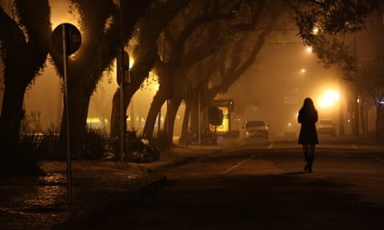
Christmas: the season for bells, baubles and …
… blaming victims of sexual assault

Slide 32
Campaigns that make it the responsibility of women to avoid sexual assault at parties only entrench damaging stereotypes. The idea that a rapist is almost always a stranger in a dark alleyway is erroneous.
According to Rape Crisis, around 90% of rapes are committed by perpetrators known to the victim – such as a colleague, a friend or a partner – meaning that it simply isn’t true that women are safer at home or at work than in public spaces. Advice to women to moderate their lives to avoid rape fails to consider the wider picture and reinforces unhelpful stereotypes.
If we advocate restricting women’s movement in response to stranger assaults in public spaces, should we also address the vastly more common problem of rape within relationships and advise women to take “precautions” by avoiding their own homes? Should women avoid going to work because of the risk of being assaulted by a male colleague? Clearly not.
It’s impossible to tell women how to “avoid” sexual violence, because it’s so widespread that it happens in all places, regardless of women’s dress, age, behaviour or any other factors they could control.
There is, however, one common factor that unites all these cases: the rapist. Logically, that’s where the focus of our attention should lie.
Christmas: the season for bells, baubles and blaming victims of sexual assault | Women | The Guardian
7 steps to staying safe when out this Christmas | Crimestoppers (crimestoppers-uk.org)

Slide 33
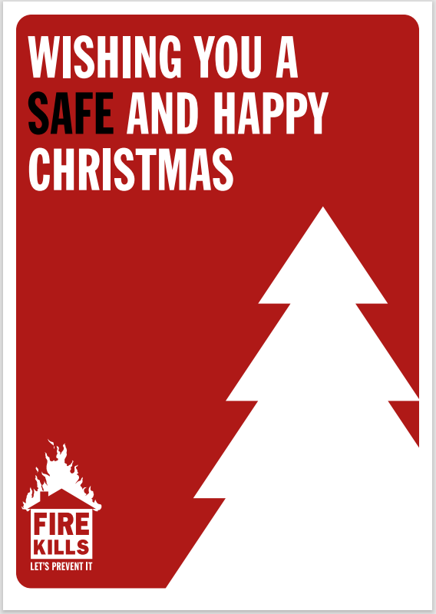
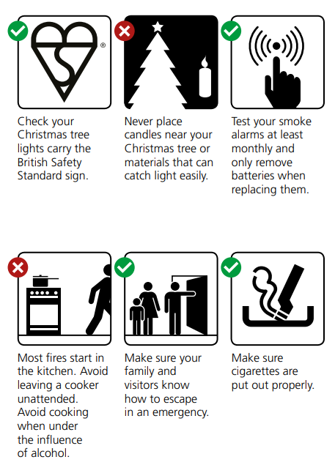
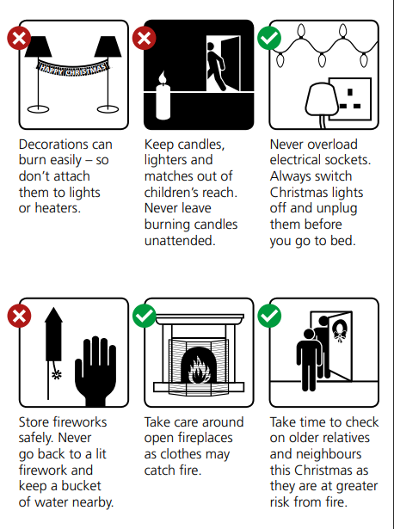
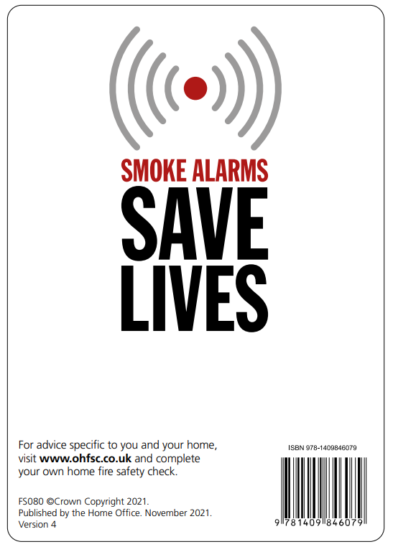
Some harms and risks are unique to how the Holidays are celebrated
Fire Kills Let's Prevent It: Fire Safety at Christmas (publishing.service.gov.uk)
Notes:
https://assets.publishing.service.gov.uk/media/6287b424d3bf7f1f45380309/Wishing_you_a_Safe_and_Happy_Christmas_v4_-_Web_accessible.pdf

Slide 34
This winter’s staffing crisis in health & social care
The UK is experiencing a significant winter staffing crisis for 2025/26, particularly in the NHS and social care sectors, driven by long-term staff shortages, high demand, financial constraints, and industrial action. This situation is exacerbated by a deepening economic downturn and ongoing challenges from seasonal illnesses, with staff ‘flu vaccine uptake at a record low.
All indicators point toward a difficult winter ahead.
Demand is rising across A&E and GP services.
Costs are increasing, squeezing NHS, care providers and councils alike.
Workforce shortages continue to strain both the NHS and the social care sector.
If emergency funding or structural support does not arrive in time, communities could see a tangible reduction in available care — especially for the elderly, disabled, and those living in poverty.
Ref: https://www.bct-group.co.uk/bee-informed-articles-blogs-and-resources/winter-2025-pressures-on-the-care-sector/#:~:text=All%20indicators%20point%20toward%20a,and%20those%20living%20in%20poverty.
https://www.england.nhs.uk/long-read/urgent-and-emergency-care-plan-2025-26/

Slide 35
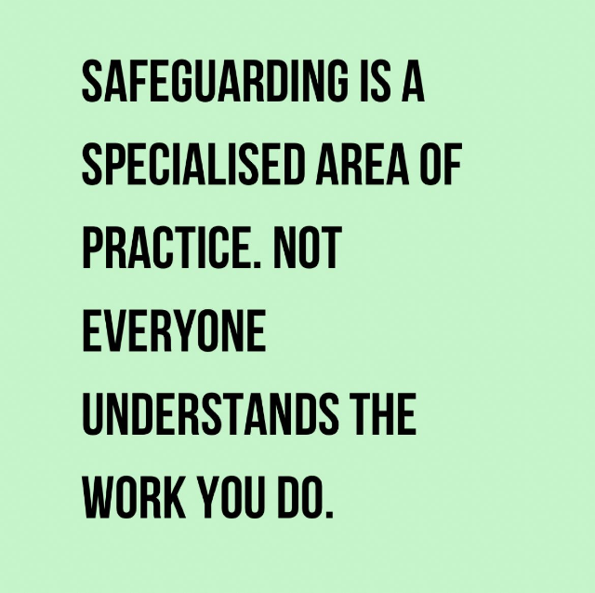
Being in Safeguarding does not mean we are immune;
it can be a lonely role and we know incidences can increase over the Holidays

Slide 36
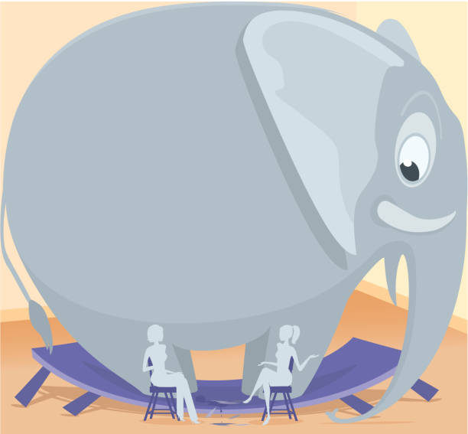

Slide 37
The elephant in the room
The 2025/26/27 transformation for NHS England and Integrated Care Boards (ICBs) are years of significant change focused on financial reset, efficiency, and a shift towards strategic commissioning.
Key aspects include major cost reductions, a new oversight framework, a move to "neighbourhood health services", and initial ICB mergers.
With the opening of the voluntary redundancy scheme earlier this month, the future continues to look uncertain for both NHSE and ICB professionals.
The challenges moving into 2026 can only be met by pulling together and keeping the lines of communication open across our regional safeguarding family.
https://www.kingsfund.org.uk/insight-and-analysis/blogs/icb-cuts-what-does-it-mean
https://www.england.nhs.uk/long-read/working-together-in-2025-26-to-lay-the-foundations-for-reform/

Slide 38
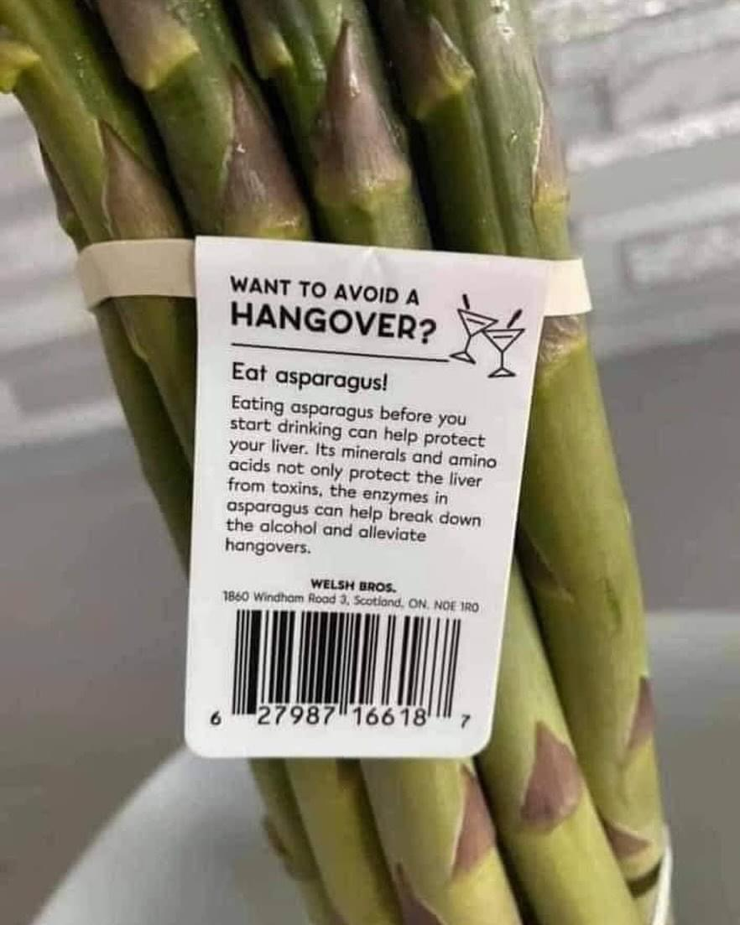
It’s not all bad though!
Social Media is awash with helpful … and sometimes maybe not so helpful advice
Notes:
Plain slide with subhead and bullets

Slide 39
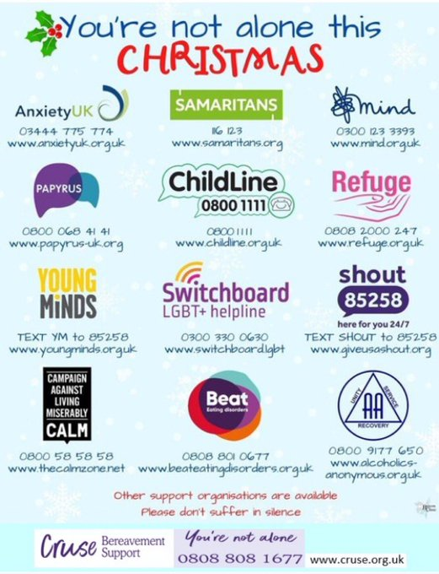
Such these useful helplines

Slide 40
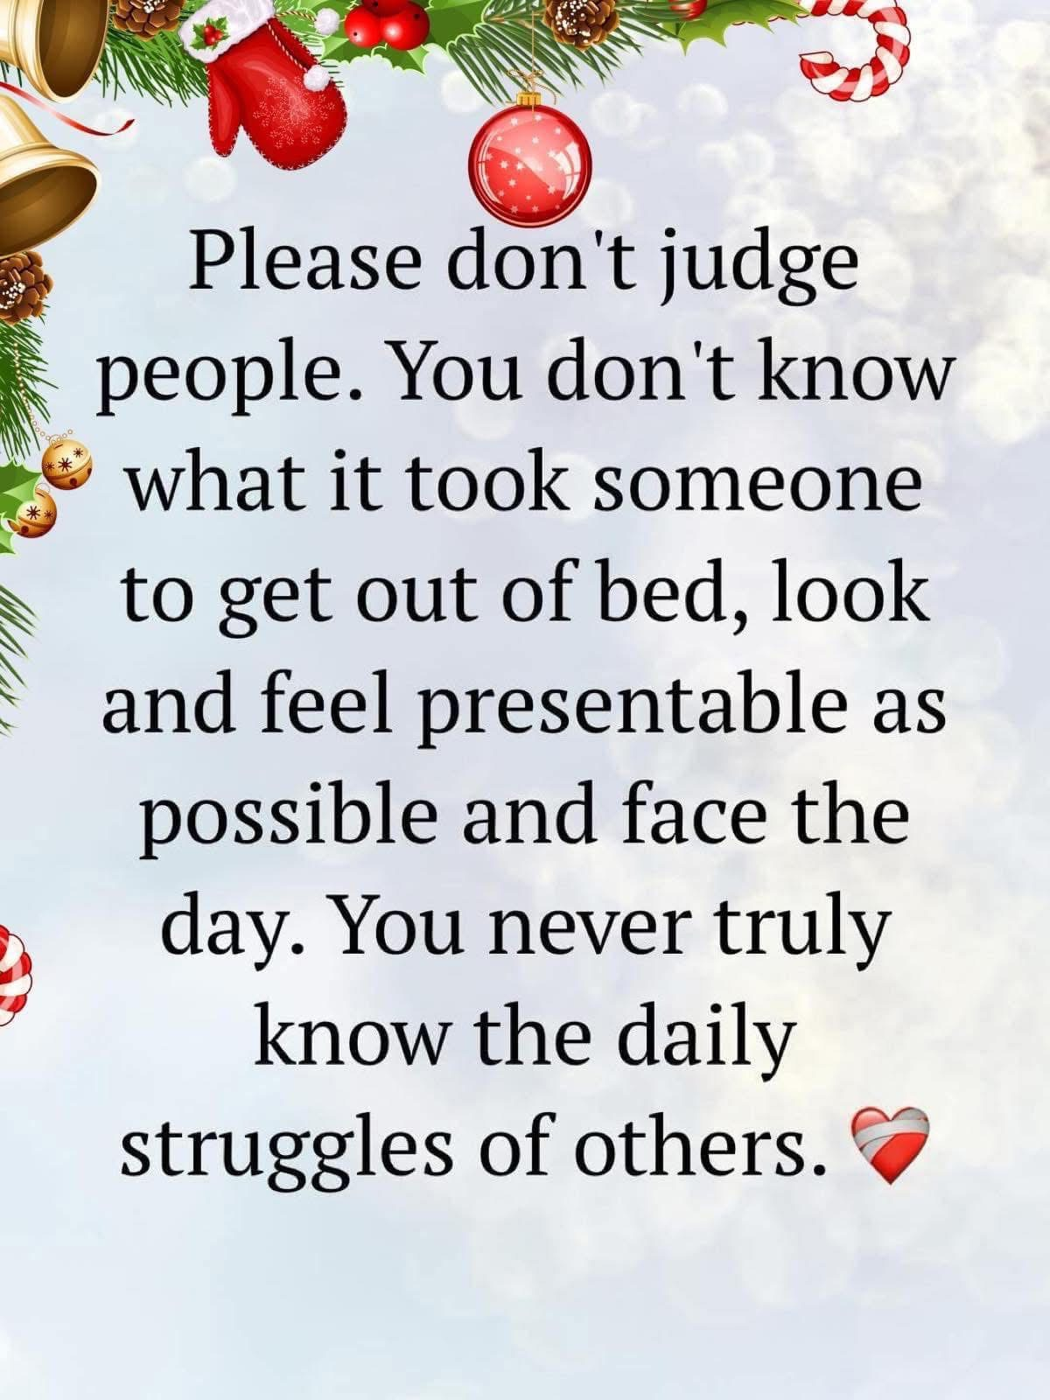
Bereavement Support organizations
Cruse Bereavement Care: Offers free, confidential support via telephone, email, or face-to-face. Call 0808 808 1677.
Sands: Supports those affected by the death of a baby. Call 0808 164 3332 or visit sands.org.uk.
Child Bereavement UK: Offers support for families and professionals when a child dies or when a child is grieving. Call 0800 02 888 40.
Bereavement Advice Centre: Provides advice on all aspects of bereavement. Call 0800 634 9494.
The Miscarriage Association: Offers support and information for those affected by pregnancy loss. Call 01924 200 799 Monday to Friday, 9am to 4pm.
The National Bereavement Service: Provides guidance on practical and legal aspects of bereavement via a helpline, email, or webchat.

Slide 41

Our telephone helpline will continue to operate over the festive period, and is open Monday to Friday, from 9am – 6pm on 0808 808 7777 including Christmas Day, Boxing Day, and New Year’s Day. Our email helpline service will be offering a reduced service from Wednesday 17 to Friday 19 December. The email service will be closed for the Christmas and New Year period and will reopen on Monday 5 January 2026. Please note that responses may take longer than usual during this period. If you need somebody to talk to or a listening ear, the Samaritans are available 24/7 and can be reached by telephone on 116 123 or by email at jo@samaritans.org
Our Helpline hours over Christmas and New Year

Slide 42

For confidential support contact our Stop It Now helpline
0808 1000 900
Stop It Now services over the holiday period:
Christmas: our helpline will close at 4pm on 24 December and reopen at 9am on 29 December 2025.
New Year: our helpline will close at 4pm on 31 December and reopen at 9am on 2 January 2026.
Watch and share these resources to empower young people to seek support and make safer choices.
What to do if you’ve shared a nude
What to do if you’ve had sexual thoughts about children
What to do if you’re worried about a friend’s sexual behaviour
For more information, please visit our website

Slide 43
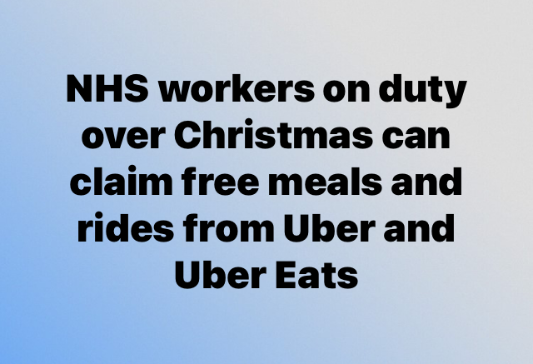
Full page image slide
There are moments when the wider public realise just how hard NHS staff work with tokens of appreciation
Eligible workers should link their official NHS/HSC email address to their Uber account by 20th December 2025, to receive two free £10 Uber rides and one £10 Uber Eats voucher for use on Christmas Eve and Christmas Day
Notes:
Uber is expected to offer free rides and meals to NHS and Health and Social Care (HSC) workers for Christmas 2025, continuing a past initiative. Eligible workers should link their official NHS/HSC email address to their Uber account by December 20th, 2025, to receive two free £10 Uber rides and one £10 Uber Eats voucher for use on Christmas Eve and Christmas Day.

Slide 44
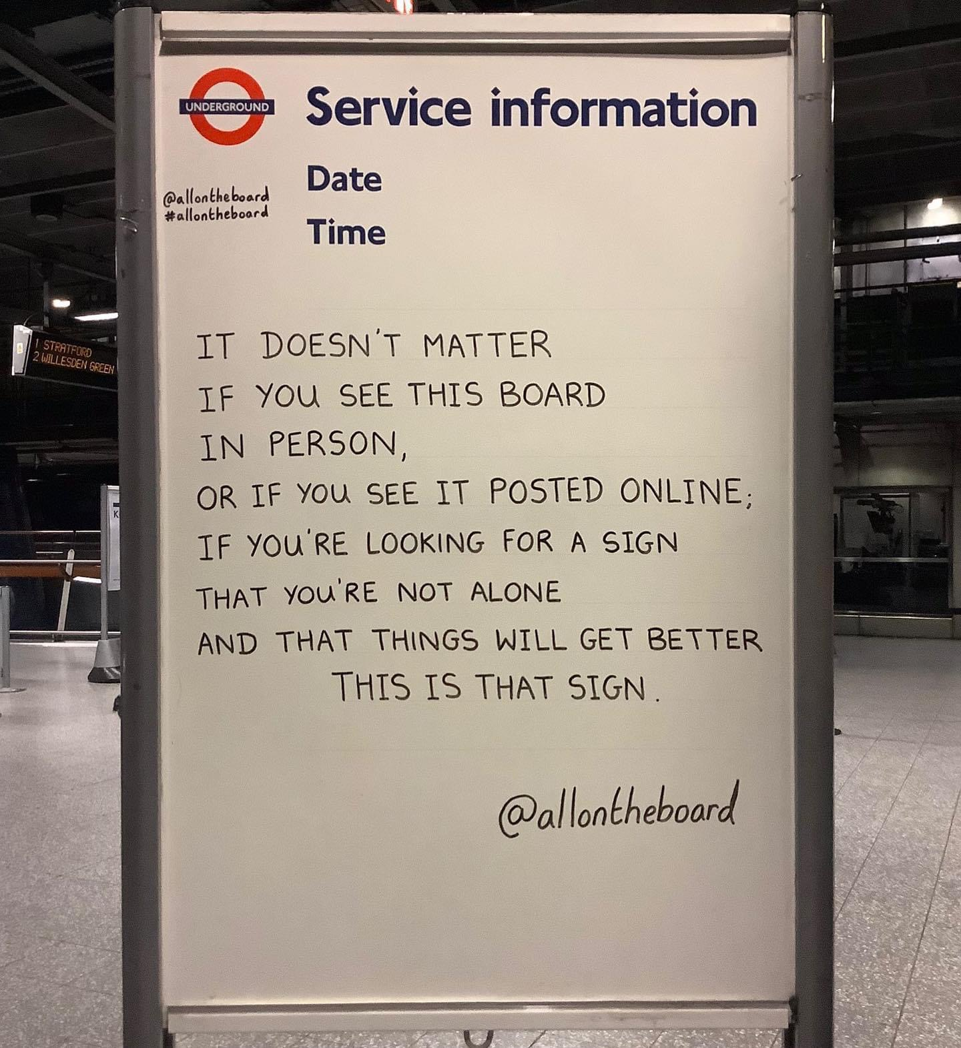
Self Permission

Slide 45
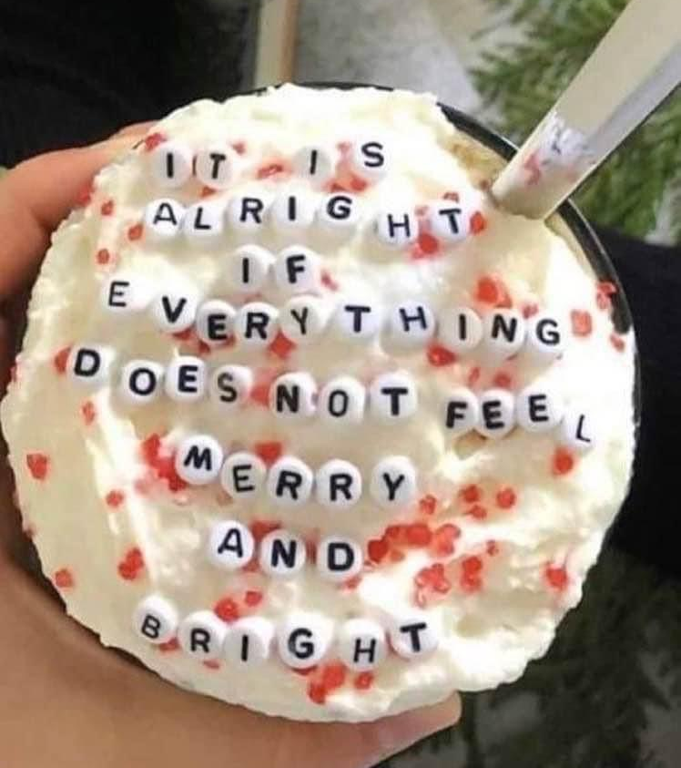
And acceptance

Slide 46

I love the
kind
and uplifting
messages
that flood
social media

Slide 47

like this ☺

Slide 48
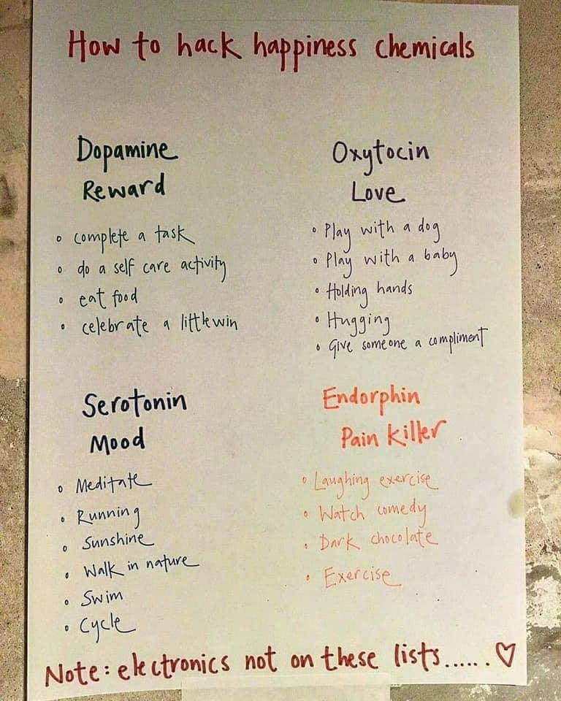
Grey image slide with small text column
Happiness
Hacks!

Slide 49
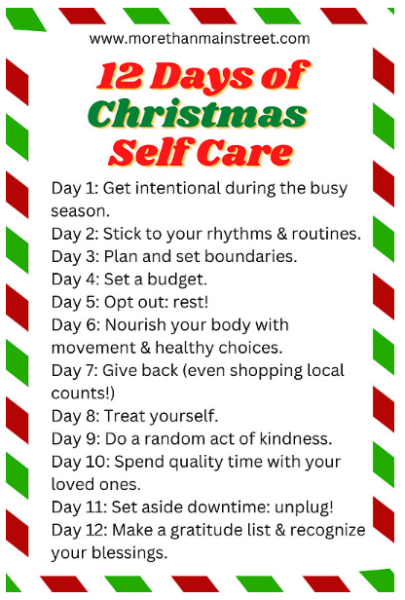
Self-care on the build-up to Christmas is critical …

Slide 50
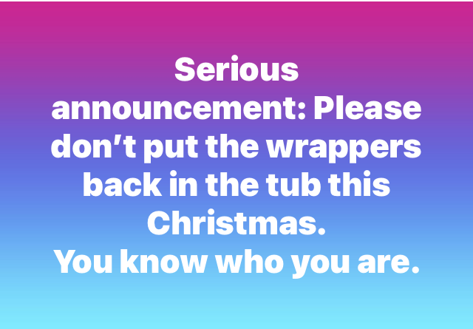
It’s
important
to find
the
lighter side

Slide 51
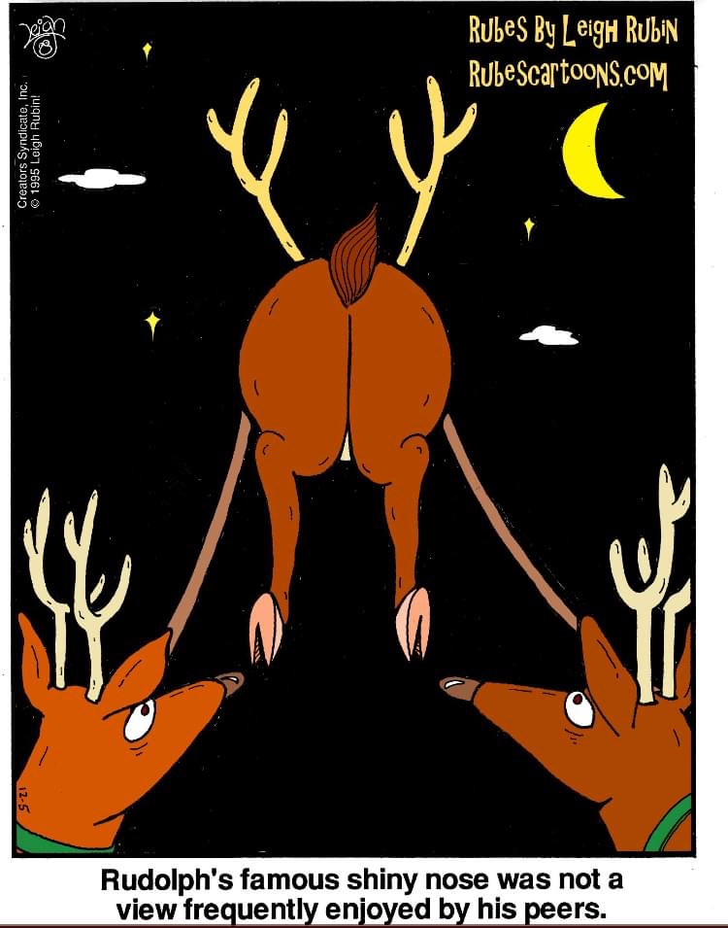
There is a great deal of humour to be found during the Holiday period

Slide 52
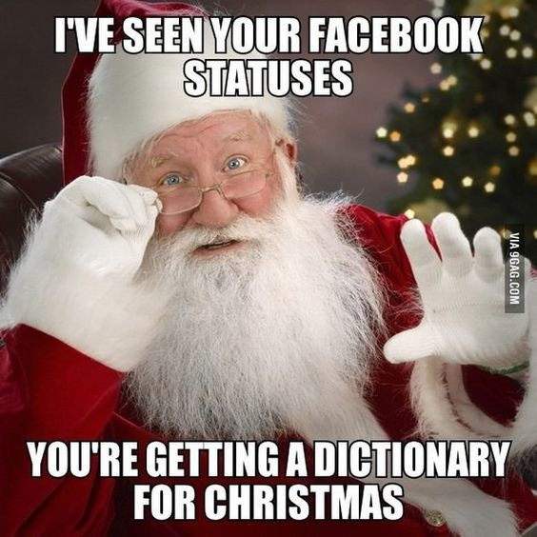
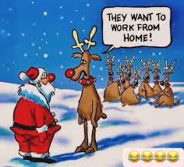
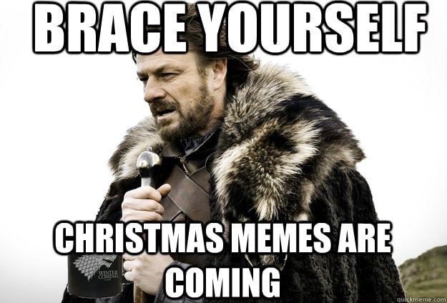
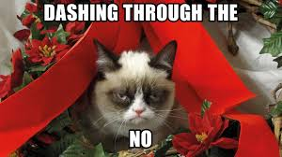
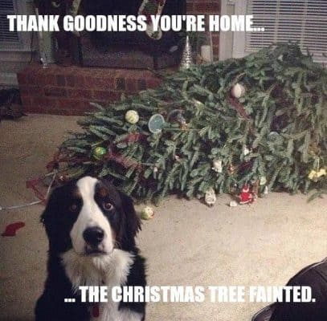
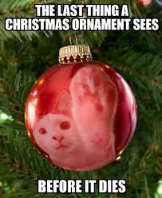
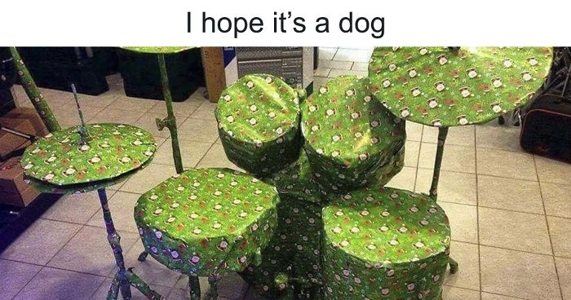

Slide 53
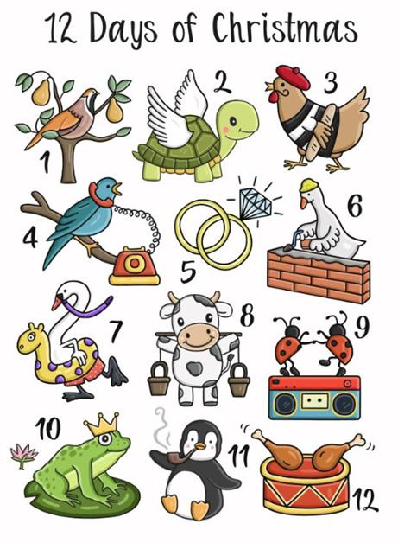
I bet you have this song in your head now!
On the twelfth day of Christmas
My true love sent to me …
Twelve drummers drumming
Eleven pipers piping
Ten lords a leaping
Nine ladies dancing
Eight maids milking
Seven swans a swimming
Six geese a laying
Five golden rings!
Four calling birds
Three French hens
Two turtle doves
And a partridge in a pear tree!

Slide 54
Festive Quiz! (office.com)

Slide 55
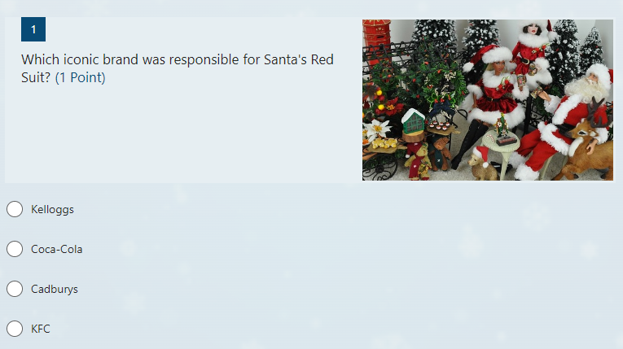

Slide 56
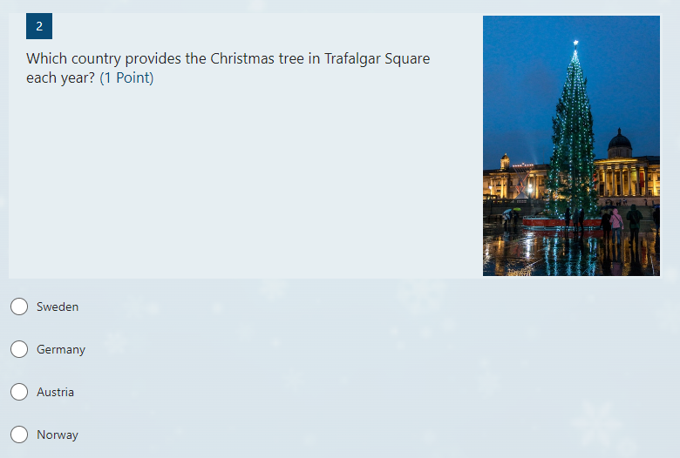

Slide 57
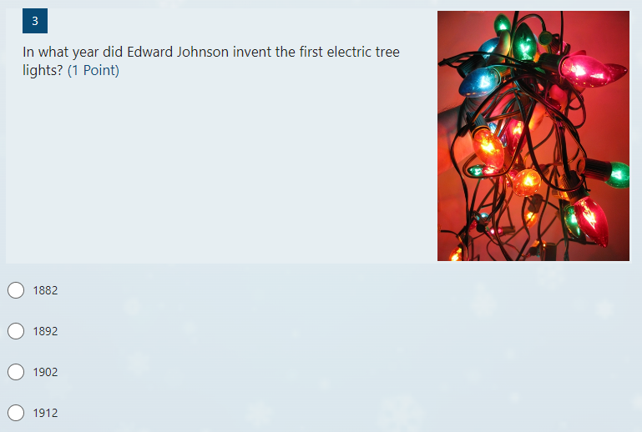

Slide 58


Slide 59


Slide 60


Slide 61


Slide 62


Slide 63


Slide 64


Slide 65


Slide 66


Slide 67


Slide 68


Slide 69


Slide 70


Slide 71


Slide 72


Slide 73


Slide 74


Slide 75


Slide 76


Slide 77


Slide 79


8 amazing (and weird) Victorian facts about the history of Christmas in the UK
The first Christmas crackers were known as ‘Bangs of Expectation’
Victorian Christmas cards were the stuff of nightmares
Beer was once a popular present for young boys (is that a Safeguarding issue?)
Our Christmas tree tradition came from Germany
The idea that Coca Cola first dressed Father Christmas in red and white is a myth (it was actually the Victorians).
Mince pies were originally shaped like coffins and contained meat, fruit and spices.
Queen Victoria’s Christmas dinner was sent to the Isle of Wight by train and royal yacht, because it was cooked at Windsor Castle – probably cold by the time it arrived!
On Christmas Day in 1851 temporary London kitchen fed 22,000 people, and got through 5,000lbs of plum pudding!
BBC Radio 4 - You're Dead to Me - 8 amazing facts about the history of Christmas

Slide 80
Please feel free to share this link wider with colleagues and partners, and providers across the region who may be interested or will benefit from these learning opportunities.
NHSE Safeguarding Training Thursday sessions provide free L3, L4 & L5 Safeguarding training
Third Thursday of every month 12:30-13:30 via MST
For training, resources and to listen back to any of our previous training sessions (plus bonus sessions!) please visit our online learning platform at:
East Safe Guarding Learning Platform - NHS training videos
If you have any questions, please email us at: england.eastsfageuarding@nhs.net

Slide 82


End slide
Chelle.farnan@nhs.net
(3) Chelle Farnan (She/Her) (@Chelleefarnan) / X (twitter.com)

