Slide 1
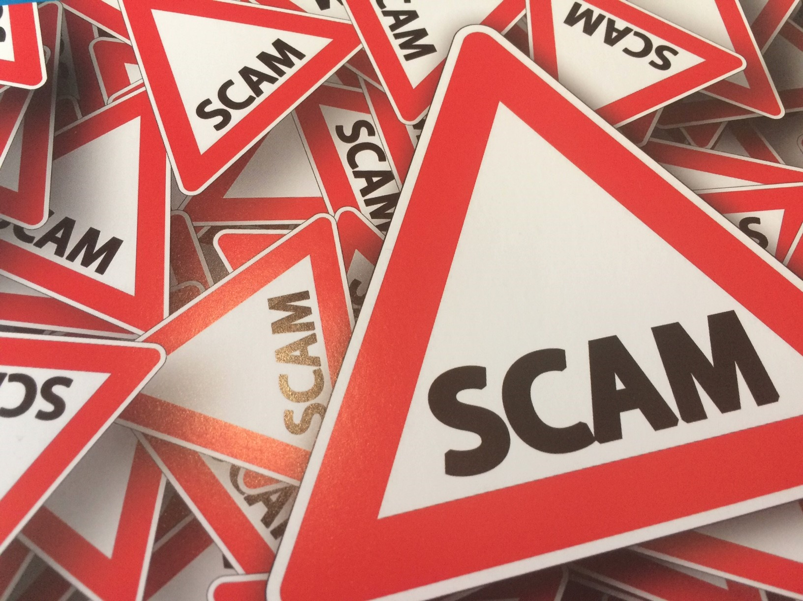
Trading Standards
Working to combat Scams,
Doorstep Crime & Fraud
Stephen Maunder – Communities Officer
Norfolk County Council Trading Standards Service

Slide 2

Who are Trading Standards and what do they do?
We protect consumers and businesses by enforcing a wide range of government legislation.
Our work covers the following areas:
Age Restricted Sales, Illicit Tobacco & Vapes
Weights and Measures
Fair Trading
Explosives
Product Safety
Food Standards
Intellectual Property
Animal Feed
Animal Health & Welfare
www.norfolk.gov.uk/scams

Slide 3

East of England Trading Standards Association
EETSA is the regional body for the Trading Standards Authorities in the East of England to support these authorities by coordinating work, allocating projects, and providing best practice advice and guidance on enforcement matters
Bedford
Cambridgeshire
Central Bedfordshire
Essex
Hertfordshire
Luton
Norfolk
Peterborough
Southend-on-Sea
Suffolk
Thurrock
www.norfolk.gov.uk/scams

Slide 4
Be Scam Aware
What is a Scam – It is a Fraud – criminal activity and financial abuse perpetrated against consumers and businesses
Designed to steal
Personal information
Financial details
Money
Many scam victims are repeatedly targeted which can lead to them becoming chronic victims
Scams are Fraud and Fraud is a Crime.
www.norfolk.gov.uk/scams

Slide 5
Some key facts
In 2022 UK losses to cybercrime and fraud totaled £1.7bn
Fraud represents 40% of all crime – largest crime type in England & Wales
86% of fraud instances are estimated to go underreported (NCA 2023)
Around nine in ten online adults in the UK (87%) have come across content they suspected to be a scam or fraud (Ofcom 2023)
www.norfolk.gov.uk/scams

Slide 6
Some key facts
53% of people aged 65 plus have been targeted by scams. An older person becomes a victim of fraud every 40 seconds (Age UK)
1 in 5 adults believe they are likely to become a victim of a scam in the next 5 years (NTS Scams Team)
www.norfolk.gov.uk/scams

Slide 7
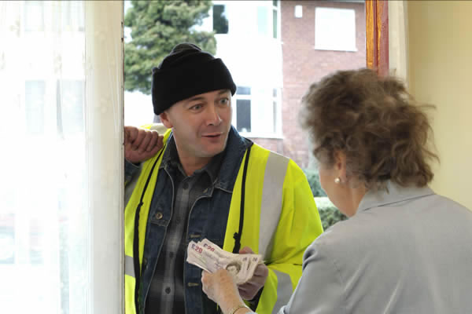
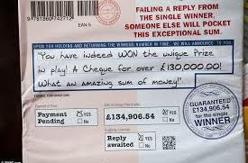

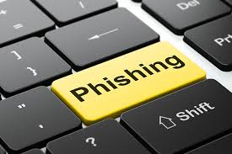
Types of Scams
Doorstep
Postal
Telephone
Online
www.norfolk.gov.uk/scams

Slide 8

Be Scam Aware
Current Doorstep Scams
Roofing – cleaning / repairs
Insulation – free checks / spray foam
Solar panels
Driveways
Trees, hedges & gardens
Doorstep sales
Gold
www.norfolk.gov.uk/scams

Slide 9

Be Scam Aware
Current Telephone/Text/WhatsApp Scams
‘Courier’ scams
Digital telephone switchover
Winter fuel payments
Parking - QR codes, fake PCNs
White goods warranties
Parcel delivery
Medical
Hello Mum/Dad…I’ve lost my phone
Employment opportunities
www.norfolk.gov.uk/scams

Slide 10

Be Scam Aware
Current Postal Scams
Clairvoyants and psychics
Prize draws
Lotteries
Unclaimed inheritance
Advance fee frauds
www.norfolk.gov.uk/scams

Slide 11

Be Scam Aware
Current Online Scams
Surveys for ‘free’ items
HMRC / DVLA / GOV.UK
‘Failed’ direct debits
Investments including deepfake and AI videos
Bank emails ‘we’re refreshing our appearance…’
Anti virus
www.norfolk.gov.uk/scams

Slide 12
Be Scam Aware
The Psychology of Scams
Authority
Government agencies (HMRC, DVLA), Banks, Police, Councils, Investments (celebs)
Urgency
Royal Mail delivery, Apple ID expiring, Claiming payments
Emotion
Competition wins, ‘Hello Mum/Dad…’ WhatsApp messages
Scarcity
Claim now, 6 months bus travel for £3 only 150 items available!
Current Events
Winter Fuel Payments…
www.norfolk.gov.uk/scams

Slide 13
Be Scam Aware
But it’s only a scam…
‘The word “scam” not only minimises the perceived financial detriment and personal impact a consumer faces but also gives a sense that there is a level of culpability or contributory negligence. This further decreases the already low probability of such a fraud being reported. It is perceived as being “only” a scam and the victim feels embarrassed, ashamed or guilty’.
Chartered Trading Standards Institute
www.norfolk.gov.uk/scams

Slide 14
#NoBlameNoShame
www.norfolk.gov.uk/scams

Slide 15
Effects of being scammed
Financial
Mental health
Physical health
Loss of trust
Loss of sense of security
Loss of confidence
Credit Score
More than a third (34%) of all victims also reported that the experience had an immediate negative impact on their mental health, increasing to nearly two-thirds (63%) among those who had lost money.
Ofcom ‘Scale and impact of online fraud’ – March 2023
Which? published a report on the link between scam victimisation and wellbeing. They estimate the additional non-financial wellbeing cost of scams at £9.3bn for 3.7m incidents of fraud between 2019-20
Which? 2021
www.norfolk.gov.uk/scams
Notes:
Financial – immediate funds / ability to meet costs / future financial security
Mental Health – Anxiety / Shame / Guilt / Embarrassment / Anger / Depression / Fear / Grief
Loss of Trust – Government / Organisations / Contacts / Family
Security – In own home / Using web etc / Banks and Finances
Confidence – Dealing with finances / contacts
Credit Score – Especially with Identity Fraud

Slide 16
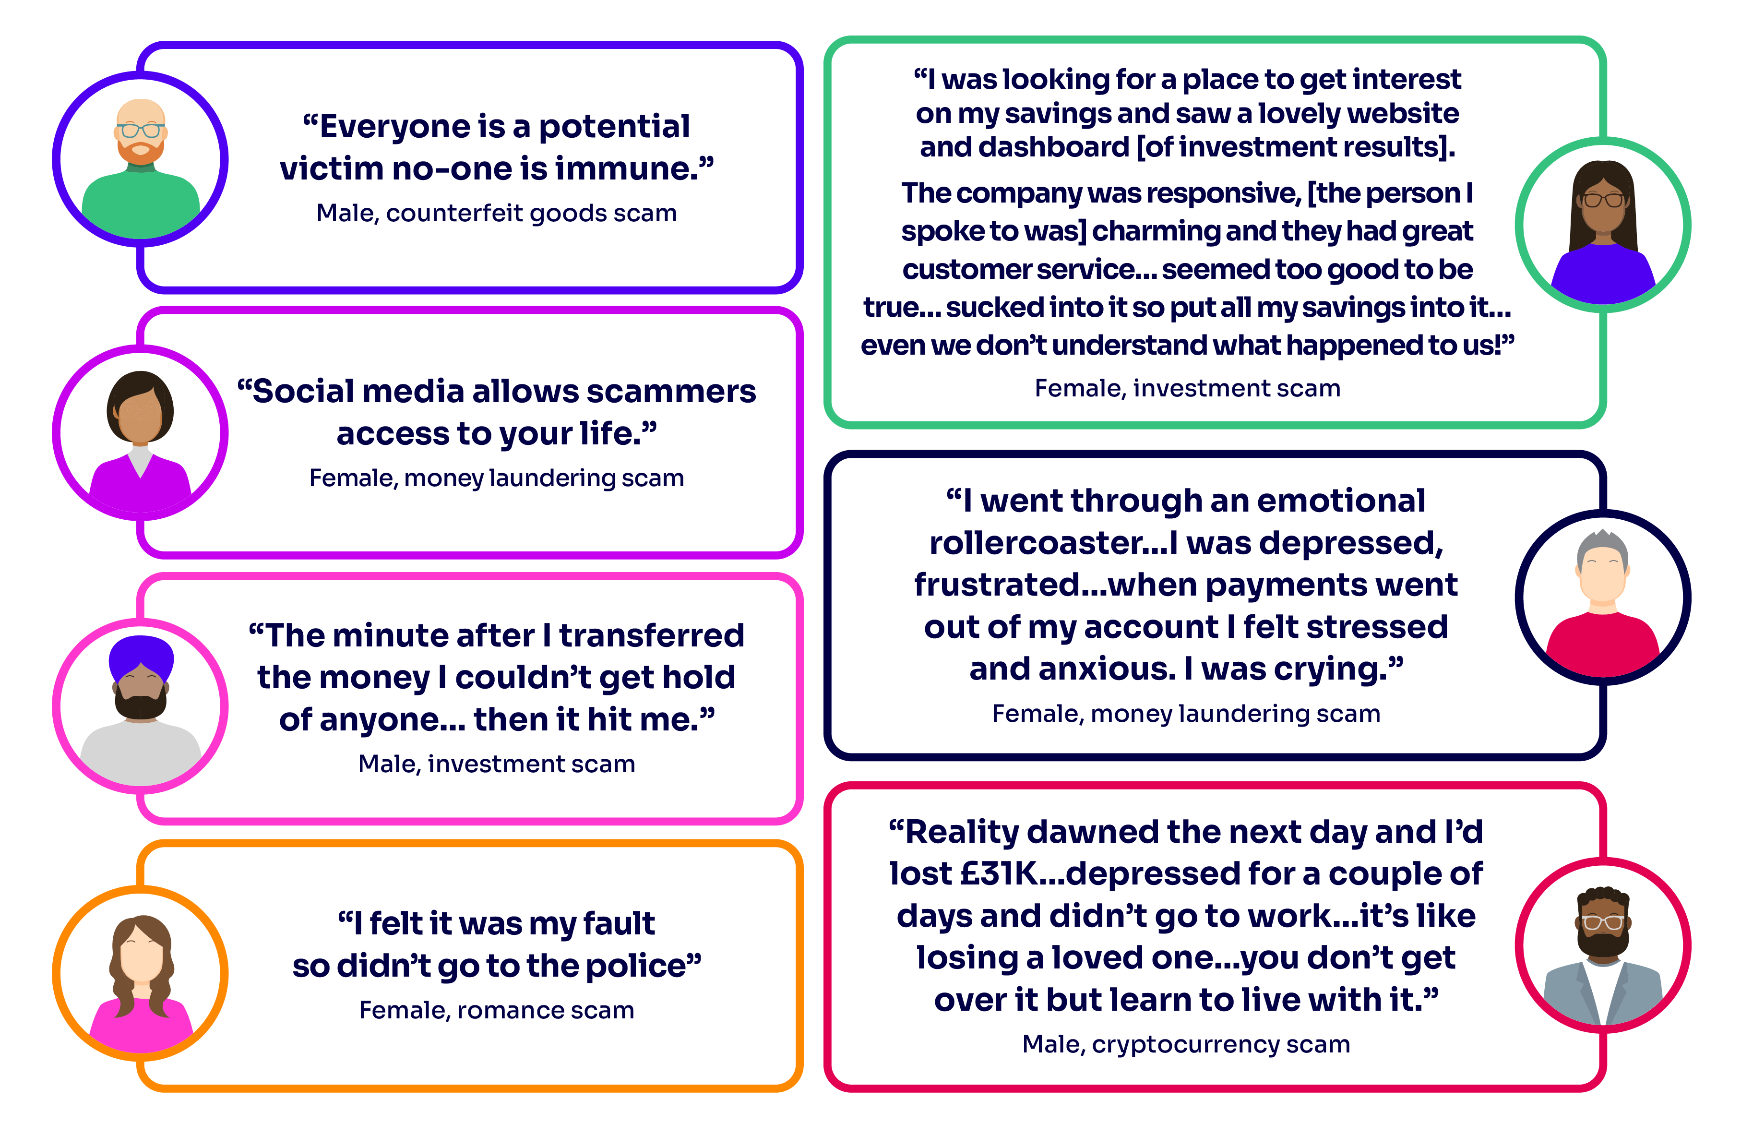
Who can become a victim
Ofcom ‘Scale and impact of online fraud’ – March 2023
www.norfolk.gov.uk/scams
Notes:
Financial – immediate funds / ability to meet costs / future financial security
Mental Health – Anxiety / Shame / Guilt / Embarrassment / Anger / Depression / Fear / Grief
Loss of Trust – Government / Organisations / Contacts / Family
Security – In own home / Using web etc / Banks and Finances
Confidence – Dealing with finances / contacts
Credit Score – Especially with Identity Fraud

Slide 17
Be Scam Aware
Stop. Challenge. Protect.
Stop
Take a moment to stop and think before parting with your money or information. It could keep you safe
Challenge
Could it be fake? It’s ok to reject, refuse or ignore any requests. Only criminals will try to rush or panic you
Protect
Think you’ve shared financial information contact your bank or card provider immediately
www.norfolk.gov.uk/scams

Slide 18
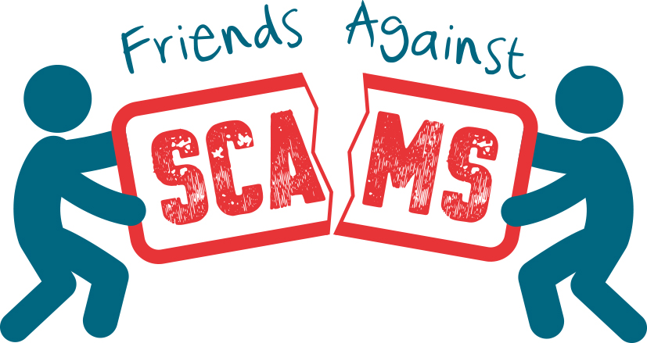
Friends Against Scams
Friends Against Scams is a National Trading Standards Scams Team training programme
By completing a Friends Against Scams awareness session in person or online, anyone can learn about different types of scams and how to spot and support a victim
Additional follow-on unit designed for health and social care staff
Anyone can be a Friend Against Scams and make a difference in their own way
Visit www.friendsagainstscams.org.uk
www.friendsagainstscams.org.uk

Slide 19
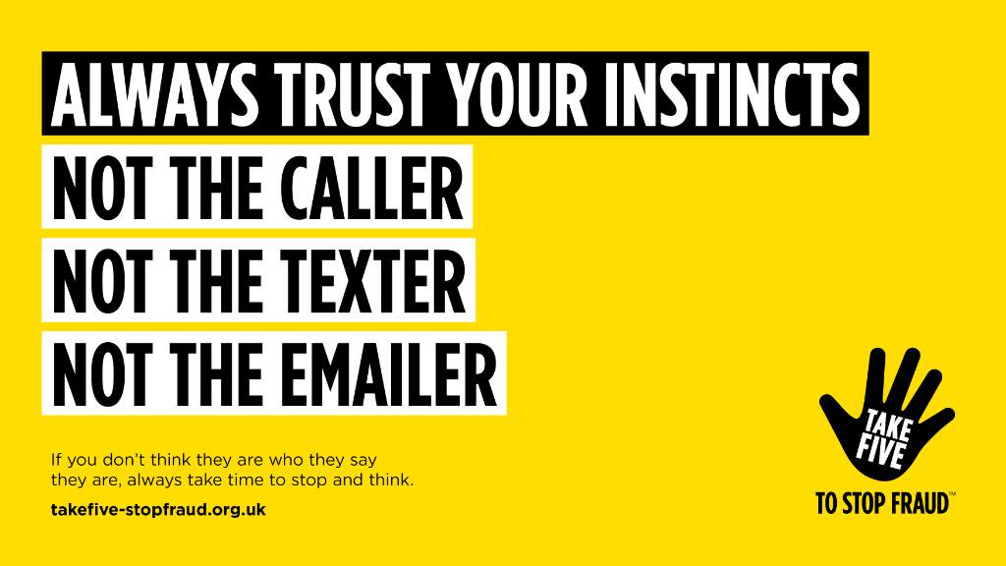
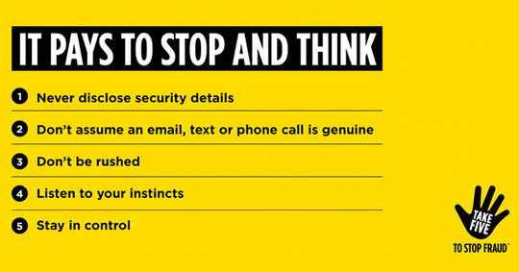

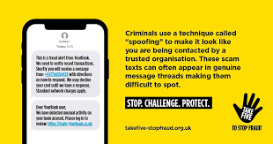
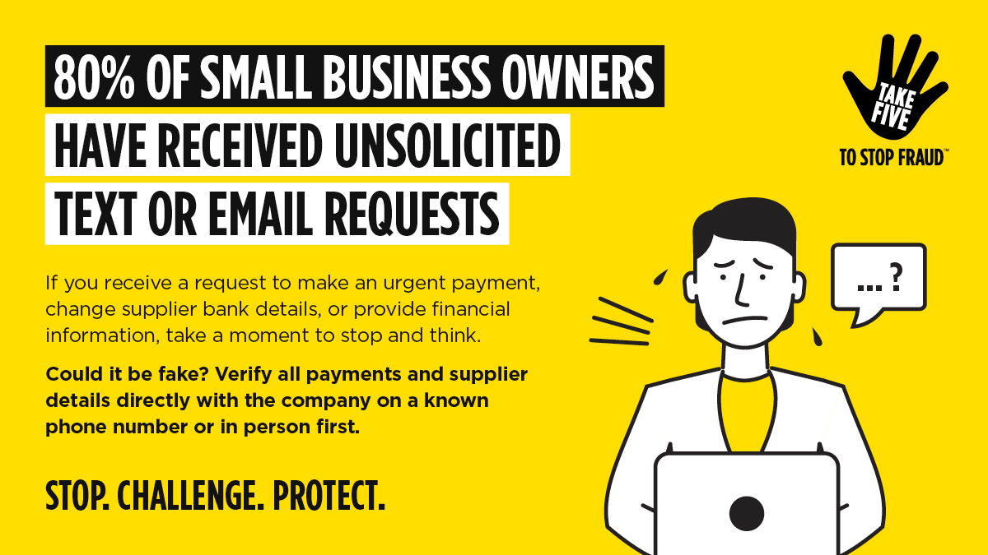
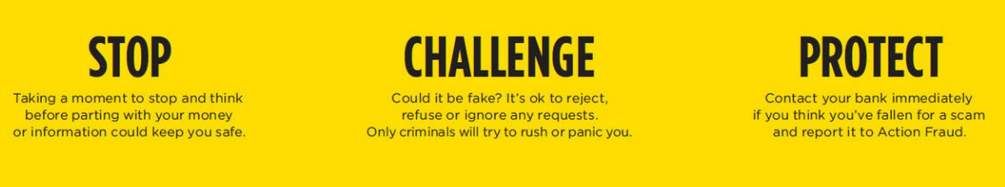
Take Five
www.norfolk.gov.uk/scams
Notes:
Supported by UK Finance

Slide 20
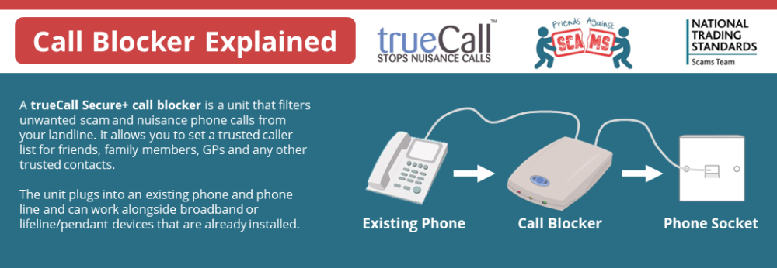
Call Blockers
www.norfolk.gov.uk/scams

Slide 21
Be Scam Aware
Help, advice & report
Norfolk Trading Standards
www.norfolk/gov.uk/scams
www.facebook.com/NorfolkTradingStandards
x.com/NorfolkCCTS
Citizens Advice consumer helpline
0808 223 1133
www.citizensadvice.org.uk/consumer
Victim Support
08 08 16 89 111
www.victimsupport.org.uk
National Cyber Security Centre
www.ncsc.gov.uk
report@phishing.gov.uk
Ofcom
7726
www.norfolk.gov.uk/scams

Slide 22
Thank you for your time today
Stephen Maunder
stephen.maunder@norfolk.gov.uk
www.norfolk.gov.uk/scams

