Slide 1

Developing a toolkit to support the identification of childhood exploitation in acute settings.
Hannah Jennings

Slide 2
Introduction and Overview
It has been recognised by the Children’s Safeguarding Team at Lister Hospital that front-line staff were not recognising or referring child exploitation cases that had been seen in the acute setting. This was noted by our ‘safety netting’ process of the discharge summaries screened on a daily basis. ​
Staff were sometimes completing information sharing forms, however not considering the contextual safeguarding concerns and using professional curiosity in order to refer the child or young person to appropriate partner agencies for ongoing support. It was thought that a simple, trauma informed flowchart or pathway would be a proactive and beneficial way for staff to recognise and respond to contextual safeguarding concerns within the Acute Trust. ​
Audit showed

Slide 3
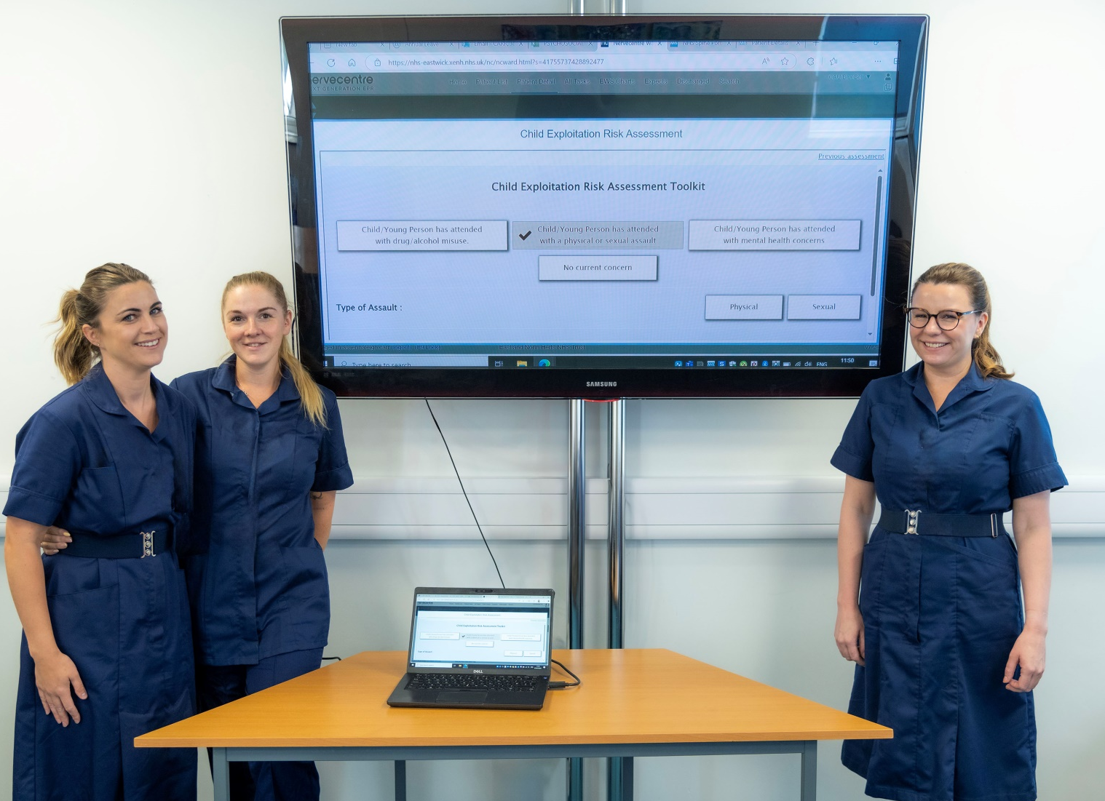
Get to know us.
The children’s safeguarding team consists of the named nurse for Children and Maternity Safeguarding, the named doctor for Children’s Safeguarding, three band 7 specialist nurses and a small, but mighty administrative team.
We also work closely with adult and maternity safeguarding and the Domestic and Sexual Abuse Team (DSAT) which consists of our Domestic Abuse support worker and our Children’s Sexual Violence Advisor (CHISVA).
Our day to day varies from screening, actioning and disseminating information sharing forms/discharge summaries to supporting the Acute teams with cases and our on-call service for Strategy discussions and Child Protection Medicals. We also provide training and supervision across the Trust.

Slide 4

RECAP: How was this implemented and nurse led and what did the audit show?
It was designed by myself after our Named Nurse had noted the gap in practice. It was then implemented with support from our digital team.
Training was then provided by our nursing team to nursing staff and management across Children’s Accident and Emergency (CED), Emergency Department (ED) and Urgent Care Centres (UCC), with their guidance on how we could best support them with their ongoing clinical workload.
The toolkit was discussed between myself and Kenny Gibson (NHS England) and the National Working Group for Exploitation (via health forums) for ongoing feedback and to consider use nationally.
The audit evidenced an increase in identification of exploitation with onwards referrals made to the CHISVA. The cases were opened for support from both agencies.
Notes:
Jan-March 2024 13 identified exploitation cases. Following the toolkit, 16 were identified between 06/06/24 – 30/07/24. 7 weeks compared to 12 weeks.

Slide 5
What is Child Sexual Exploitation (CSE)?
Child sexual exploitation involves situations, contexts or relationships in which a person under 18 is given something, such as food, accommodation, drugs, alcohol, cigarettes, affection, gifts or money in return for performing sexual activities or having sexual activities performed on them. It can also involve violence, coercion and intimidation, with threats of physical harm or humiliation.
going missing from home or care or school
physical injuries
misuse of drugs or alcohol
repeat STI’s, pregnancies or terminations
evidence of online sexual bullying
emotional distance from family members
poor mental health
receiving gifts from unknown sources
The person exploiting the child or young person is able to create the impression of authority over them in some form.
This could be because of their age, gender, intellect, physical strength or economic situation.
Sexual exploitation of children can start through the use of technology, without them immediately realising.
For example, they might be persuaded to post images on the internet or via mobile phone without immediate payment or personal gain.
Violence, coercion and intimidation are common, with a particular vulnerability of the child or young person being used against them.
This can make the young person feel as though they have no choice but to continue the relationship.

Slide 6
What is Child Criminal Exploitation(CCE)?
Criminal exploitation is child abuse where children and young people are manipulated and coerced into committing crimes. Organised criminal gangs groom children and young people because they’re less suspicious and are given lighter sentences than adults. ​
It's not illegal for a young person to be in a gang – there are different types of ‘gang’ and not every ‘gang’ is criminal or dangerous. However, gang membership can be linked to illegal activity, particularly organised criminal gangs involved in trafficking, drug dealing and violent crime.​
County Lines is the police term for urban gangs exploiting young people into moving drugs from a hub, normally a large city, into other markets - suburban areas and market and coastal towns - using dedicated mobile phone lines or “deal lines”. Children as young as 12 years old have been exploited into carrying drugs for gangs. This can involve children being trafficked away from their home area, staying in accommodation and selling and manufacturing drugs.
peer pressure and wanting to fit in with their friends
they feel respected and important
they want to feel protected from other gangs, or bullies
they want to make money, and are promised rewards
they want to gain status, and feel powerful
they’ve been excluded from school and don’t feel they have a future
A child is more at risk if they are not in school:
This is as less professionals have “eyes” on the individual. They also have “time”.
They are more at risk of they are vulnerable:
For example: have a learning disability or poor MH because they do not have the capacity to understand they are doing something illegal and/or are vulnerable.
They are more at risk if there are already concerns at home:
Such as domestic abuse, sexual abuse or neglect. This is due to Adverse Childhood Experiences and added vulnerability.

Slide 7
The difficulties with identifying criminal exploitation and implications of the criminal justice system.
Shaw (2024) noted that professionals working with victims of child criminal exploitation reported that the young people are fearful of repercussions and are therefore difficult to engage with.
Professionals from children’s services, youth offending teams, police officers, charities and the NHS have also stated that, at times, parents will ask young people to remain quiet owing to the violence it brings to the family home; namely, that if they speak up, the family is likely to experience violent repercussions.
Marshall (2024) also explains that identification of child criminal exploitation can have considerable implications for young people’s involvement within the justice system; for example, those who did not engage with police were seen to be ‘hiding something’ and therefore at risk of being subject to criminal proceedings.
This confirms the need for further exploration surrounding the experiences of CYP within the realm of child criminal exploitation

Slide 8
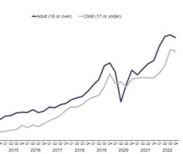
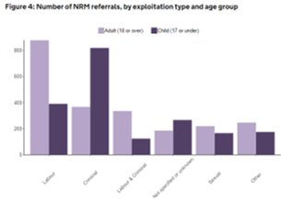
National Facts and Figures
16’330 cases of child exploitation were identified in England in 2021-2022 during Child in Need assessments undertaken by Children’s Services (Edwards, 2023). This shows the importance of ensuring front-line staff have the awareness of how to recognise child exploitation and when to refer into children’s services to trigger a Section17 assessment. ​
During 2021/22 in England and Wales, 17’486 crimes were logged by police where children had been sexually exploited, which is an average of 48 offences a day. This is a 10% increase within a year (NSPCC, 2022).​

Slide 9
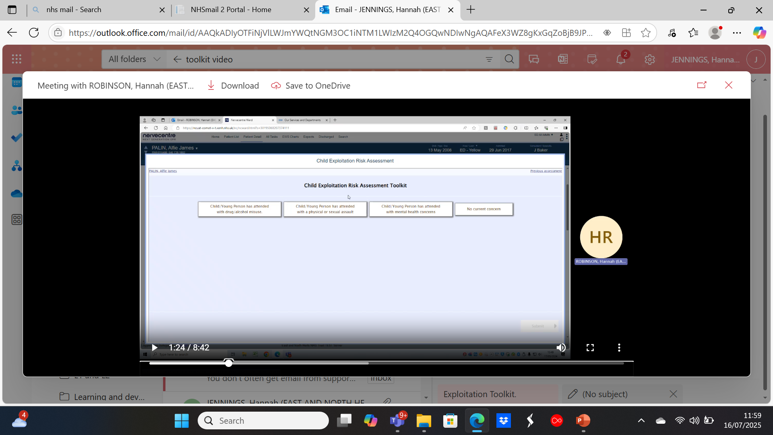
Introduction to toolkit and current progress:
We have worked closely with the National Working Group (NWG) for Exploitation who added this to their website so the toolkit could be requested for download in a “word” document format for their own use/amendment. It has been downloaded by 26 areas nationally.
Currently as of July 2025 the toolkit is being implemented and digitalised in 3 of these areas.
There Is an ongoing partnership whereby we continue to attend health forums and the NWG continue to collate feedback.
Nursing Times Award shortlist – presenting in September.

Slide 10
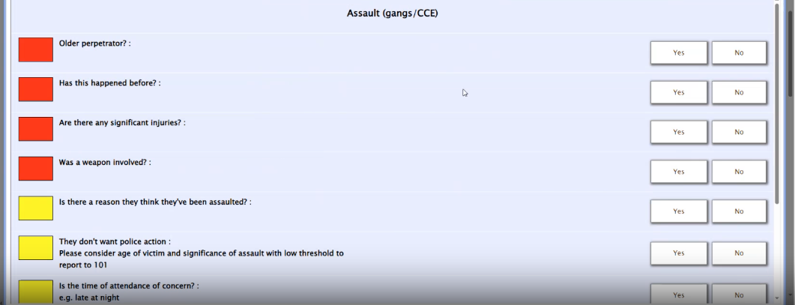
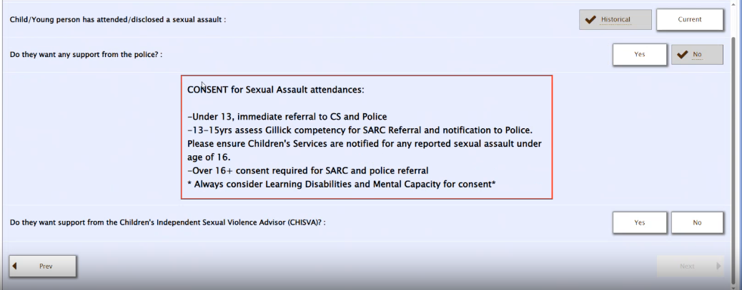
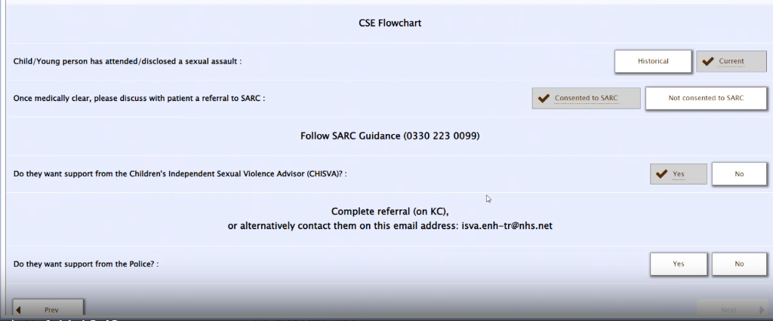
A small preview:
Red – high risk: Children’s Services referral (CS)
Yellow – lower risk: Information sharing form (ISF)
This directs staff with their next steps.
We discuss consent and capacity.
Step by step on how to refer with contact details to prevent delay.

Slide 11
DATA COLLECTION
ENHT
In 2024 there were 34 referrals to the authorities (CS, police, HALO) for Children/Young People (CYP) who were victims of exploitation. 14 more than in 2022. In comparison to 2014, there were only 2 referrals made.
Toolkit was implemented June 2024. Clear increase in identification.​
HALO
22 current open cases (July 2025).​
NATIONAL FIGURES
In 2023 the National referral mechanism (NRM) received 7,432 referrals regarding children (45% increase from 2021) 3,123 of these referrals were due to criminal exploitation.​
In 2024, Halo dealt with 121 non-crime Child Protection Investigations.​
Jan-April 2025: 45 non-crime already.
The NRM (2023) received 17,004 referrals for people trafficked for sexual exploitation: 44% were under 18.​

Slide 12
The prevalence and impact of exploitation.
Longfield (2019) wrote a report that focussed more on criminal exploitation. Her article highlights that if a child is involved in a gang, they are 95% more likely to suffer from emotional, social and mental health issues, be more than twice as likely to self-harm and 8 times more likely to be misusing substances
The National Referral Mechanism (NRM) in 2023 detailed a 45% increase in referrals made regarding child exploitation from 2021. 42% of referrals were related to criminal exploitation. Other signs of criminal exploitation Barnardo’s (2024b) list are: unexplained injuries, difficulty walking, drug/alcohol misuse, behavioural changes.
Barnardo’s (2024a) list some sexual exploitation signs as: unexplained injuries, sexually transmitted infections and mental health issues. Laird et al., (2020) discusses that children and young people affected by sexual exploitation could have PTSD amongst other concerns.
These studies demonstrate the importance of staff to utilise professional curiosity with young people when they attend the Acute trust with mental health, substance misuse or physical/sexual assaults. The toolkit provides them with the ability to screen any child/young person who attends with these concerns, guiding them with specific questions and supporting them with the correct referral agencies alongside discussing consent.

Slide 13

Our local services/referrals
The toolkit indicates where referrals should be made which include the following:
-Children’s Service’s.
-Sexual assault referral centre (SARC).
-Children’s Sexual Violence Advisor (CHISVA).
-HALO (police sexual exploitation/prevention team).
-Or simply an Information Sharing Form (ISF) which is liaised out with school nursing teams and any other health/social care professionals involved with the child/young person.

Slide 14
Alisa, our Children’s Sexual Violence Advisor (CHISVA):
CASE STUDY:​
-15 yr old: goes missing often, known risk of CSE, on a Child Protection Plan (CPP).​
-Sexually assaulted by ex-boyfriend, attended A&E.​
-Felt it was her fault as she was smoking weed and drinking at the time. Was scared of repercussion if she pressed charges.​
-Referred to Alisa in CED who supported with a referral to the Sexual assault referral centre (SARC).​
-Alisa worked with her to recognise she was a victim, after 3 months she decided to open police investigation.​
-Alisa completed trauma work and coping mechanisms and continues to support. ​
Toolkit suggests referral to Alisa
Alisa makes contact
Alisa supports YP & makes appropriate referrals
Upon discharge, onwards referrals made for specified support services if needed
YP attends ED, toolkit completed
Alisa continues to support as long as required
Referral made
Notes:
This shows how the toolkit can provide a positive outcome via specialised and individualised support. ​
The CYP did not consent to opening a police investigation, although did speak to the police. Empowering CYPs through support options – not forcing.

Slide 15
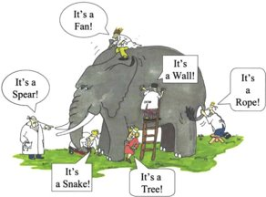
Importance of a detailed referral:
When a referral is made, the information you provide should be as detailed as possible to allow professionals to screen urgently and prioritise workload. If a referral has limited information, other referrals may take priority.
When referring to Children’s Service’s in particular it is important you explain what you think needs to happen to keep the child safe so that the clinician reading the referral is able to allocate to the appropriate team.
This means they will have a greater understanding of your professional and contextual safeguarding concerns as a health care professional and the impact this could have on their holistic health.​
If future referrals are made to Children’s Service’s, they will look at previous involvement and referrals –therefore it is important all referrals are made as part of the information sharing process as a minimum. This enables a bigger picture to be built as time goes on and can really benefit risk assessment.

Slide 16
The Casey Report
The Casey report (2025) evaluates the understanding of the scale, nature and drivers of group-based child sexual exploitation and abuse (CSEA) at a national and local level. A timeline on child sexual exploitation was completed starting from 2009. It highlighted the recurring themes have not been addressed since then:
The ability to identify risk factors and recognise signs of grooming/exploitation.
The toolkit provides staff with signs of exploitation to explore and discuss further.
The need to improve information sharing, data gathering and staff training.
The toolkit is always shared with local authorities and community health agencies. Staff are trained regarding the use of the toolkit, but also exploitation in general with up-to-date evidenced based information.
The report found that health systems and the criminal justice system have limited data.
Notes:
This demonstrates the importance of the toolkit being utilised for data collection and information sharing across local authorities. Health services have a huge role in promoting health and well-being for CYP and can provide onwards referrals to a number of health and social care agencies individualised to the young person.

Slide 17
Voice of the Child & parent/guardian views.
“I didn’t feel judged or made to feel like a bad mum. The questions we were asked made me think about my daughters vulnerable age & the influence of others. I hadn’t considered someone had given her alcohol to take advantage, I had assumed she was being naughty. The support we have had following referrals has been great and the school continue to support us both”.
“The questions helped me talk to her when we got home because I felt I gathered an insight into how things were at school and with her friends. We had lost our connection, I thought she hated me but I think she is just so angry and upset with friendship problems which was found out at hospital. I always thought exploitation was people being slaves. I do forget that she is only 13 because she looks older, It was a reminder of her vulnerabilities.
“The toolkit would be helpful to other people my age as it helps you tell someone what has happened. It was hard because they kept prompting me and did not put words in my mouth, so I had to say what happened – but now looking back, I think that it is better this way so people my age can have the chance to speak how they want to”.
12yr old female, Attended CED intoxicated with her friend.
“I felt comfortable with the staff and the questions they asked me. I struggled to answer some because I can’t remember everything. The questions were quite helpful though and the staff were really nice. It was a pretty good process, it made me have to talk about it all”.
“All questions asked were appropriate, we were put into a private room and the questions did allow *Alex* to open up, but he was quite dysregulated at the time and so did not answer them that well, I answered on his behalf. The staff were great and the triage was quick and simple. I do wish some questions were more invasive to open Alex up more”.
CHISVA case study.
14yr old boy, attended with ketamine misuse and addiction – asking for support to stop. Attended with mum.

Slide 18

What is next?
What’s next?
Maternity services
School nursing
GP
West Herts
Community pharmacies
Sexual health clinics

Slide 19
Conclusion – how will this toolkit make a positive difference to the lives and lived experiences of Children and Young people?
1) Staff will have the training to be aware of signs of exploitation and how to best support the child/young person (CYP). ​
2) The toolkit provides a quick screening to prevent delay, ask sensitive and important questions and promote referrals for onwards individualised health and social care support. ​
3) Encourages autonomous working for nurses, improving long term outcomes.​
4) Exploitation causes significant emotional, social, mental and physical health problems. By identifying exploitation, we can intervene effectively.​
5) By having a positive experience whereby support is offered, the CYP should recognise a safe place to attend if they do need further support in future. ​
6) Information sharing occurs routinely and provides effective multidisciplinary working and awareness across all agencies to have low threshold for concerns again in the future.​
7) This toolkit has the ability to be implemented ANYWHERE across a variety of health and social care settings and can be easily adapted/amended to suit.​
8) Early intervention and onwards referrals could reduce Adverse childhood experiences (ACE’s and promote health into adulthood.
Notes:
The need for additional training on a national basis was identified in the Casey Report.​
Recovery in the community.​
This will empower them and enhance their skills and develop their confidence for future cases. All of this improves outcomes for CYP due to quicker identification and therefore quicker support/ less missed opportunities. ​
Quicker support, less snowballing to bigger issues.​
Even knowing they were asked the questions could encourage re-attendance to be asked again “get out of jail free card” without feeling “weak”.​
The need for improved information sharing nationally is another finding in the Casey report.​
It has been downloaded by LAS – lots of different areas in the health & social care field on the forum found this a useful toolkit.​
We want to help break the cycle – we know those sexually abused often go on to sexually abuse and those exploited go on to exploit.

Slide 20

Any Questions?

Slide 21
References
Barnardo’s (2024a). Child sexual abuse and exploitation. Available at: https://www.barnardos.org.uk/get-support/support-for-parents-and-carers/child-abuse-and-harm/child-sexual-abuse-and-exploitation. (Accessed 16th October 2024).
Barnardo’s (2024b). Criminal exploitation of children. Available at: https://www.barnardos.org.uk/get-support/support-for-parents-and-carers/child-abuse-and-harm/criminal-exploitation-children. (Accessed 16th October 2024).
Bentivegna F and. Pataly, P. (2022). The impact of sexual violence in mid-adolescence on mental health: a UK population-based longitudinal study. Lancet Psychiatry. 9(11), pp 874-883. Available at: doi: 10.1016/S2215-0366(22)00271-1.
Edwards, J (2023). Child Exploitation: A Hidden Crisis, Barnardos.​
Internet Watch Foundation Millions of attempts to access child sexual abuse images online during lockdown https://www.iwf.org.uk/news-media/news/millions-of-attempts-to-access-child-sexual-abuse-online-during-lockdown/​
Jennings, H (2025). Development of a toolkit to aid health and social care staff in acute hospitals to identify childhood exploitation. British Journal of Nursing, 34 (11).
Longfield, A (2019). Gangs and knife crime: A national emergency. British Journal of School Nursing 14(3), pp 139-140. Available at: DOI:10.12968/bjsn.2019.14.3.139
Laird, JJ. Et al. (2020). Demographic and Psychosocial Factors Associated With Child Sexual Exploitation: A Systematic Review and Meta-analysis. JAMA Netw Open. 3(9) Available at: DOI: 10.1001/jamanetworkopen.2020.17682

Slide 22
References
Marshall H. Child criminal exploitation and the interactional emergence of victim status. Br J Criminol. 2024;64(5):1011–1027. https://doi.org/10.1093/bjc/azae008
Shaw J. ‘Won the battle but lost the war?’ ‘County lines’ and the quest for victim status: reflections and challenges. Youth Justice. 2024;24(2):231–247
https://www.nspcc.org.uk/about-us/news-opinion/2022/child-sexual-exploitation-crimes-up-10-in-the-last-year/ ​
https://www.gov.uk/government/statistics/modern-slavery-national-referral-mechanism-and-duty-to-notify-statistics-uk-october-to-december-2022/modern-slavery-national-referral-mechanism-and-duty-to-notify-statistics-uk-quarter-4-2022-october-to-december​
https://www.nspcc.org.uk/what-is-child-abuse/types-of-abuse/child-sexual-exploitation/
https://www.nspcc.org.uk/what-is-child-abuse/types-of-abuse/gangs-criminal-exploitation/
https://www.herts.police.uk/advice/advice-and-information/caa/child-abuse/child-sexual-exploitation/
https://learning.nspcc.org.uk/research-resources/2025/summary-national-audit-group-based-child-sexual-exploitation-abuse
https://www.gov.uk/government/statistics/modern-slavery-nrm-and-dtn-statistics-end-of-year-summary-2023/modern-slavery-national-referral-mechanism-and-duty-to-notify-statistics-uk-end-of-year-summary-2023

