Slide 1
Midlands Learning Disability & Autism (LDA) Epilepsy Advisory Group 24.01.23

Slide 2
Why is improvement in epilepsy care for people with LD&A needed?
There are wide variations in the provision of epilepsy services across the country. Services supporting epilepsy care is often poorly integrated
Lack of expertise to support commissioning and oversight of care for people with a learning disability, autism or both who have epilepsy
Poor quality of epilepsy care in community residential and specialist hospital settings
Staff competency in supporting people with a learning disability and epilepsy can be limited- need for better standards and guidance
Limited understanding of the link between epilepsy and behaviours deemed to be challenging leading to avoidable and inappropriate hospital admission

Slide 3
Foundations
Leadership at a regional level
System level engagement and buy-in
Establishment of Regional Epilepsy Advisory Group – right expertise
Develop standardised approach to measuring progress and outcomes consistently across the region
Epilepsy Conference – click to see event recording

Slide 4
LDA EPILEPSY PLAN: Progress overview
4
Health literacy: Individuals with a learning disability who suffer from epilepsy, and their families and carers, are supported to understand and manage epilepsy and epilepsy risks.
5
Epilepsy Management: Annual Health Checks effectively provide Individuals with an effective review of their epilepsy as part of wider comprehensive annual health check. Epilepsy medication and treatment is optimised to enable individuals with a learning disability to live the best quality of life possible in line with STOMP STAMP principles
2
3
Care Provision: Specialist hospital and community care providers commissioned to provide care for people with a learning disability, autism or both are equipped to provide safe and effective epilepsy care.
Care commissioning & Oversight: Health and social care commissioners are equipped to commission and oversee safe epilepsy care for people with a learning disability, autism or both
1
Strategic Planning: There are good integrated epilepsy care services and support for people with a learning disability, autism or both informed by a good understanding of the local population and their needs.

Slide 5
Strategic Planning – Epilepsy Benchmarking
Increased focus on improving epilepsy care for people with a learning disability and autism embedded in system wide improvement to tackle health inequalities
Bringing together of system partners across primary, secondary and social care, and voluntary sector to drive improvement
Shared understanding of the extent to which services are working well together to deliver good care
Shared understanding of where gaps in provision or quality exist, and springboard for new or enhanced services identified.
Shared understanding of workforce capacity & capability, and where further investment is needed
Improved integrated strategic commissioning of epilepsy services and support
Better use of system wide resource to improve outcomes
Foundations in place to support the development of integrated epilepsy care

Slide 6
Epilepsy Benchmarking Review – the plan
Allocated system lead/s by 3rd November 2022
Drop-in advice clinic – 16th January 2023
Desktop review – early January 2023
Consultation – mid Jan – early Feb 2023
Drop-in advice clinic – 25th January 2023
Submission of completed epilepsy benchmarking assessment by 17th February 2023
System level workshops – mid February to mid March 2023
Midlands wide epilepsy conference & workshop – end of March 2023

Slide 7
2. Strengthening Commissioning Capability
EPILEPSY GUIDANCE FOR COMMISSIONERS AND CARE PROVIDERSl SUDEP ACTION & CORNWALL FT
Two strands -> For commissioners and providers of community residential settings
-> For commissioners and providers of specialist hospital inpatient settings
---------------------------------------------------------------------------------------------------------------------------------------------------------------------------------------------------------------------------------------------------------------------------------------------------------------------------------
Outcomes -> Good practice guidance for commissioners and providers
-> Engagement with commissioners and providers in developing and testing resources
-> Training video/slides for providers and commissioners
-> Webinar to promote guidance in partnership with NHS England

Slide 8
My Life with Epilepsy
– A tribute to the learnings from the life of Clive Treacey
Project Phases
Phase 1
Identification of draft themes to inform summary guidance.
Phase 2
Engagement with commissioners and providers re. content and implementation.
Phase 3
Development of draft guidance with summary guides.
Phase 4
Implementation plan and project report
Phase 5
Production videos, webinar and launch
Jul’ – Sep’
2022
Sep’ – Dec’
2022
Dec’ – Feb’
2022/2023
Jan’ – Mar’
2023
Mar’ – May
2023
Notes:
Themes drawn from the following documents/reports
Treacey Report
NHS Rightcare
Royal College of Psychiatrists
Step Together
Homes not Hospitals
LeDeR Mortality Review
OM Mandatory Training Trial
Project in two strands
Residential settings
In-patient settings

Slide 9
3. Improving Care Quality
EPILEPSY TRAINING
Epilepsy Subgroup has looked at training requirement and potential opportunities for improvement
Who needs training and at what level, what should be prioritised
Existing guidance and standards on epilepsy training (ILAE, ESNA, RCPsych, Joint Epilepsy Council
Who is well placed to provide training
How can the quality of epilepsy training provision be improved
How can health and care systems be supported to improve levels of epilepsy training and capability of staff
Examples of good practice including dedicated session to look at successful train the trainer model delivered by Quarriers in Scotland

Slide 10
Improving Quality and Availability of Epilepsy Training
Emerging opportunities to work with commissioners and providers:
Raise awareness: Promote the case for good epilepsy training for staff to support people with a learning disability, or both
Promote guidance and advice to health and care systems on competencies staff need, what good epilepsy training looks like and how it can be provided
Support training needs assessment
Establish a directory of vetted epilepsy training providers compliant with ESNA guidelines
Develop and make available high quality training resources
Support online assessment of trainers drawing on established assessment tool
Potential to develop train the trainer model in Midlands applying a PDSA approach
Seek to test out improvement approach with a single ICS and promote learning
Foundations for delivery in 23/24 to be developed by the end of 31 March.

Slide 11
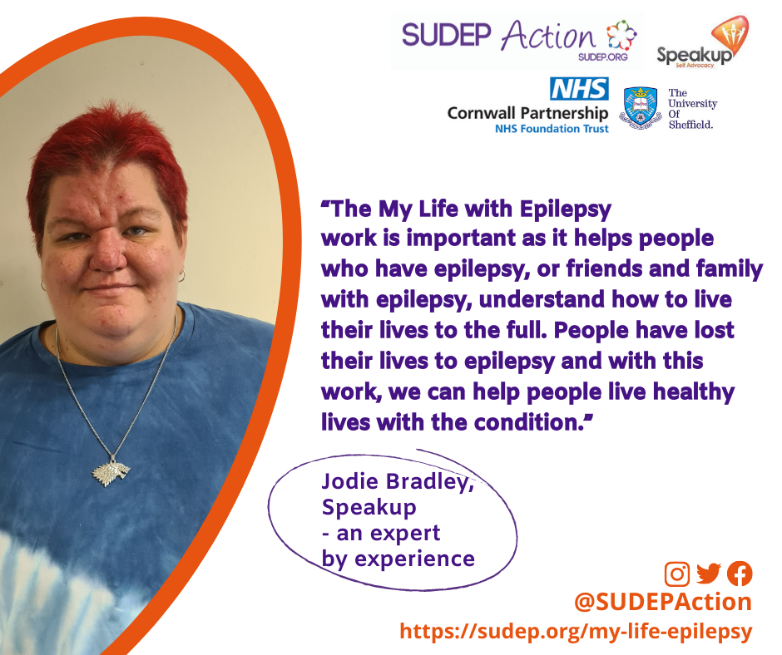
4. Health Literacy – My Life with Epilepsy Project
Co-designed resources led by experts by experience
ICS network support and involvement
Bereaved families consulted
Background research report published
Resources coming soon:
Easy read Epilepsy/SUDEP risk leaflet
Epilepsy/SUDEP Risk leaflet for carers (family/paid)
Videos on risk for people with learning disability and epilepsy, and for family/paid carers.
Feedback on EpSMon (www.sudep.org/epsmon) – how to make it as accessible as possible to people with a learning disability & epilepsy and their family/carers.
Once finalised, the resources will be circulated across the Midlands for dissemination. Communications plan TBC

Slide 12
Strengthening Primary Care Epilepsy Capability
PCN Quality Improvement Project to explore potential for improvement
Key components:
Make visible and stratify LDA population with epilepsy according to risk
Develop role of primary care to support individuals by risk and support required
Strengthen AHCs and Medication reviews for people with LDA and epilepsy
Explore how primary care can empower individuals and their families and carers through health facilitation and Purple Book
Foundations for delivery in 23/24 to be developed by the end of 31 March.

